Slide 1
BUILDOFFSITE MEMBER’S MEETING
COLLABORATING FOR IMPACT
8TH APRIL 2021
Member Meeting – April 2021

Slide 2
HOUSEKEEPING
Please remain muted until the Q&A session
Raise your hand to indicate that you need something from the host
Feel free to type any comments or questions into the Q&A box
Presentations will be shared with delegates post-event
Share your views:
@Buildoffsite │ #CollaboratingForImpact
Member Meeting – April 2021

Slide 3
AGENDA
10:05 – Roadmaps, pathways and building back to play better
10:10 – Collaborating for Impact: The Buildoffsite Manifesto
10:20 – Framing the network: Sector Working Group Launch
10:30 – The Client Perspective: Client Group Launch
10:35 – Revolutionising events and Knowledge sharing
10:40 – Q&A
10:50 – Project & Activity Updates
11:20 – Member Showcase & Activity Updates
11:50 – A look forward
12:00 – Close
Member Meeting – April 2021

Slide 4
ROADMAPS, PATHWAYS & BUILDING BACK TO PLAY BETTER
Leanne Clowting
Executive Director, CIRIA
Member Meeting – April 2021

Slide 5

The best laid plans
2020 was planned to be Buildoffsite's year of transformational change, and it was, but not according to plan!
Building a positive future laid out our promise to our members:
                Amplify our voice
                Working more collaboratively
                Shaking up the old hub structure
                Strategic events and knowledge content
                Providing insight, opportunity and guidance
Member Meeting – April 2021

Slide 6

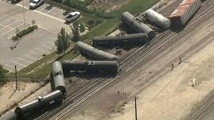

The reality
                Complete diversion to online
                Ramped up events
                Adjustment to new ways of working
                Completely different approach to the network
                Few detours, derailments and delays
                Supporting members in the optimum way
                Industry refocus
                Priority work to support MMC in COVID response
                Many, many policy initiatives, statements, visions and ambitions
                A new context for the future
Member Meeting – April 2021

Slide 7

A new perspective
We’ve learned a lot in the past 12 months, revised thinking, collaborated and reviewed.
Using the new perspective and policy context to build back to play better and further the offsite and MMC sectors:
                Collaborating for Impact – the Buildoffsite Manifesto
                Lobbying and influencing
                New event programme
                Opportunity focused
                Client Group
                Sector working groups
                Guidance and knowledge
                Stakeholder support
                Working with members
Member Meeting – April 2021
Notes:
Mention team energy and focus and excitement to collaborate more structured way to enable communication and inform all we do

Slide 8
COLLABORATING FOR IMPACT
THE BUILDOFFSITE MANIFESTO
Joe Dyde
Business Manager, Buildoffsite
Member Meeting – April 2021

Slide 9
For 15 years, Buildoffsite have sought to;
Promote
Support
Increase
the adoption of offsite & MMC in the built environment
Now, more than ever, we seek to deliver;
Permanent
Positive
transformation & impact in the sector
This can only be delivered through clear direction & objectives in all of our activity, internally and with and on behalf of our members & collaborators
Member Meeting – April 2021
Notes:
Since its creation, Buildoffsite has sought to promote, support and increase the adoption of offsite and pre-manufactured solutions across construction and the built environment. Working with our membership, wider network and key industry stakeholders & partners, we seek to deliver permanent, positive transformation and impact through collaboration.
This vision can only be delivered through clear direction and objectives in all activity we undertake; both internally and with, and on behalf of, our members and collaborators.

Slide 10

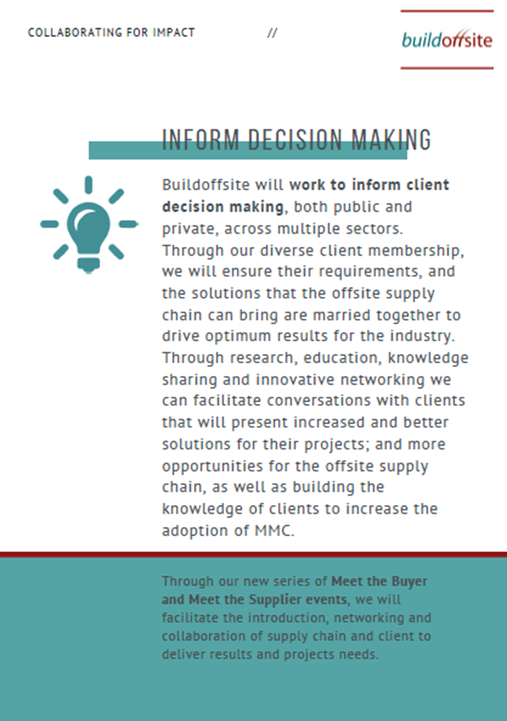
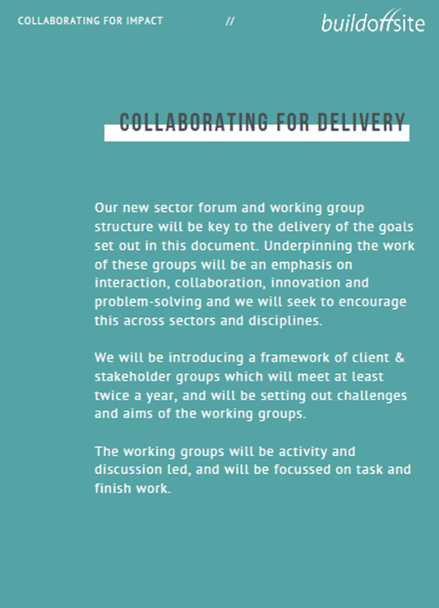
Member Meeting – April 2021
Notes:
In order to achieve this, we set out our key pledges for delivering this change. These objectives will drive all activity we undertake and will be regularly monitored and referred to with members.
As always, we will continue to bring industry together and promote innovative and collaborative ways of working and doing business across our diverse network.
Ultimately, we aspire to ‘normalise’ offsite & Modern Methods of Construction, enable greater project delivery and ensure we continue to break down the barriers to achieving this for the benefit of our members and the industry as a whole.

Slide 11



Create & strengthen relationships with policy makers
Strategically engage members in this influencing activity
Create opportunities to strengthen understanding & engagement
Lobby & support UK Government on behalf of, and with, our members
Maximise the opportunity for stimulated growth of the sector
Ensure a permanent & growing transformation within Government Estates programmes
Work with Clients to inform their decision making
Understand requirements, and demonstrate solutions from the supply chain
Collaborate & drive optimum results for industry
Member Meeting – April 2021
Notes:
Influence & Inform
Through creating and strengthening relationships with policy makers, we pledge to help shape and inform the current and future conversations, and decisions around offsite construction and the built environment. We will strategically engage members in this influencing activity for the benefit of the wider network.
Lobby Government
We will lobby UK Government on behalf of, and with our members, to ensure the required level of support is available for the increased adoption and growth of offsite and pre-manufactured solutions. Following the presumption in favour of offsite, and the commitments made by various departments to increase the use of offsite solutions in their portfolio, the sector has never before seen greater opportunity for stimulated growth. However, we want to ensure this remains a permanent and growing transformation within Government estates programme.
Inform Decision Making
We will work to inform client decision making, both public and private, across multiple sectors. Through our diverse client membership, we will ensure their requirements, and the solutions that the offsite supply chain can bring are married together to drive optimum results for the industry. Through research, education, knowledge sharing and innovative networking we can facilitate conversations with clients that will present increased and better solutions for their projects; and more opportunities for the offsite supply chain, as well as building the knowledge of clients to increase the adoption of MMC.

Slide 12




Debunk & demystify perceptions around MMC
Increase adoption
Better informed to grow
Identify & support industry to break down barriers
Identify and present solutions to ‘normalise’ offsite construction
Improve awareness & understanding of key trends, information & opportunities
Provide a voice & platform to enable debate & conversation
Develop & disseminate current future thinking & knowledge
Facilitated research, guidance & reporting
Help shape the future of the sector
Enable the increased adoption and success of offsite
Member Meeting – April 2021
Notes:
Challenge Perceptions
We will challenge perceptions around offsite. Despite the increased adoption and growth in the sector there are still some common misconceptions held regarding offsite. This includes factors around cost, quality, durability, repairability and more. Our role, representing our members and the wider industry, is to debunk and demystify these perceptions to ensure the sector doesn't face barriers to increased adoption and is ultimately better informed moving forward.
Address Barriers
As perceptions are challenged, we will identify, seek to & support industry to address barriers to the increased adoption of offsite. Our goal is to work with members and key industry stakeholders to ensure these barriers are broken down, solutions identified and to normalise offsite construction.
Build Insight & Knowledge
We will provide insight and knowledge on the offsite sector. Through our events and webinar programme, marketing and communications, and research and guidance activity we will ensure that all aspects of industry improve awareness and understanding of the key trends, information and opportunities that are shaping the sector. We will provide a voice and platform for our members and industry stakeholders to comment and discuss the factors that are influencing offsite, and enable debate and conversation both with and for our members.
Demonstrate Evidence
Buildoffsite will demonstrate through evidence the benefits and activity of the offsite sector. Through facilitated research, guidance and reporting this evidence will help shape the future of the sector and can be used to help enable the increased adoption and success of offsite solutions.

Slide 13
The manifesto will be shared with members, stakeholders, Government & wider industry
These pledges will drive all activity we undertake
Regularly monitored and referred to with members
Measures will be implemented in order for us to track success and influence across these pledges
Will form part of regular reviews undertaken with the membership
Underpinned by our working groups and events activity & delivery
Member Meeting – April 2021
Notes:
These objectives will drive all activity we undertake and will be regularly monitored and referred to with members. Measures will be implemented in order for us to track success and influence across these pledges, and this will form part of an annual review undertaken with the membership.

Slide 14
FRAMING THE NETWORK
SECTOR WORKING GROUPS
Joe Dyde
Business Manager, Buildoffsite
Member Meeting – April 2021

Slide 15
The Buildoffsite Sector Working Groups have evolved from the original Hub framework, which has undergone a review in line with member feedback and future strategy.
Innovative
Impactful
Collaborative
Interactive
Provide Solutions
Member Meeting – April 2021
Notes:
The Buildoffsite Sector Working Groups have evolved from the original Hub framework, which has undergone a review in line with member feedback and future strategy. We want them to be as effective as possible and to learn from each other. The activity of the new Sector Working Groups will align with the pledges of the Buildoffsite Manifesto, challenges set by the Buildoffsite Client Group and wider strategic priorities.

Slide 16
Through collaboration, knowledge sharing, or the production of research and guidance the Sector Working Groups will deliver outputs which;
Influence & Inform
Challenge Perceptions & Address Barriers
Build Insight & Knowledge
Demonstrate Evidence
Member Meeting – April 2021

Slide 17
Each sector working group will create an annual work plan which will identify activities and opportunities for collaborative output and impact; to benefit group members own business objectives the Client Group other Buildoffsite members the wider offsite industry
Producing research & guidance
Facilitating solutions-focussed workshops
Developing reportage
Educating & informing clients
Member Meeting – April 2021
Notes:
Each Sector Working Group work plan will differ in terms of agreed activities, time & input required, but will likely include activity such as;

Slide 18
Ensuring collaboration, insight, cross-pollination and delivery there will be a cycle of regular feedback, communication, discussion and dissemination
Sector Working Groups
Group Chair Meetings
Newsletters
Member Meetings
Client Group
Meet the Buyer
Member Meeting – April 2021
Notes:
Ensuring collaboration, insight, cross-pollination and delivery there will be a cycle of regular

Slide 19




Member Meeting – April 2021
Notes:
Supporting Policy
The Buildoffsite Sector Working Groups call for a transformation in the delivery of built assets that will support the UK Construction 2025 targets:
Lower costs – a 33% reduction in the initial construction and whole life cost of built assets;
Faster delivery – a 50% reduction in the overall time, from inception to completion for new build and refurbished assets;
Lower emissions – a 50% reduction in carbon emissions in the built environment;
Improvement in exports – a 50% reduction in the trade gap between total exports and total imports for construction products and materials
In addition, the sector Working Groups will seek to align and support the Government’s Construction Playbook (2020), the Defining the Need report (2021) and the work of other industry stakeholders.
The Group’s also intend to increase;
Improved certainty of cost and time aspects of project plans at all levels;
A reduction in impact of construction disruption on stakeholders;
Improved aspirations for aesthetics and environmental fit;
Support for clients to achieve to their objectives with respect to offsite, lean, whole life cost and BIM.

Slide 20
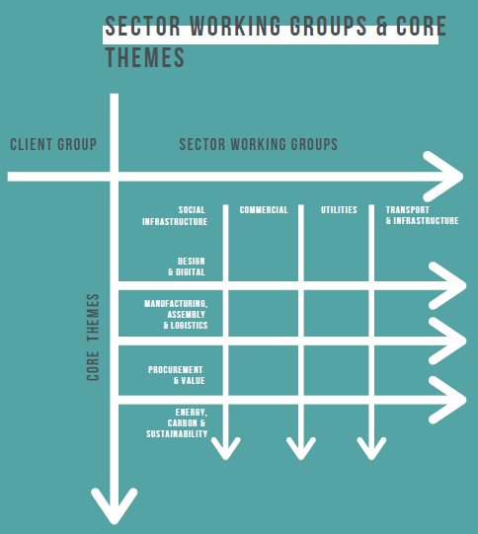
Sector Working Groups
Transport & Infrastructure
Utilities
Commercial
Social Infrastructure
As work is identified, a golden thread of core themes may be identified by Working Groups that facilitate the need for sub-groups to support across sectors
Design & Digital
Manufacturing, Assembly & Logistics
Procurement & Value
Energy, Carbon & Sustainability
Member Meeting – April 2021
Notes:
Structure
In April 2021, we will be launching the following Working Groups;
Client Group
Transport & Infrastructure Working Group
Utilities Working Group
Social Infrastructure Working Group
Commercial Working Group
Some of these are an evolution of existing hubs, others formed from member feedback & request.
Working Groups, will all;
have clear policies and terms of reference
have clear objectives agreed and set
produce ideas and outputs that can be shared to benefit wider membership
be reviewed and measured for success
Aligned with the Client Group & our Events & Knowledge Sharing activity which my colleagues will update on…
Details on how members can contribute and collaborate to these groups will be shared in due course.

Slide 21
THE CLIENT PERSPECTIVE
CLIENT GROUP LAUNCH
Doug Waters
Client Group Lead, Buildoffsite
Member Meeting – April 2021

Slide 22
BUILDOFFSITE CLIENT GROUP - Aims
Understand and develop the benefits of Offsite construction for Client organisations
2-Way Collaboration with other Buildoffsite members to understand:
                procurement options
                design methodologies
                risk management attitudes
Sharing and collaborating with the other working groups
        defining of the offsite agenda
        developing working plans
        proposing R&D projects
Innovations and new techniques, share lessons learnt and case studies
Aid the continued growth of offsite and increase its appeal to Client organisations
Support the UK Construction 2025 targets
Align and support the Government’s Construction Playbook (2020)
Member Meeting – April 2021

Slide 23
BUILDOFFSITE CLIENT GROUP: Terms of Reference
Meeting in person or virtually as required
Production of an Annual Workplan (including targets)
Workplan to include projects, research & development, publications etc.
Group will operate for the benefit of all its members and the wider Buildoffsite membership
Monthly and Annual Reporting
Support the planning and delivery of Buildoffsite events
Provide support and advice to other Working Groups
Help deliver the Buildoffsite Manifesto, increase membership and uptake of Offsite
Member Meeting – April 2021

Slide 24
REVOLUTIONISING EVENTS & KNOWLEDGE SHARING
Leanne Clowting
Executive Director, CIRIA
Member Meeting – April 2021

Slide 25

Events
Strategic review combined with feedback from members in late 2019 identified a need to move away from the traditional bi-monthly cycle of single format member meetings:
                Improve access
        Improve strategic insight
        Provide a wider coverage of relevant topics
          Offer CPD value
        Reduce time burden and therefore improve attendance
        Enable members to inform the programme
        Be more relevant to the ’20s
        Improve value to members
2020
Strategy was superceded by necessity – complete online shift - 30+ webinars across a range of topics
Member Meeting – April 2021

Slide 26

Events
The 2021 programme will be more strategically focused, and aligned with the Manifesto, it will:
Enable collaboration and present wider opportunities as outlined
Improve engagement with partners and stakeholders
Reflect current ways of working
Offer a blend of virtual and physical events later in the year
Enable easier and increased access
Offer increased member benefits
Member Meeting – April 2021
Notes:
Finding ways to enable bus dev – online and with physical opps

Slide 27
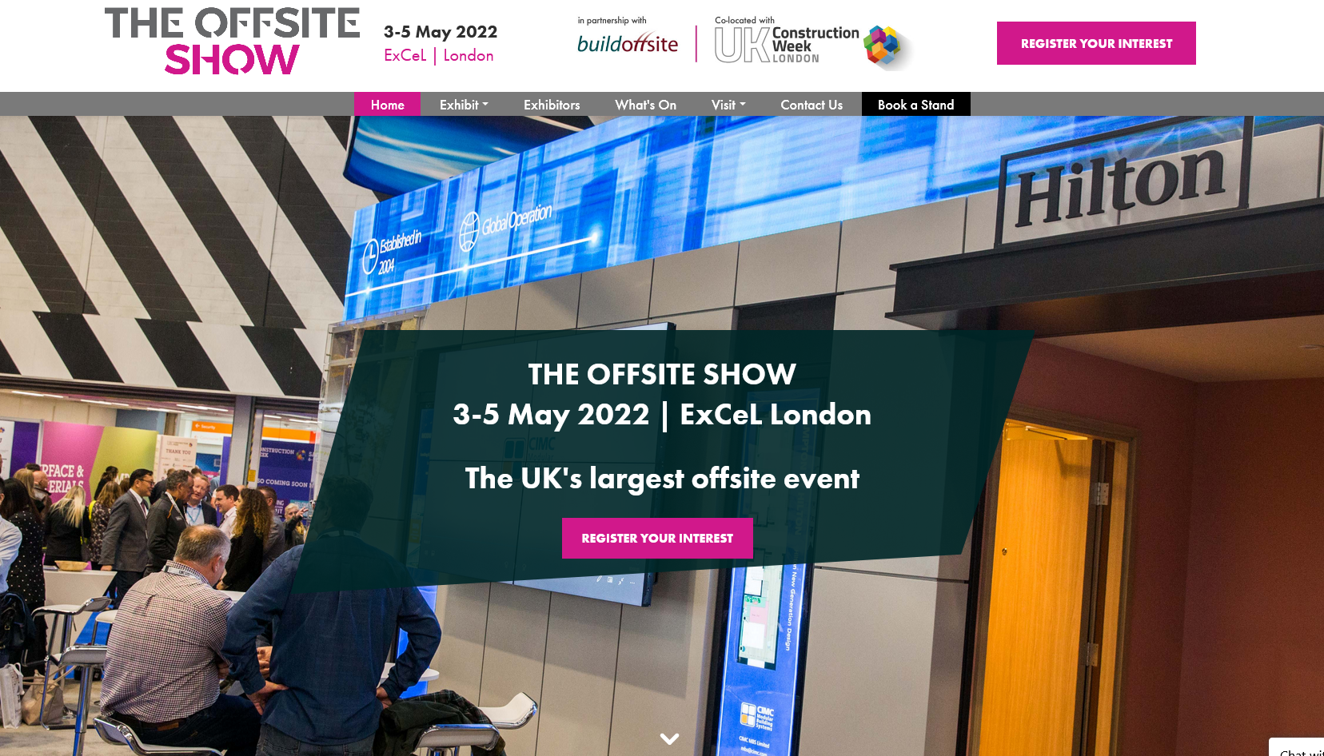
Key Events
Virtual Half/Full Day Conferences
Quarterly member meetings
Bespoke member workshops
Meet the Buyer
Funded events aligned with policy
Project Events & Publication Launches
BOPAS
Client & Sector Working Group Meetings & Workshops
Networking Events
Training
The Offsite Show @ ExCel May 2022
Member Meeting – April 2021
Notes:
Virtual Half/Full Day Conferences – following success of our January conference, we will be holding at least a further 2 this year.
Quarterly member meetings
Bespoke member workshops e.g. Construction Playbook, offsite logistics
Meet the Buyer events for all Sector Working Groups
Funded events aligned with policy & Government e.g. Playbook 6 Months On, Green Industrial Strategy Review
Project Events & Publication Launches e.g. Water DfMA guide, Linear Overbuild Guide, Sustainable Resilience Guidance & others
BOPAS New approach to be developed and agreed with partners
Client & Sector Working Group Meetings & Workshops
Potential Training Development & Delivery for MMC
Networking Events – hopefully face-to-face later in the year!
Planning and development towards The Offsite Show @ ExCel May 2022

Slide 28
Knowledge Sharing
Ongoing review of website
Monthly members highlights newsletter
Media Relations
Member content
Free content
Reports and guidance
Communication cycle
Communications reach
Leverage CIRIA’s reach
Team
Members
Sector Groups
Client Group
Stakeholders
Member Meeting – April 2021
Notes:
Overhaul of website mapping of categories and language prior to members meeting to align with manifesto, working groups etc.
New membership fee level introduced for £0-5M turnover business at £2.5K per annum
New member application form introduced to capture T&C acceptance, and will be captured with existing members as part of renewal cycle
Planning to introduce a monthly members highlights newsletter – promoting our activity & events and that of our members
Engagement with external press bodies to raise our profile and of our activity

Slide 29
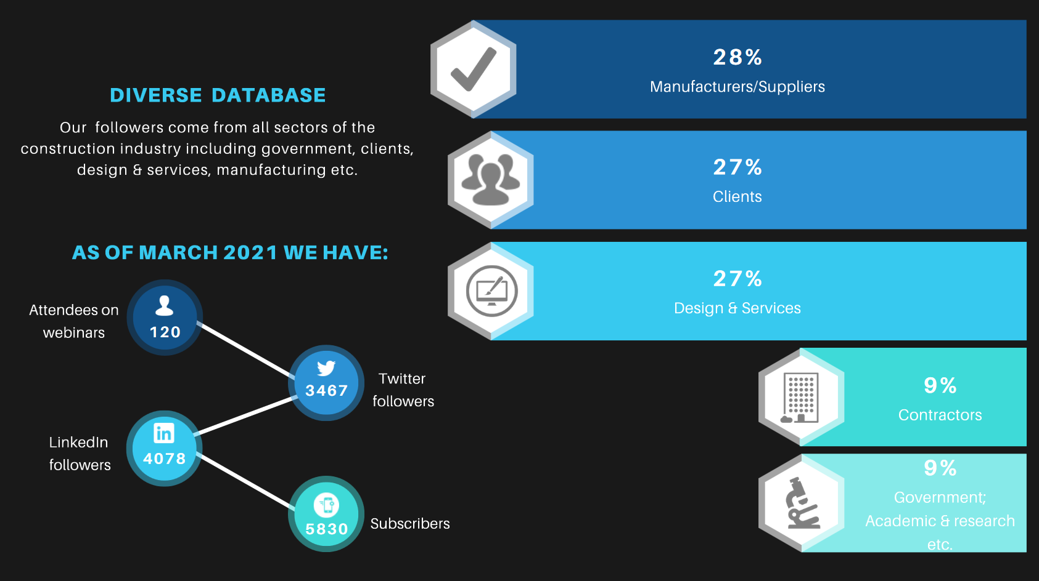
BUILDOFFSITE DRAFT TEMPLATE
Communications Reach
Member Meeting – April 2021

Slide 30
Q&A
Member Meeting – April 2021

Slide 31
PROJECT & ACTIVITY UPDATES
Fareita Udoh, Project Manager, Buildoffsite
Roger Marlow, Principal Consultant, Arcadis
Nigel Fraser, Industry Advisor, Buildoffsite
Member Meeting – April 2021

Slide 32
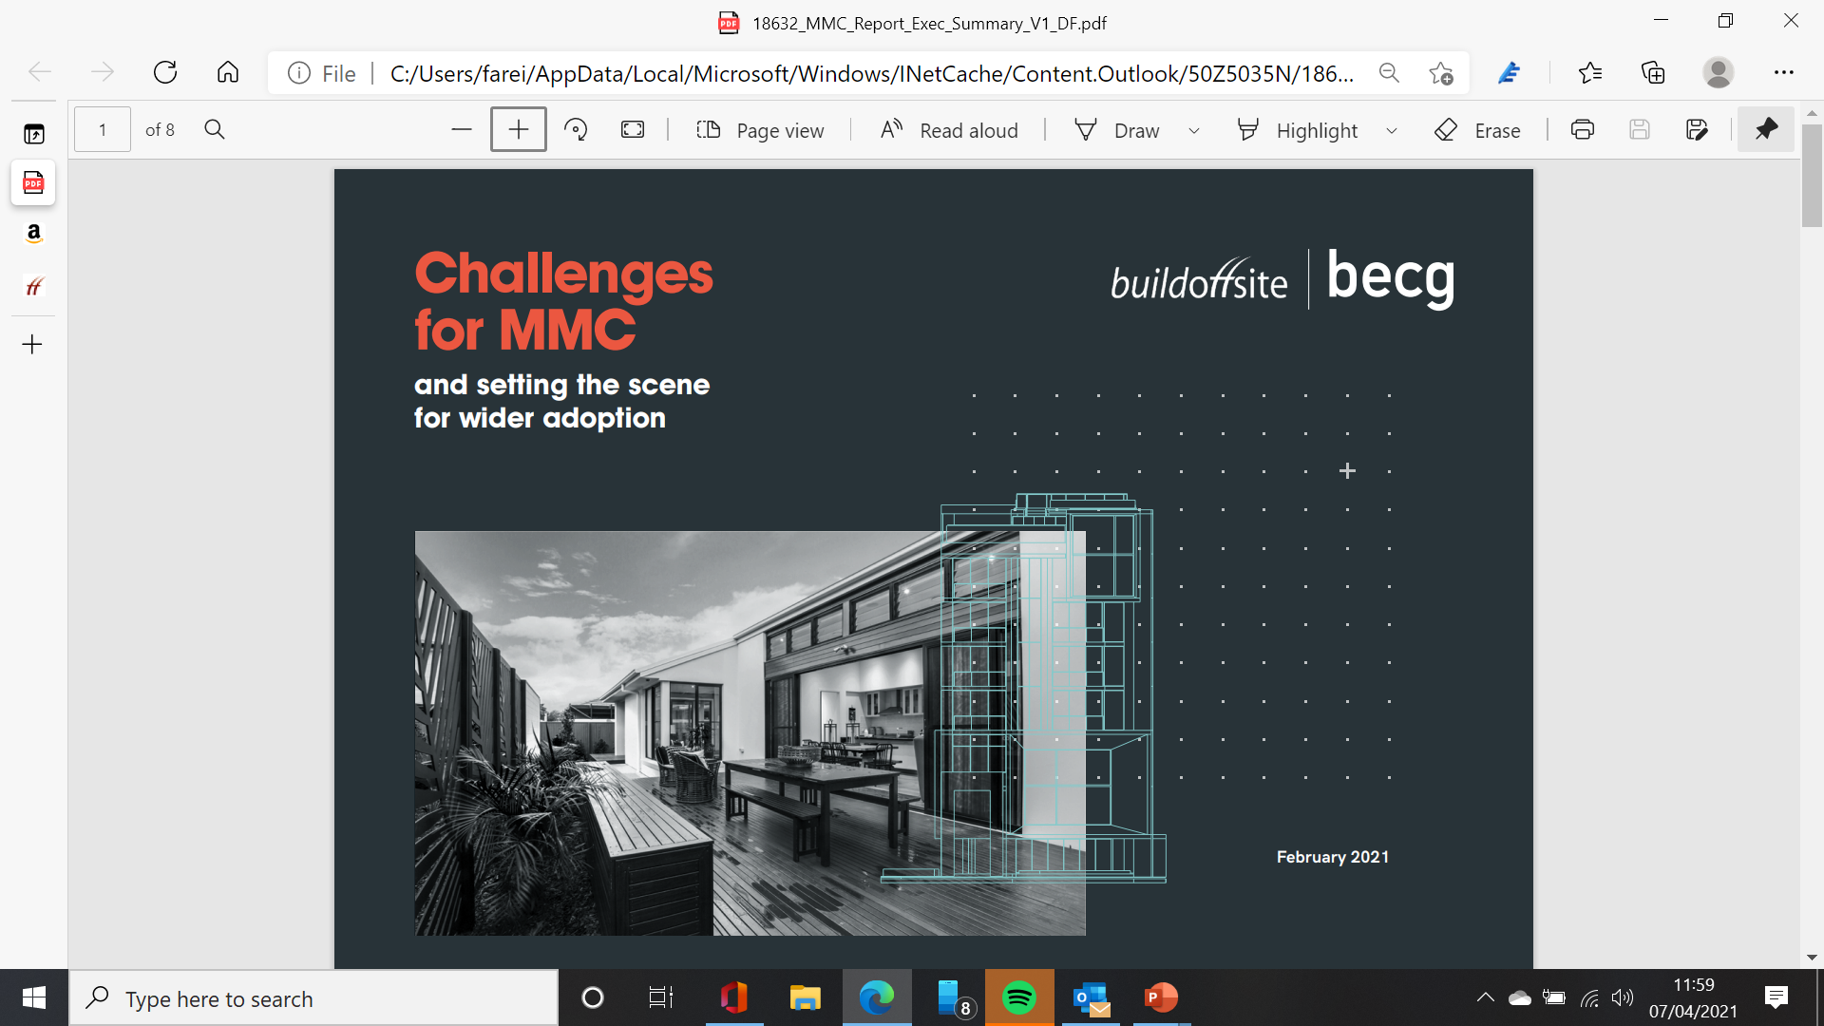
Member Meeting – April 2021

Slide 33
In late 2020, BECG partnered with Buildoffsite to survey its members about the logistical and political challenges for the MMC sector.
The following is a summary extract from the report which can be accessed shortly from our website, with the full report available from BECG.
Member Meeting – April 2021

Slide 34
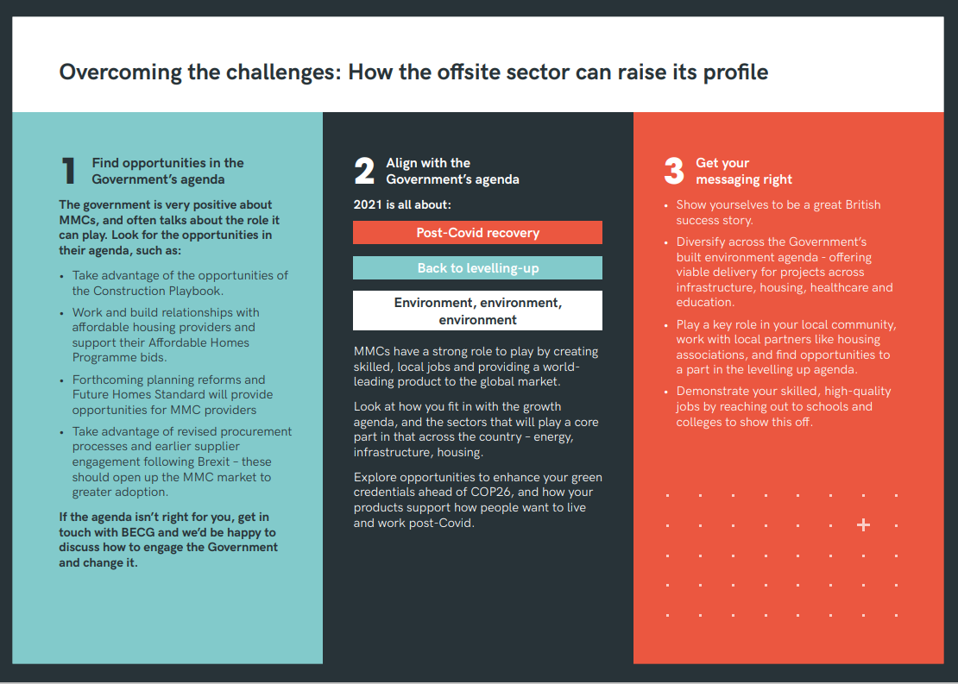
Member Meeting – April 2021

Slide 35
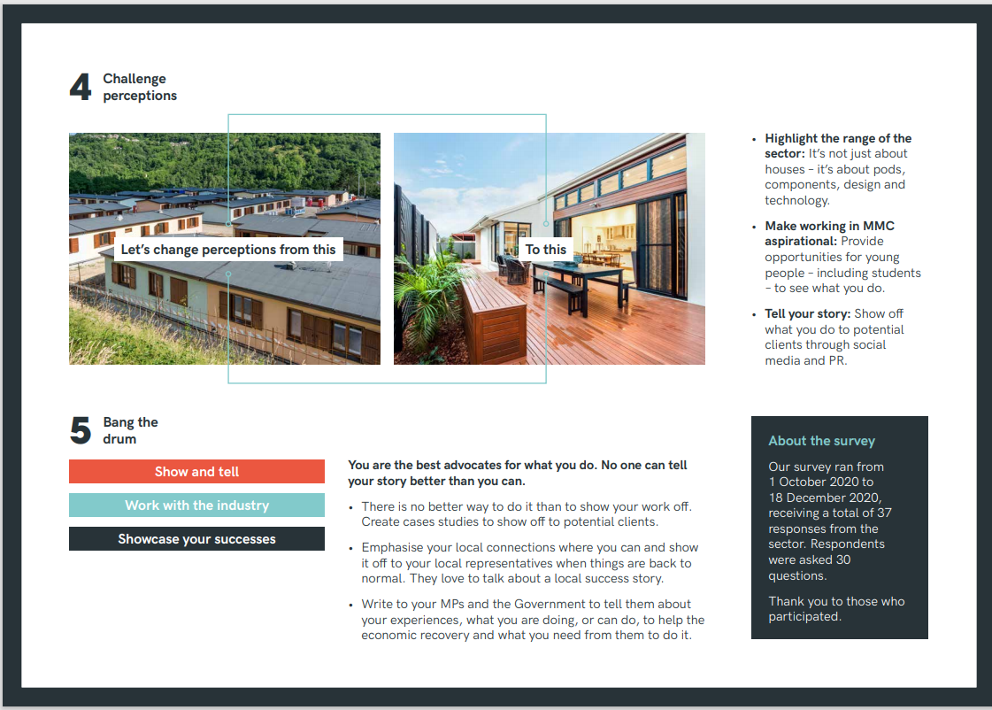
Member Meeting – April 2021

Slide 36
OFFSITE DYNAMIC PURCHASING SYSTEM
Buildoffsite is positioned as the authority on adoption and implementation of offsite
Member Meeting – April 2021

Slide 37
Transformation at the centre
Recovery and a fairer greener future for all
Make offsite supply chain visible
Deliver short term impacts and long term change
Support more businesses delivering offsite solutions and make access for buyers easier
Embed supply chain solutions into the market now to ensure construction and offsite bounce back stronger
Creating a Dynamic Purchasing System is the key to unlocking offsite & fast market recovery for faster delivery of required buildings
Member Meeting – April 2021

Slide 38
What happens next?
Build a Dynamic Purchasing System for Offsite, hybrid & traditional
Deliver a prequalified database of suppliers
Supplier validation across Financial, H&S, Quality, Environmental, Carbon Credentials, Build UK Common Assessment Standard (CAS)
Buyer & Supplier Procurement Training
Supplier/Premarket Engagement
Meet the buyer events & pipeline publication of opportunities
Member Meeting – April 2021

Slide 39
Update on Review of WIMES 8.02 & Built Offsite Solutions for Chemical Dosing Equipment
Roger Marlow - Arcadis
Buildoffsite & Arcadis
8th April 2021

Slide 40
What are we working on/promoting?
WIMES 8.02 – Phase 1 Review
WIMES 8.02 update - so far comprised 5 webinars including a Supply Chain Showcase December 2020
BIM4Water Product Data Templates - Pump Centre (WIMES), the BIM4Water SLG and chemical dosing system suppliers working together to agree the format and content of these PDTs
Water Industry (WIMES) embodied carbon calculator
DfMA guide for dosing equipment - WIMES/Water Hub to jointly publish

Slide 41
What is WIMES?
WIMES stands for Water Industry Mechanical & Electrical Specifications
The WIMES have been managed by the Pump Centre for over 25 years
There are over 80 WIMES available, ranging from simple items, such as pumps and motors, to complicated package plant
All of the UK’s WASCs and WSCs use the WIMES
A full list of the WIMES and their associated resources can be found at www.pumpcentre.com
Development/maintenance of the WIMES involves a lot of collaboration between water companies and their supply chain

Slide 42
WIMES 8.02 update
WIMES 8.02 – Phase 1 Review
Issue 2 was published in October 2011
A lot has happened in 10 years!
The specification needs updating to include the following ‘built-off-site’ dosing solutions:
Integrally bunded solution
Walk-in kiosk solution
Non walk-in kiosk solution
Double skinned tank solution

Slide 43
Who is involved from the supply chain?
Dosing Equipment & Pumps
EPS Water
Lintott
Colloide
Grundfos
Watson Marlow
Ross-Shire Engineering
Leada Engineering
NPS [Northern Pump Suppliers]
IPS Flow Systems
WES
Nomenca
Richard Alan
Pipework & Tanks
Aliaxis
Durapipe
George Fischer
CSO Group
Miscellaneous
CMPD JV

Slide 44
Integrally Bunded Solution

Slide 45
Walk-in Kiosk Solution

Slide 46
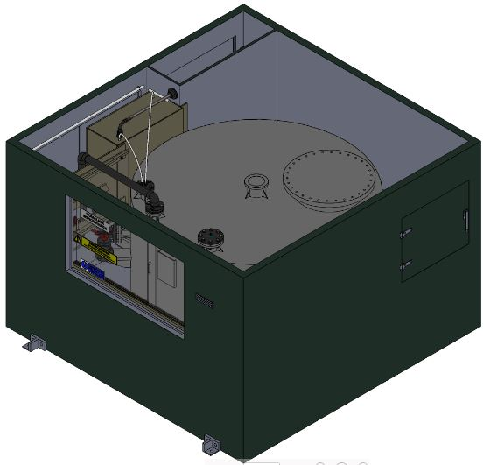
Non Walk-in Kiosk Solution

Slide 47
Double Skinned Tank Solution

Slide 48
BIM4Water Product Data Templates
The revised WIMES 8.02 will require suppliers to generate Product Data Templates (PDTs) for certain components comprising chemical dosing systems
What is a Product Data Template?
PDTs will allow product manufacturers to supply non-graphical information about their products for use in water industry projects implementing BIM Level 2 – the ‘digital twin’
PDTs provide the following benefits:
They allow designers to select, compare and analyse product data more accurately and efficiently
They help contractors with procurement and creation of the as-built model
They allow water companies to operate and maintain their assets more effectively

Slide 49
Delivering on Regulatory Policy – Water Industry Embodied Carbon Calculator
The Water Industry is the 4th most energy-intensive industry and a major national contributor to emissions responsible for around five million tonnes each year, roughly equivalent to 378,000 cars with average use
Water companies in England & Wales have an ambitious commitment to achieve net zero emissions by 2030 with Scottish Water having a similar commitment for 2040
The Water Industry is well ahead of the government’s 2050 net zero target for the country as a whole
By promoting the use of a water industry (WIMES) Embodied Carbon Calculator we are helping the industry meet these targets

Slide 50
DfMA Guide
To be jointly published by WIMES and the Water Hub
The DfMA guide will provide ‘best-practice’ guidance for the design, manufacture & assembly of chemical dosing equipment for the water industry using built offsite solutions

Slide 51
Summary of deliverables
Updated WIMES 8.02 specification
Product Data Templates for chemical dosing equipment
Water Industry embodied carbon calculator (already available for use)
DfMA guide
Delivery late summer 2021
Notes:
Design for productivity & housing hazardous materials
WIMES 8.02 inclusion for pumps & control panels
Accessibility to tanks or kiosks for inspection & maintenance
Design to be modular
Design Specification to make manufacturing easier
Use of Common parts & materials

Slide 52
What’s next?
WIMES 8.02 Webinar 6 - 21st April (10am – 3pm)
WIMES 8.02 Webinar 7 - 25th May (10am – 3pm)
Join Us!

Slide 54
What’s Next?
21st April Webinar 6 10am – 3pm
25th May Webinar 7 10am – 3pm
Join Us!

Slide 55
Nigel Fraser
Industry Advisor
Current focus – collaborative research reports & publications
Member Meeting – April 2021

Slide 56
RECENT PUBLICATIONS
Linear Infrastructure Overbuild Guide – post COVID-19 follow up
An Offsite Sector Response to the Construction Playbook – next steps?
As we emerge from the lockdowns we will be revisiting these reports
Member Meeting – April 2021

Slide 57
WORK IN PROGRESS – 1
Let’s protect structures so we do not have to waste the carbon it takes to produce them. Let’s minimise whole life carbon.
Achieving Sustainable Resilience in New Precast Concrete Structures.
A collaborative project with:
Mott MacDonald, C-Probe Systems & Structural Healthcare
Opportunities for pre-casters to contribute in the coming weeks
And an open invitation for the review panel
Due for publication this summer
Member Meeting – April 2021

Slide 58
WORK IN PROGRESS - 2
RIBA updated its Plan of Work now the DfMA Overlay is being revised by RIBA in conjunction with the Supply Chain School & Buildoffsite
Technical author appointed & working on initial draft.
Publication anticipated in the autumn.
Member Meeting – April 2021

Slide 59
IN DEVELOPMENT with CIRIA
Offsite construction, concept design and delivery
A definitive guide to consolidate CIRIA, Buildoffsite & Industry knowledge / best practice
This is in scope development with a funding campaign underway.
Anticipated development period – 12 months.
Member Meeting – April 2021

Slide 60
HOW WOULD YOU LIKE TO COLLABORATE / CONTRIBUTE?
Let me know at: nigel.fraser@buildoffsite.com
Member Meeting – April 2021

Slide 61
MEMBER SHOWCASE & ACTIVITY UPDATES
Adrian Tomlinson, Operations Director, WS Transportation
Abel Maciel, Director, Construction Blockchain Consortium
Member Meeting – April 2021

Slide 62
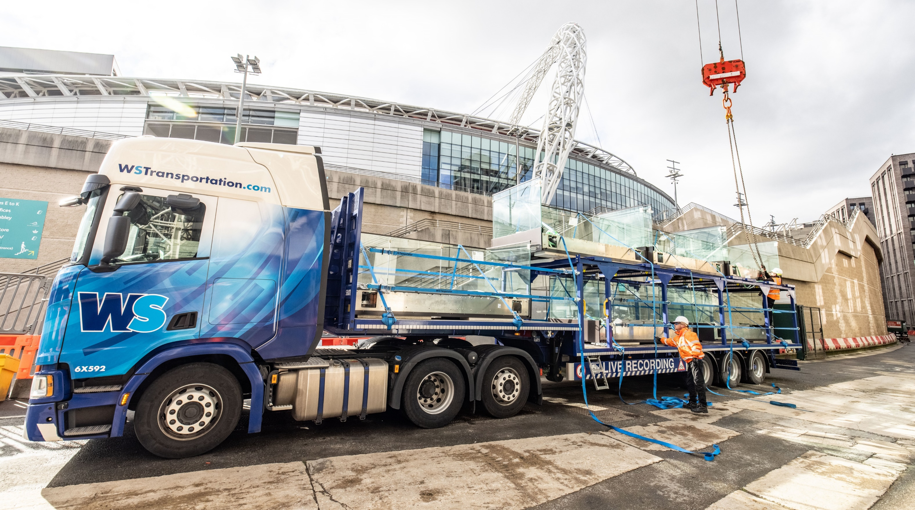

Build Offsite
Networking
Thursday 8th April 2021

Slide 63
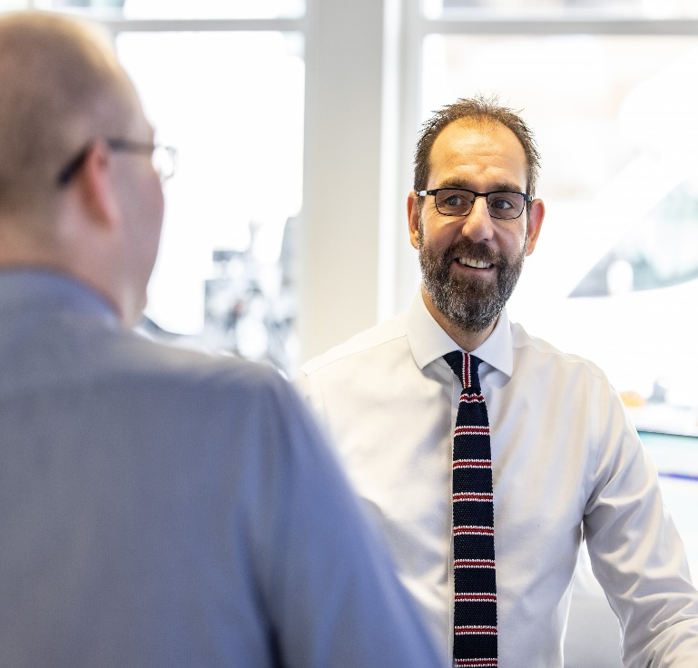

Introduction
Adrian Tomlinson
Operations Director
Mobile: 07766 207023
Email: adrian.tomlinson@wstransportation.com

Slide 64


WS Transportation
Overview:
FORs Gold, CLOCS, Crossrail, Euro 6 compliant
All vehicles are Direct Vision Compliant
Own workshop based in Runcorn
Won 3 awards this year:
  Best Nationwide Haulier, SME News
  Excellence in Construction Transport Services, SME News
  Transport Solutions Company of the Year, Manchester & North West Prestige Awards
Depots:
Runcorn
Thirsk
Wombourne
Rugby
Coventry
Loughborough
Dagenham
Immingham
Ballianamallard
Coleraine
Lutterworth
Fleet:
44 Hiabs
60 vehicles on Flatbed division with 350 trailers
22 vehicles on High and Heavy division
(mixture of stepframes and kickers)
65 vehicles on Curtain Sider division with 150 trailers

Slide 65












































Customers

Slide 66
Contact Us
For further information about WS please contact:
Adrian Tomlinson
Operations Director
07766 207023
adrian.tomlinson@wstransportation.com
Emma Desmond
Commercials
07377 523068
emma.desmond@wstransportation.com
Jez Desmond
Head of Commercial
07931 115377
jez@wstransportation.com

Slide 67
LOOKING AHEAD
Member Meeting – April 2021

Slide 68
Publication of Manifesto
Details on how members can get involved in Working Groups or Client Group & details of first meeting & agenda
Events Calendar and dates for the diary – Buildoffsite & BOPAS
New Monthly Member Highlights
Refreshed website & new members area
Updates on activity and opportunities to engage with other industry groups
Construction Innovation Hub
Smart Construction Network
Construction Leadership Council
Member Meeting – April 2021

Slide 69
THANK YOU!
Member Meeting – April 2021

