Slide 1

Offsite data for onsite assembly
Rob Gardiner
Armstrong Ceilings
Commercial Technical Manager EMEA
05 November 2018

Slide 2
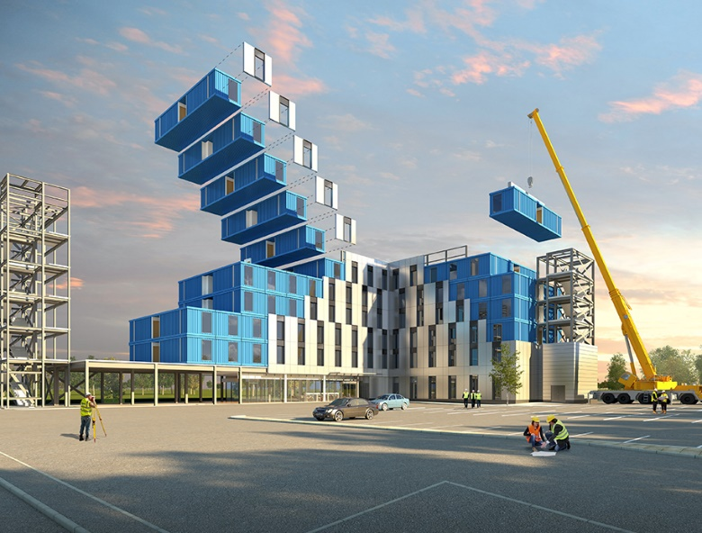

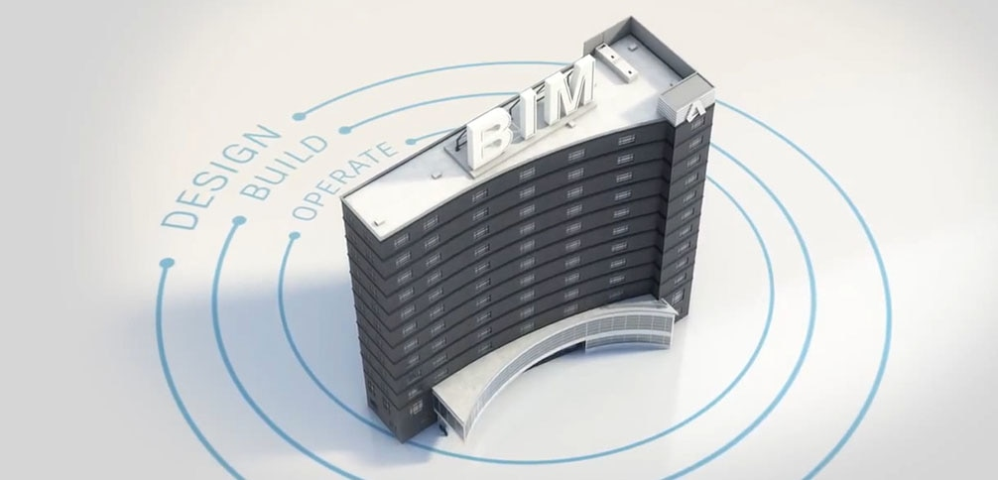
Offsite manufacture and BIM – perfect partners?
“Designing buildings and assembling them onsite from offsite manufactured assemblies and components can deliver improvements in quality, value and productivity for UK construction.”
“BIM supports the efficient design, delivery and maintenance of infrastructure and buildings. The data you generate is then available to help others in the supply chain to make more informed decisions to improve productivity and reduce waste.”
Notes:
Offsite construction and BIM have many shared goals….
Less waste, eliminate onsite errors, improved productivity…
It’s really all about construction efficiency

Slide 3
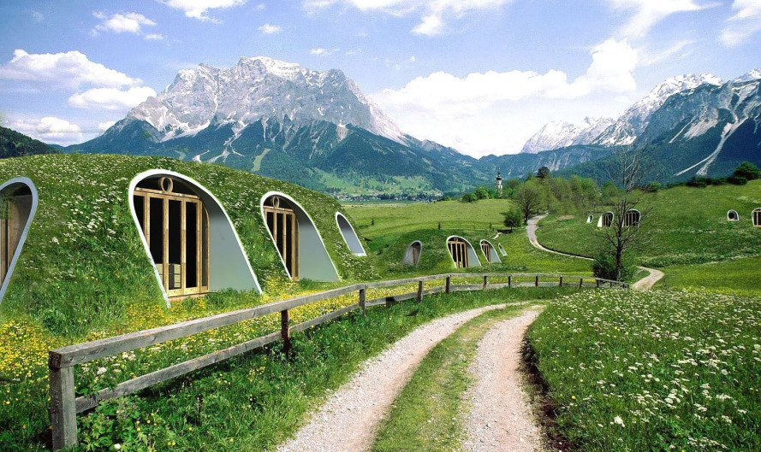
What can be manufactured offsite…?
Notes:
Whole buildings….
Whole rooms…
Elements of structure…
Bathroom pods… and much more

Slide 4

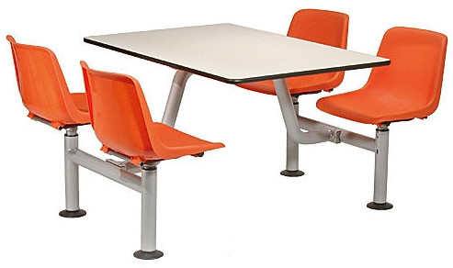
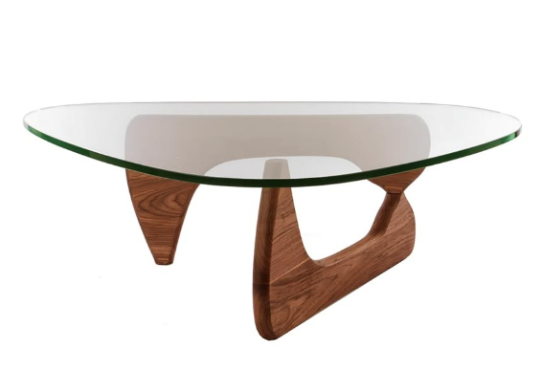
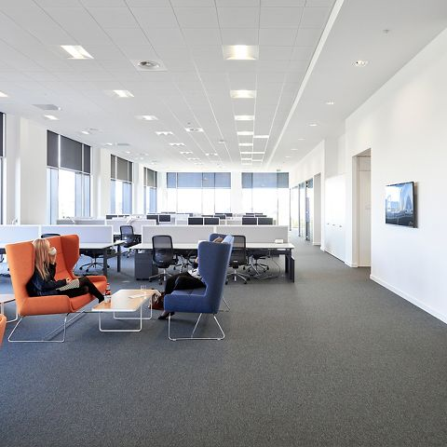
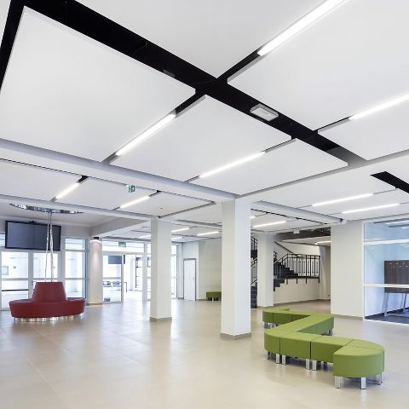
Can everything be assembled offsite?
It doesn’t make sense for all elements of a building to be assembled offsite…
But it is not just furniture…
Other fit-out components such as carpets, ceilings, etc.…
Notes:
However, not everything makes sense to be assembled offsite.
Some things are obvious, but others less so.
I strongly believe that even if something is not pre-assembled offsite, you can design it in such away to make the onsite assembly or installation as smooth and as efficient a process as possible.

Slide 5



So, what about elements that cannot be assembled offsite?
Notes:
Should we bury our head sin the sand?
Be one or all of the 3 wise monkeys?
No! Just because something cannot be included as part of offsite assembly doesn’t mean that it should be ignored.
If anything exactly the opposite is true!

Slide 6

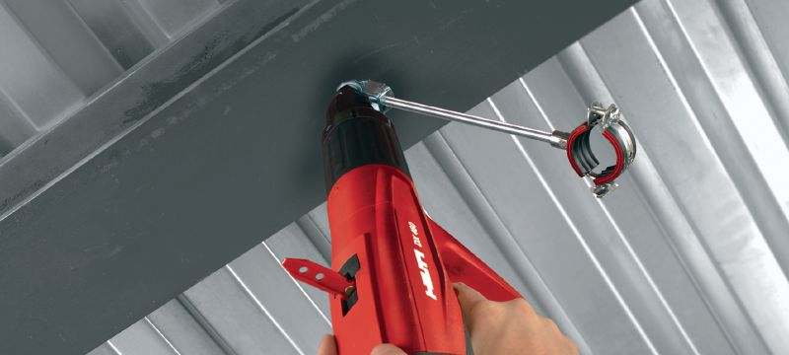
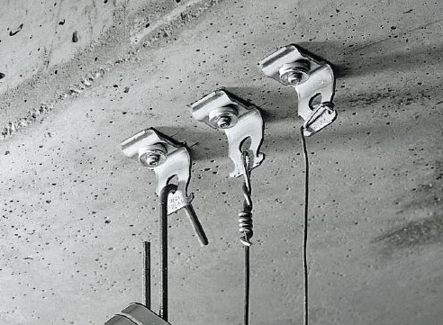
Designing offsite for onsite assembly
So what is the solution?….
Think about how, in your offsite assembly designs, you can include things to make the onsite assembly process easier and more efficient…
Notes:
If you cannot assemble it offsite, then there is a huge benefit to be had from designing the assemblies in an intelligent way that enables the onsite processes to be completed the most efficient.
One simple example from my world of suspended ceilings…. Pre-install fixing points in the right position in an offsite assembly to save time and reduce mistakes in installing the ceilings on site…

Slide 7

How to manage this…?
Notes:
BIM!
Digitally designed buildings incorporating offsite assemblies can use product data in the design – product positioning pinpointed, clashes detected, construction scheduling checked, even using AR to assist the onsite assembly process.

Slide 8
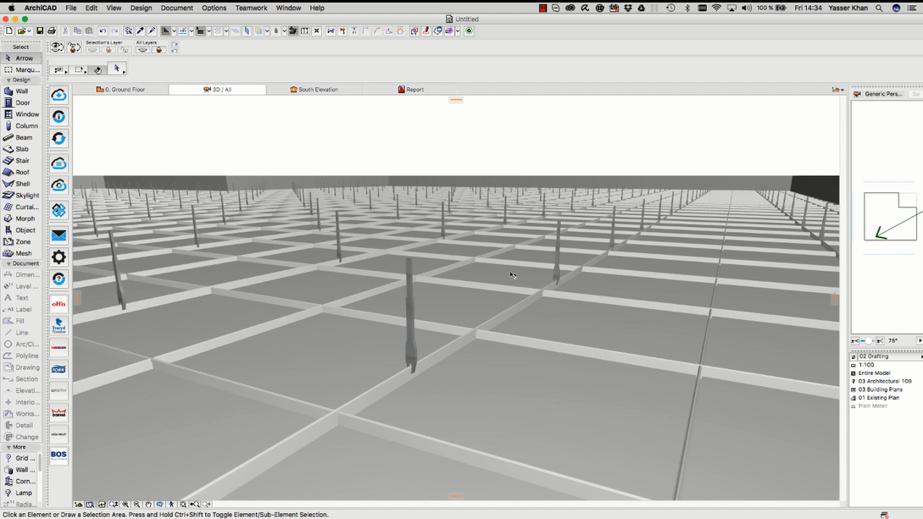
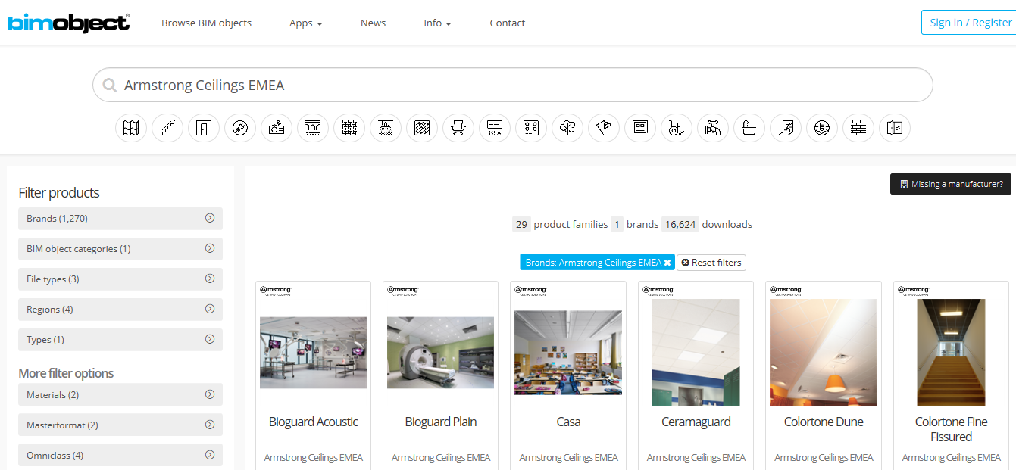
Use manufacturers product data in the BIM environment
Notes:
Use product data to within manufacturers BIM files to inform your design and improve construction efficiency.
Having manufacturers product data in the BIM environment can allow you to use offsite data for better onsite assembly

Slide 9
Questions?

