Slide 1
Offsite Applications for Rail Overbuild Part 3
19 July 2018

Slide 2
Case Study
Twickenham Station
Development

Slide 4
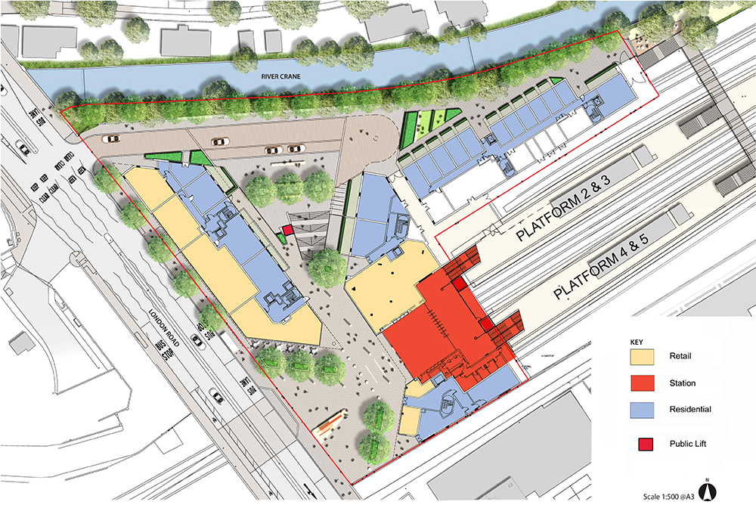
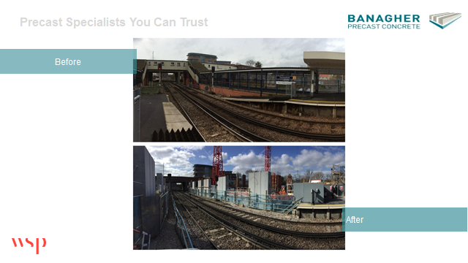
Precast Specialists You Can Trust
Proposed Development
Notes:
Full precast solution

Slide 5
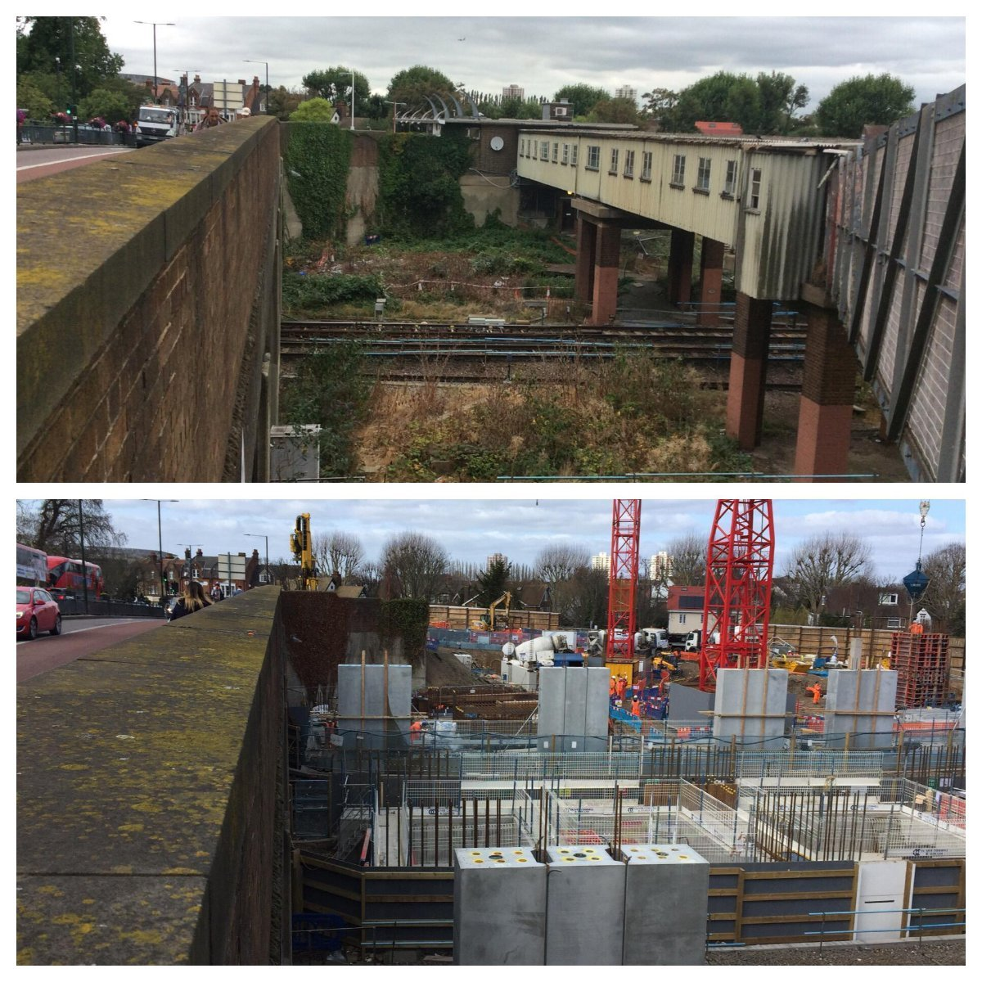
Precast Specialists You Can Trust
Before
After

Slide 6
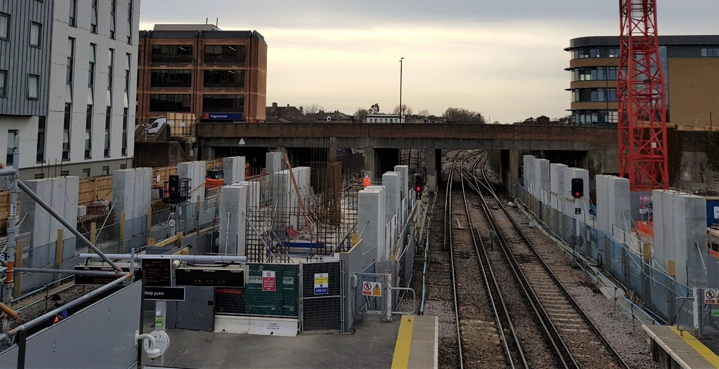
Precast Specialists You Can Trust
Twickenham Station – Columns Installed
#ChallengeUs

Slide 7
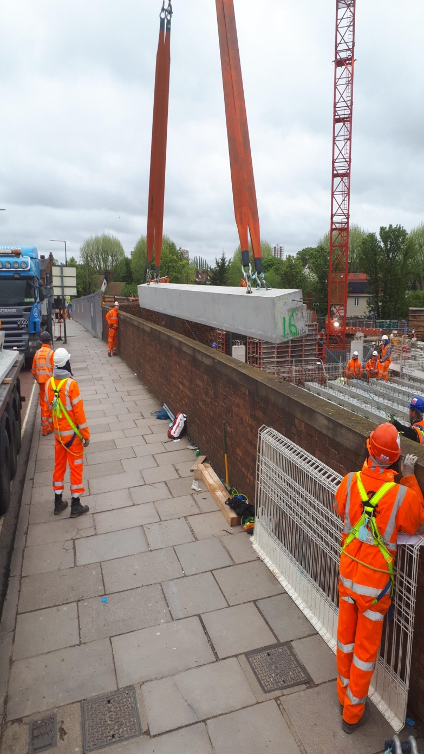
Precast Specialists You Can Trust
Twickenham Station – Final Edge Beam
#ChallengeUs

Slide 8
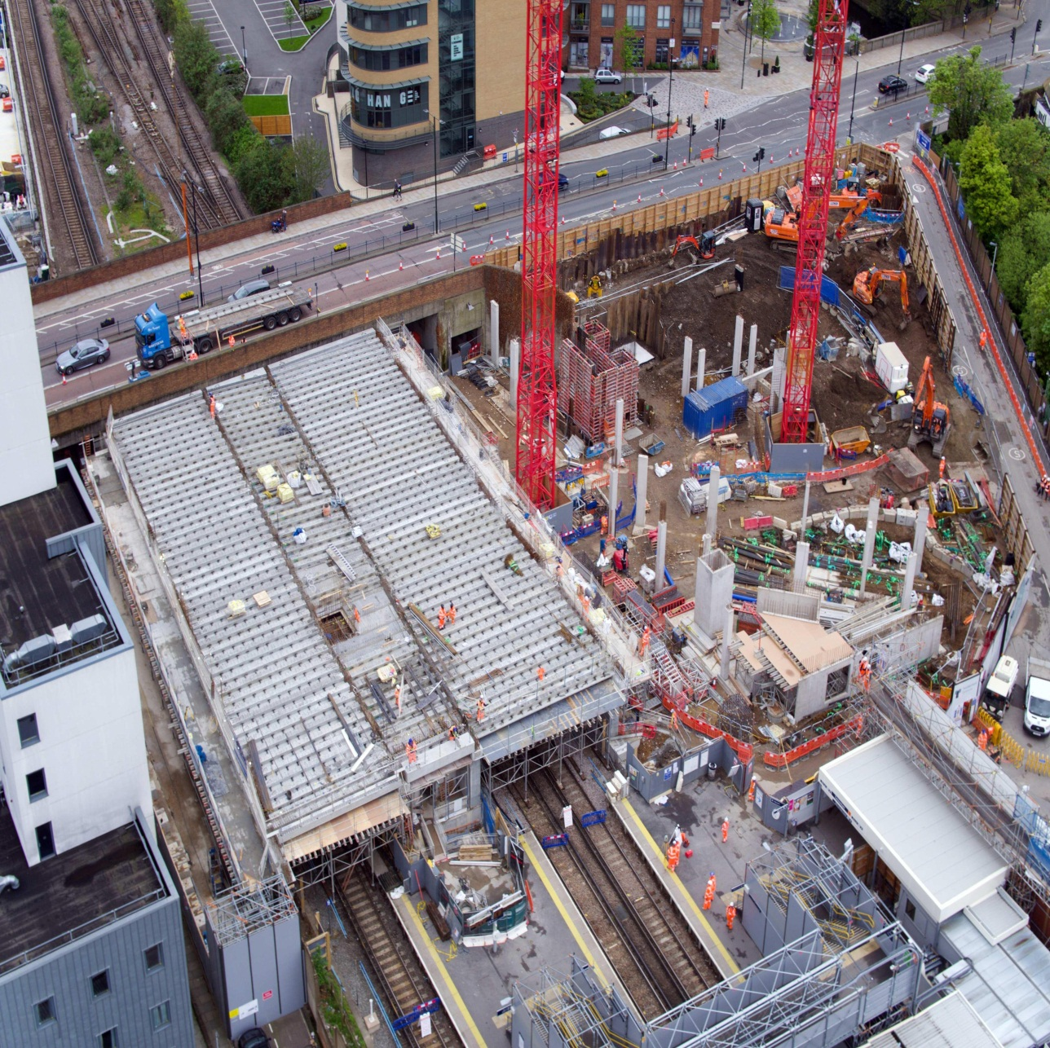
Precast Specialists You Can Trust
Twickenham Station
#ChallengeUs

