Slide 1
Offsite Applications for Rail Overbuild Part 2 Royal Mint Gardens
19 July 2018

Slide 2
Case Study
Royal Mint Gardens London
DLR Line Encapsulation

Slide 3
Precast Specialists You Can Trust
Proposed Development
Notes:
Full precast solution

Slide 4
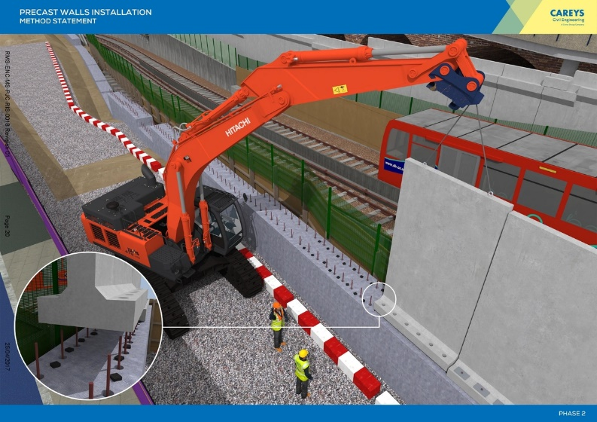
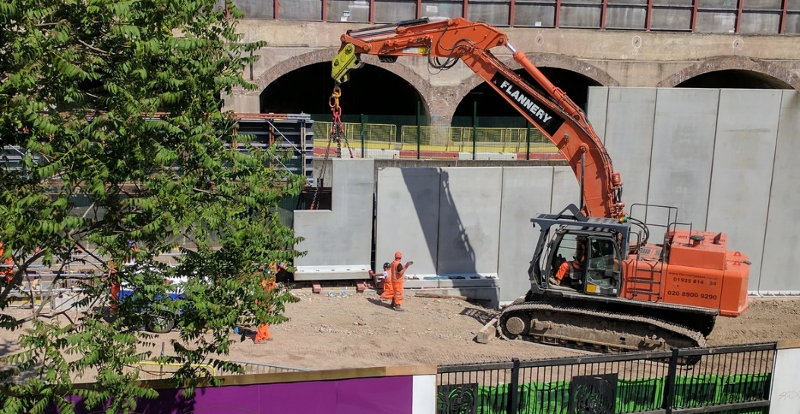
Precast Specialists You Can Trust
Method Statement and Actual Installation of the Precast Walls
Safety by Design
Notes:
Full precast solution

Slide 5
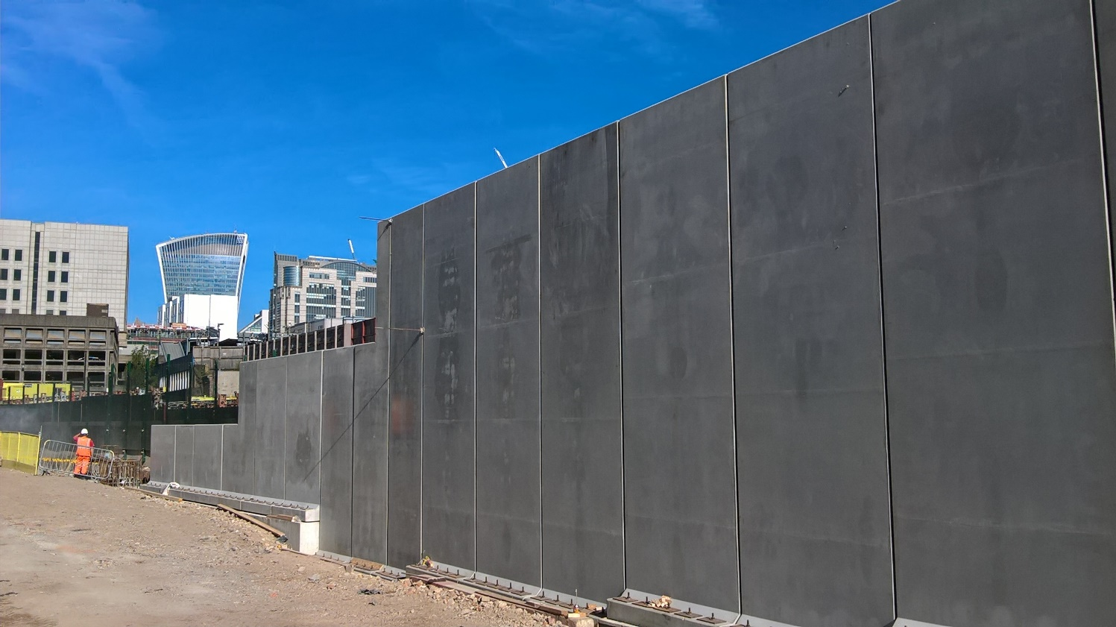
Precast Specialists You Can Trust
Bespoke precast walls – installed beside live rail line in central London
Notes:
Full precast solution

Slide 6
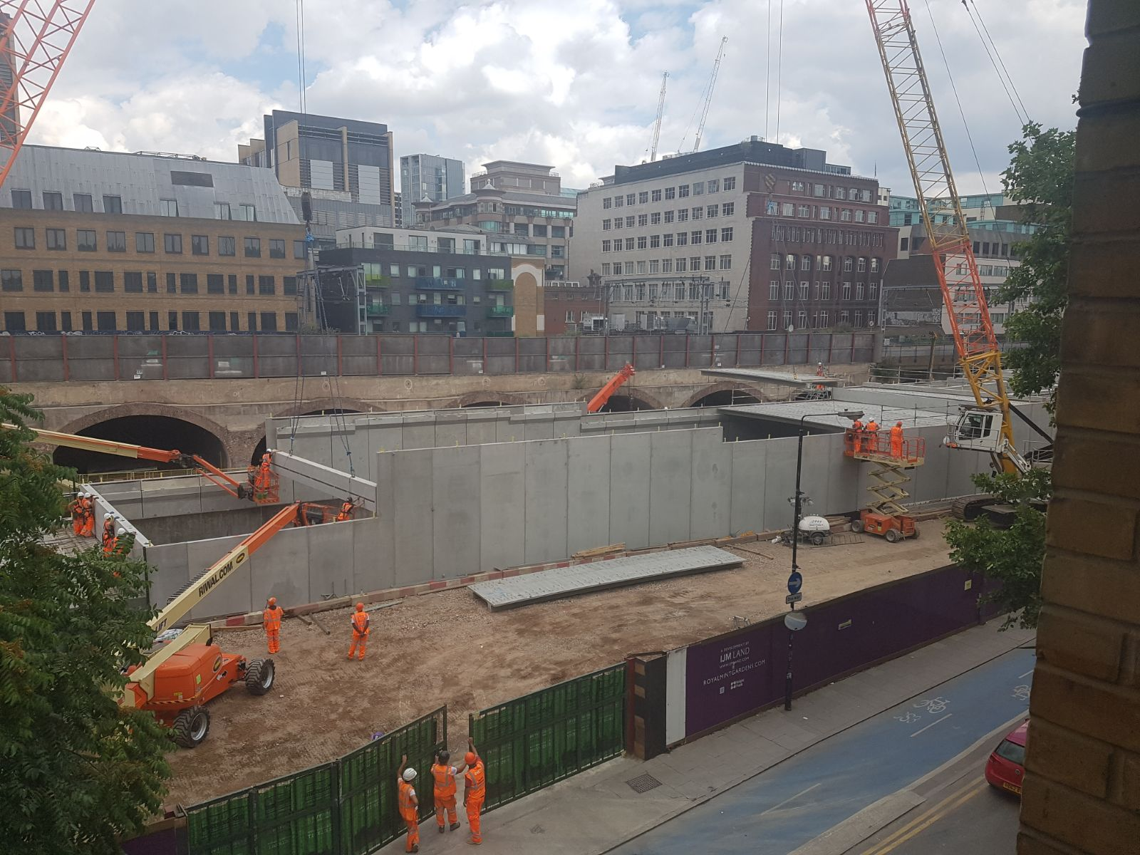
Precast Specialists You Can Trust
Restrictive site central London

Slide 7
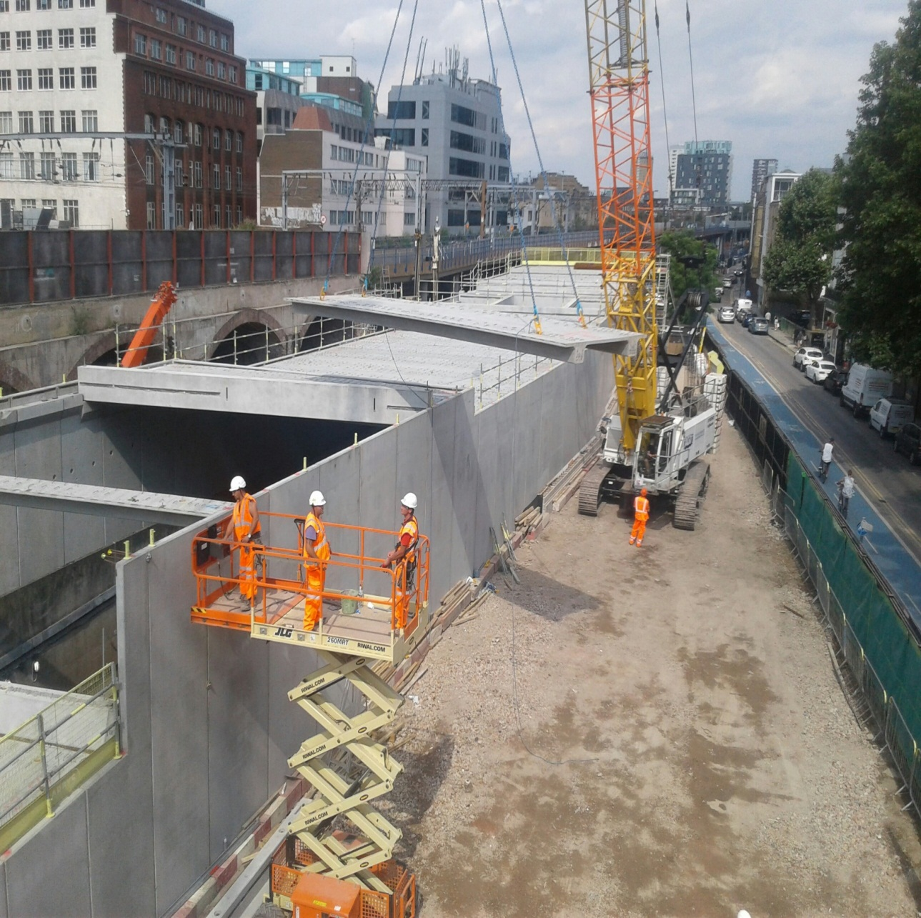
Precast Specialists You Can Trust
Restrictive site central London

Slide 8
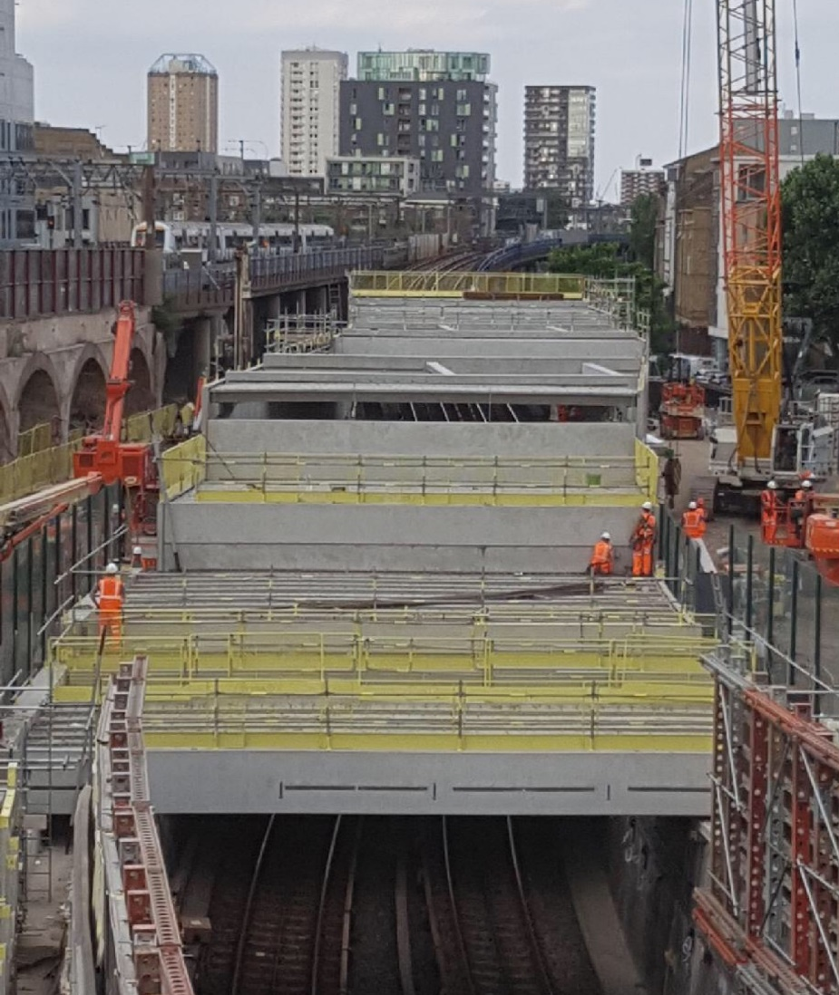
Precast Specialists You Can Trust
Installation Complete
Notes:
Full precast solution

Slide 9
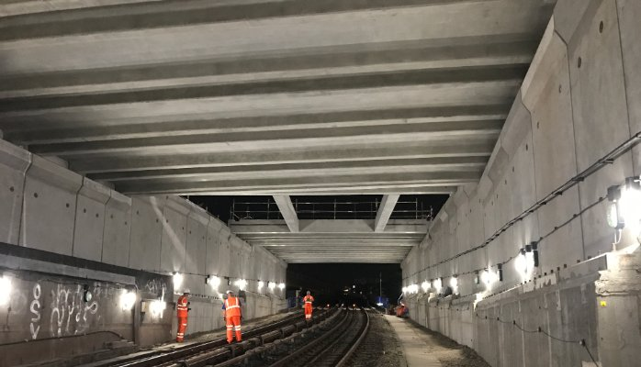
Precast Specialists You Can Trust
Encapsulation Inspection by
Network Rail
Notes:
Full precast solution

