Slide 1
Offsite Applications for Rail Overbuild Part 1
19 July 2018

Slide 2
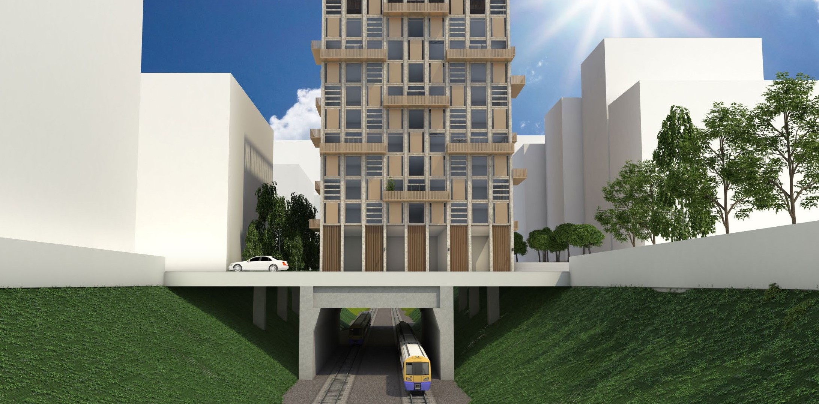
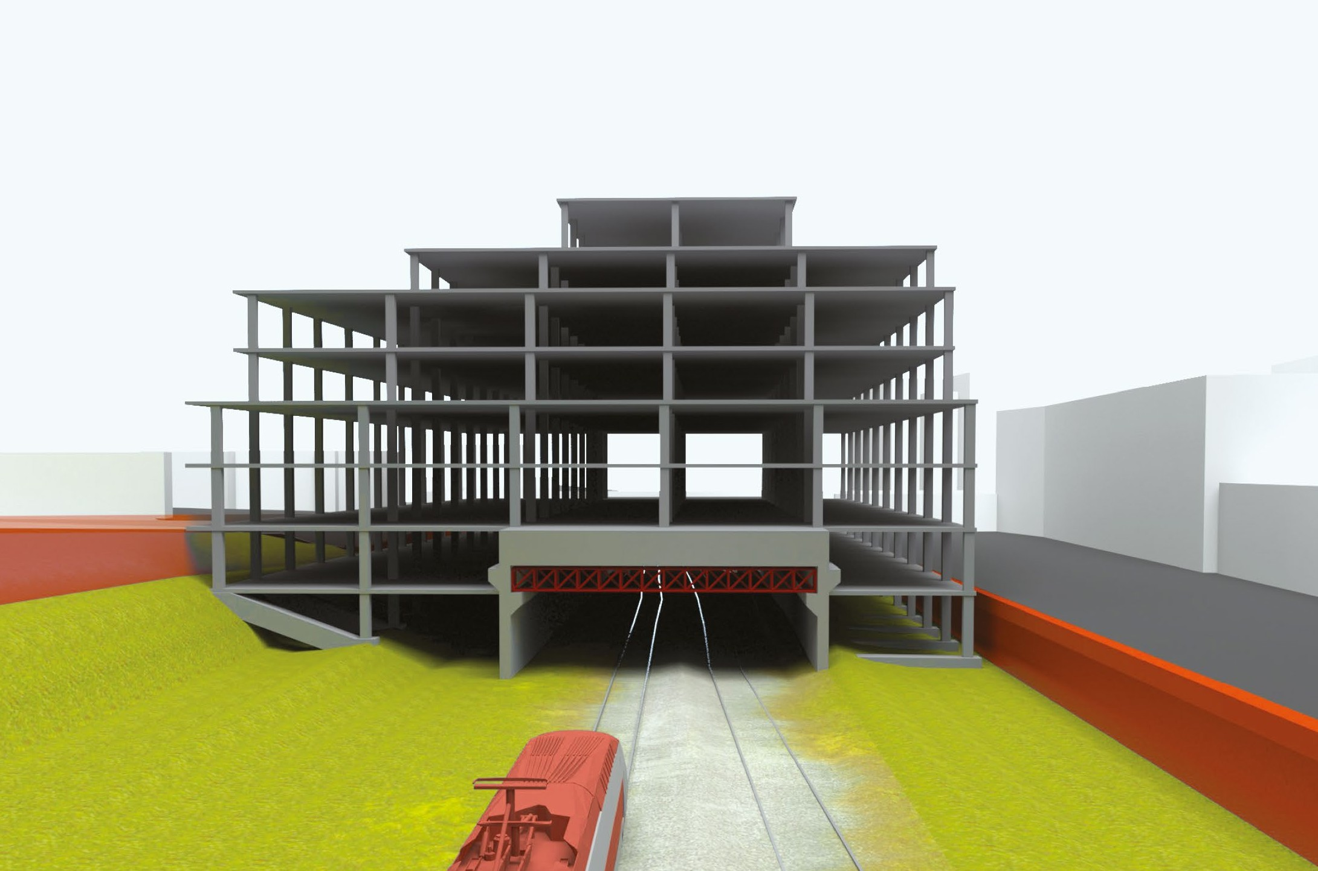
Key Issues:
Restrictive sites / limited space
Limited rail possession
Offsite solutions to minimise onsite work:
Precast or prefabricated encapsulation structures
Lightweight / modular superstructures

Slide 3
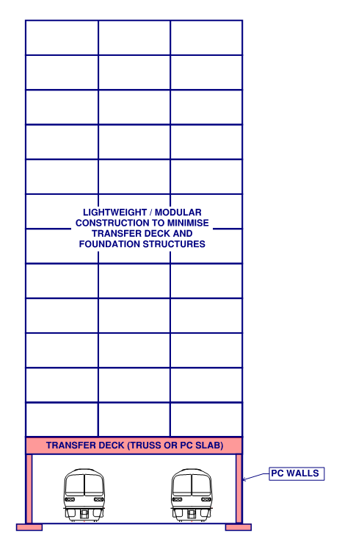
Offsite Solutions
Precast concrete deck and walls for encapsulation of rail assets
Trusses needed to achieve longer spans/ higher capacity
Lightweight / modular superstructures to minimise transfer deck (depth and / or weight) and foundations

Slide 4
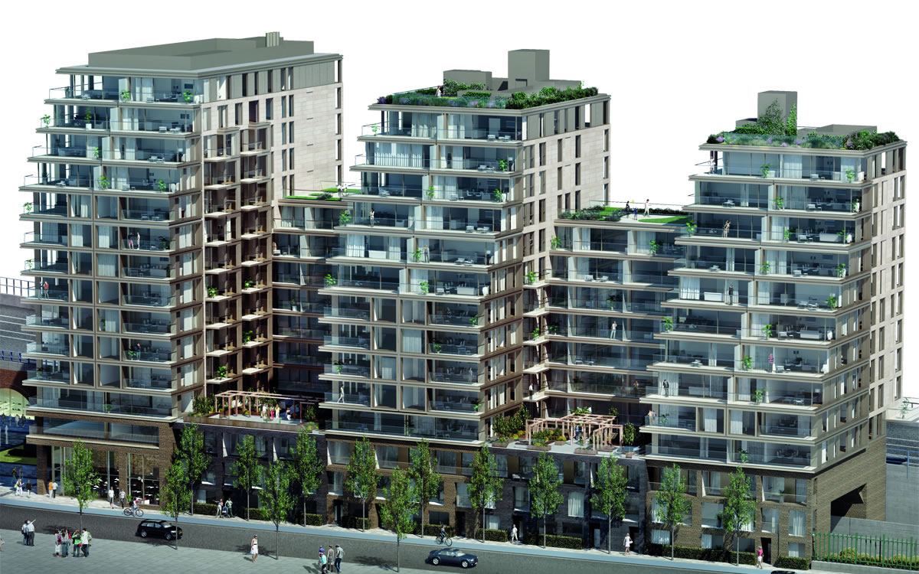
Case Study
Royal Mint Gardens

Slide 5
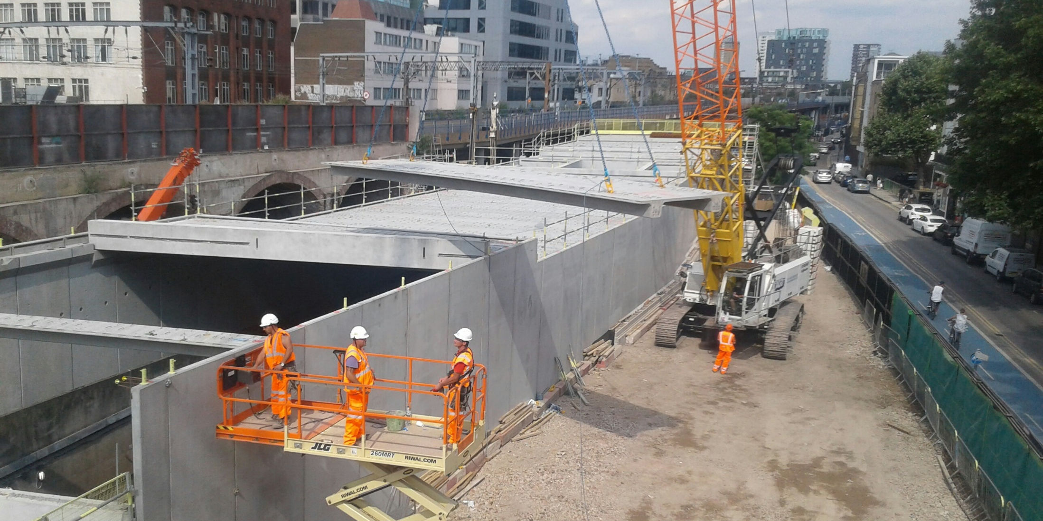
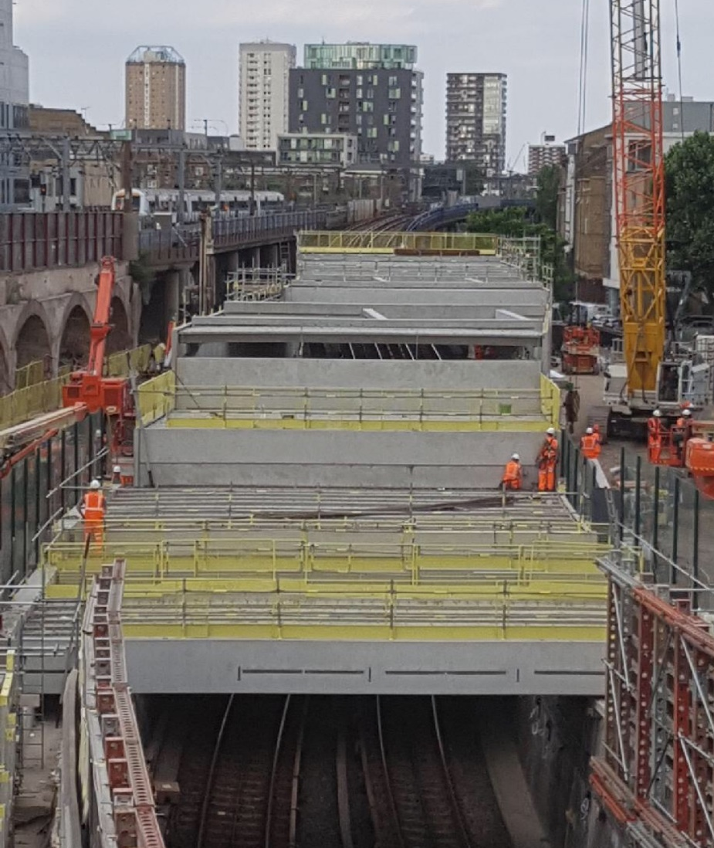
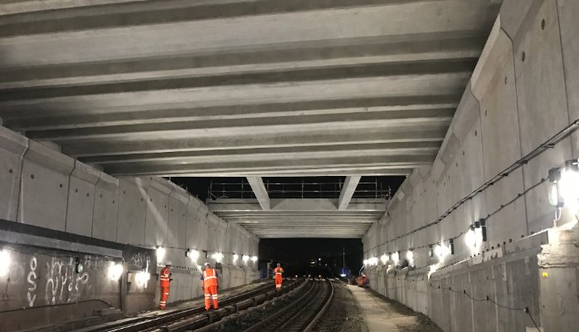
Royal Mint Gardens
Encapsulation
Encapsulation of the DLR line - Project Photos from Banagher Precast

Slide 6
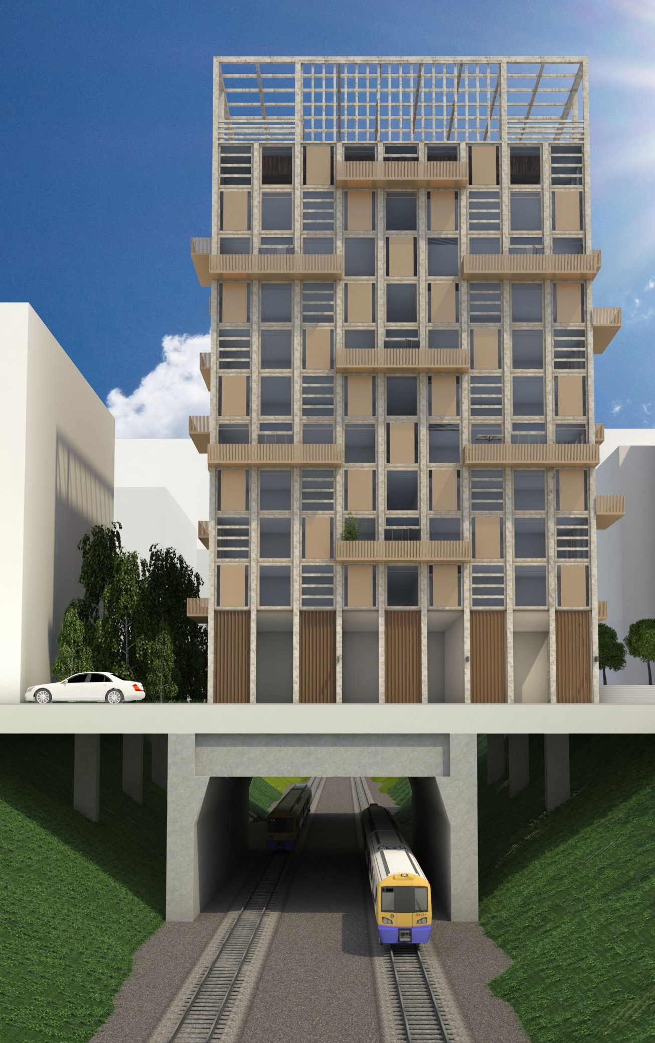

Load Comparison for Offsite solutions
Comparative unit weights per floor | Volumetric Modular LGSF |  | Volumetric Modular LGSF with hot rolled chassis |  | Cross Laminated Timber |  | Traditional RC Flat Slab
Load type | Dead | Live | Dead | Live | Dead | Live | Dead | Live
Floors | 1.21 | - | 2.26 | - | 3.03 | - | 7.55 | -
Ceiling | 1.13 | - | 1.43 | - | 0.92 | - | 0.89 | -
Walls | 1.70 | - | 1.70 | - | 4.99 | - | 2.22 | -
Imposed | - | 1.50 | - | 1.50 | - | 1.50 | - | 1.50
Equiv UDL unit load per floor [kN/m²] | 4.04 | 1.5 | 5.39 | 1.5 | 8.94 | 1.5 | 10.65 | 1.5
Total Equiv UDL | 5.54 |  | 6.89 |  | 10.44 |  | 12.15
Comparison to Traditional RC frame | 46% |  | 57% |  | 86% |  | 100%
Comparative loads for 12 storey building with PC deck over rail | Volumetric Modular LGSF |  | Volumetric Modular LGSF with hot rolled chassis |  | Cross Laminated Timber |  | Traditional RC Flat Slab
Load type | Dead | Live | Dead | Live | Dead | Live | Dead | Live
PC deck | 5.4 | - | 5.4 | - | 5.4 | - | 5.4 | -
Deck trusses swt | 1.5 | - | 1.5 | - | 1.5 | - | 1.5 | -
Deck superimposed DL (assume retail) | 4.0 | - | 4.0 | - | 4.0 | - | 4.0 | -
Deck Imposed (assume general retail) | - | 4.0 | - | 4.0 | - | 4.0 | - | 4.0
Deck UDL [kN/m²] | 10.9 | 4.0 | 10.9 | 4.0 | 10.9 | 4.0 | 10.9 | 4.0
12 Storey Residential Superstructure [kN/m2] | 48.4 | 18.0 | 64.6 | 18.0 | 107.3 | 18.0 | 127.8 | 18.0
Total Equiv UDL | 59.3 | 22.0 | 75.5 | 22.0 | 118.2 | 22.0 | 138.7 | 22.0
Total Equiv UDL [kN/m2] | 81.3 |  | 97.5 |  | 140.2 |  | 160.7
Comparison to Traditional RC frame | 51% |  | 61% |  | 87% |  | 100%
Circa 40-50% load reduction possible with lightweight / modular forms of construction

