Slide 1
Accelerating Housing Delivery through the use of modern methods of construction
Embassy of Ireland
Michelle Hannah
03rd May 2018

Slide 2
Introduction
Panelised
Volumetric
Pods
Onsite assembly
Technology driven
How can modern methods of construction support the delivery of housing in the UK.
Not only addressing capacity challenges but the ability to deliver at speed with a higher standard of quality.

Slide 3
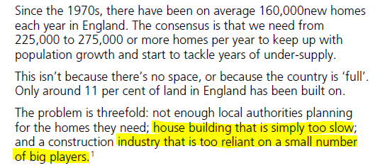
Housing Delivery
Government target to deliver 1 million homes by 2020 (September 2015)
“Average rents in Britain are almost 50 per cent higher than average rents in Germany, France and crowded Holland.”
“Britain’s housing costs are absurdly high by international standards: eight times average earnings in England, fifteen in London.”

Slide 4
Current State of Housing Delivery
Challenge around Supply and Demand
BUT we must also address…
Lack of Tenure Diversification (‘sales led’)
Shortage of Skilled Workers
Fragmented Supply Chain
Poor Quality Housing ‘Boom and Bust’
Lack of Investment in R&D
Lack of Collaboration and Learning

Slide 5
Modernise or Die
Tri-stakeholder collaboration
Shared responsibility
Government support
Accelerating housing delivery
Diversify on home ownership model
Increasing the players – disrupters and LAs
Improving on quality standards
Zero defects
Better life expectancies
Investment in R&D
Continually developing and learning
Increased productivity and efficiencies
Creating a sustainable future for the industry

Slide 6
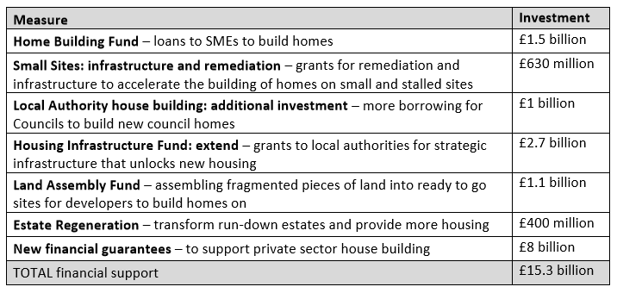
Stimulating Housing Supply and Demand
Autumn Budget 2017
Home Ownership Initiatives:
Help to buy allows housebuilders to maintain a rate of sale - premium price?
National Planning Policy Framework

Slide 7
Government Stimulus the ‘silver bullet’?
Real creation of additional capacity?
Symptoms of failure continue to exist?
The need for a new delivery model to create additional capacity and address the symptoms of failure.
Lack of Tenure Diversification (‘sales led’)
Shortage of Skilled Workers (then Brexit)
Fragmented Supply Chain
Poor Quality Housing
Lack of Investment in R&D
Lack of Collaboration and Learning

Slide 8
Additional capacity through OSM…
Housing delivered using offsite manufacturing techniques or onsite innovation of DfMA.
Thinking differently about the way we construct.

Slide 9
Construction as Manufacturing
Skills and Training?
Housing delivery using offsite manufacturing techniques and systems to accelerate delivery, increase capacity and improve on quality.
Investment levels?
Factory based operations where the product is delivered no different to that of an in-situ build but in a much more controlled environment.
Opposite ends of delivery
Factory based operations where the product is delivered using a highly automated, manufacturing aligned, assembly led, computerised process.
Commonalities in the approach
Early design considerations?
Repetition, Standardisation and Rationalisation
Creating a Product Design Platform
“Construction”
Digital Manufacturing

Slide 10
Procurement Challenge
Early engagement
The ‘square peg, round hole’ conundrum.
Existing procurement rules
Price vs Quality scoring mechanisms
Single Stage Design and Build
Upfront payments / Vesting
Contract size
Single point of ownership

Slide 11
System Agnostic?
Manufacturer specific design “unique”?
Standardisation and rationalisation – creating an holistic approach?
“Making design for manufacturer simpler to support an increase in precision manufactured homes.”
Funders
Designers
Constructors
Developers (public and private)
Owners
Occupiers

Slide 12
Warranty Challenge
Assurance vs Insurance
Standards and accreditations
MHCLG working group on creating a scheme with commonality

Slide 13
Opportunities for Diversifying and Accelerating
Local Authority Self Delivery
Ability to demonstrate turnkey capabilities and experience
Potential for pipeline demand certainty
Need for acceleration and standardisation
Accreditation and warranty will be critical
Build to Rent & Affordable Housing
Standardised design aligned to improving the operational strategy
Benefit from early receipts
Market sale is not excluded
Client Collaboration and Partnership
Local Authority / Housing Associations
Not system ‘wedded’ – opportunities for more than one factory
Client custom design flexibility (finishes, cladding etc)

Slide 14
Volumetric Modular Delivery Models
The age of the Manufacturer as the Main Contractor
Clients that want a full turnkey solution with a single point of ownership
Sub-contractor delivery model creates unnecessary profit-on-profit
Sub-contractor delivery model creates additional construction risk pricing
Lack of main contractor interest from construction industry – unfamiliar, insufficient profit

Slide 15
Who is out there? Opportunity to grow capacity?
There is a growing number of volumetric modular providers as existing, new and crossover entrants to Residential

Slide 16
Thank You

