Slide 1
Rising to the Challenge
- a Contractor’s View

Slide 2
The Challenge
Construct 66,000 new homes a year
60% to be affordable
Off-site construction
Step change in delivery

Slide 3
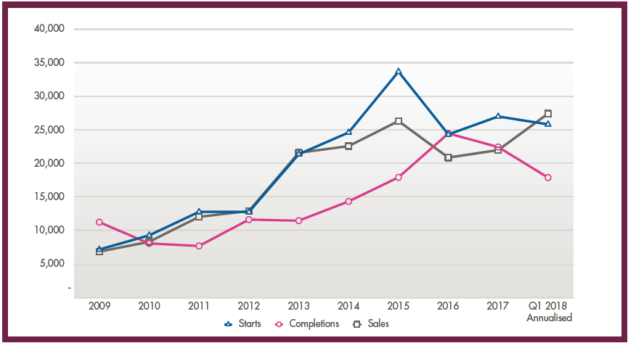
Current Market

Slide 4
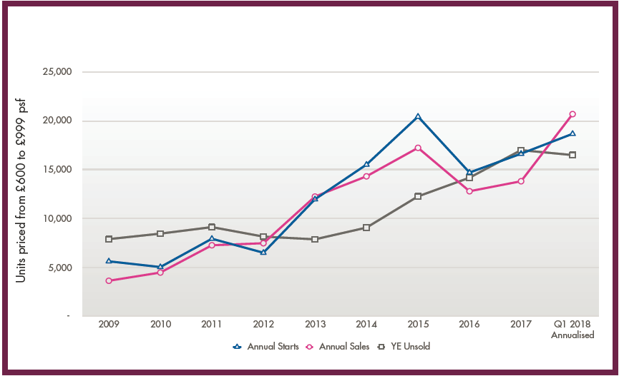
Market at ‘affordable levels’ (up to £999/ft²)

Slide 5
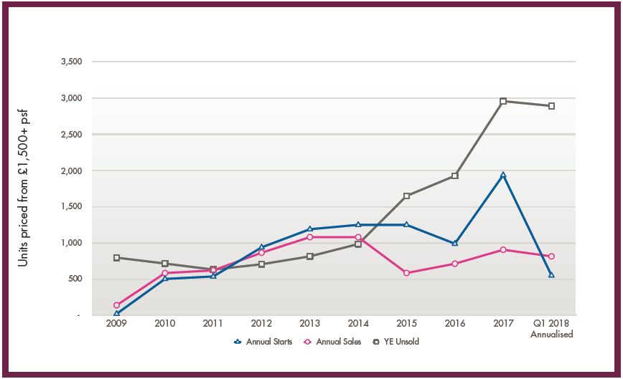
Market above help to buy (over £1000/ft²)

Slide 6
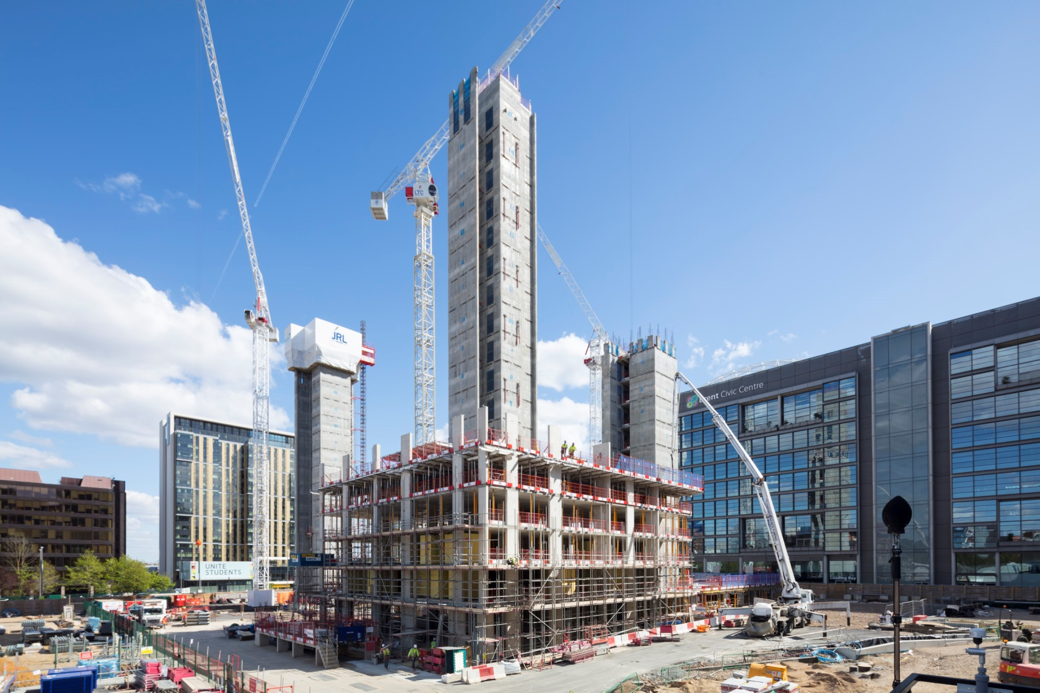
The Product - Frame

Slide 7
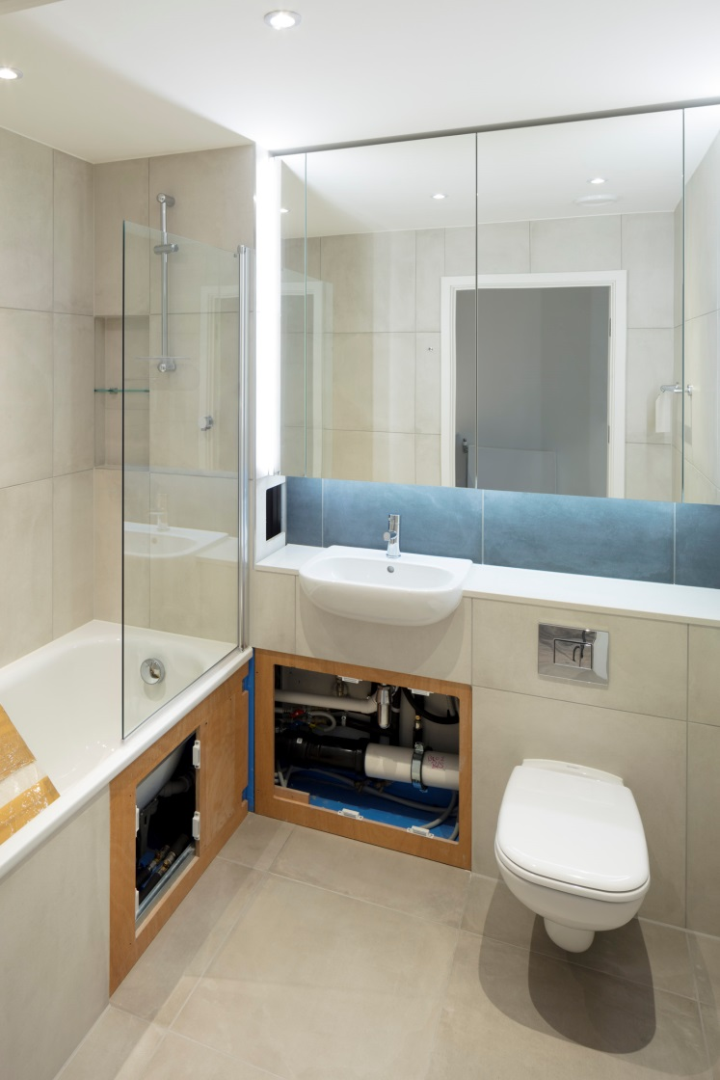
The Product - Pods

Slide 8
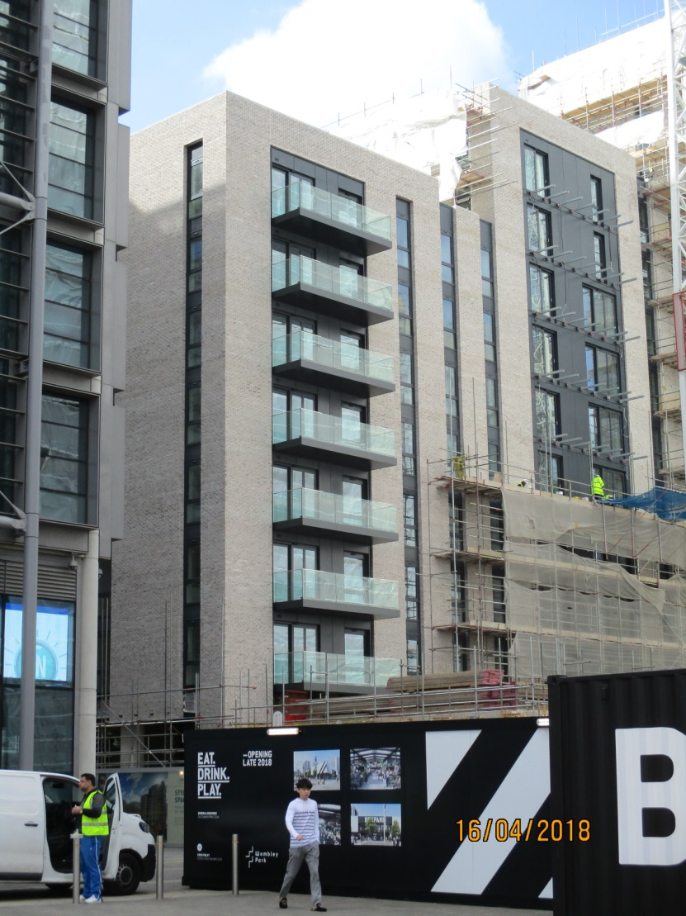
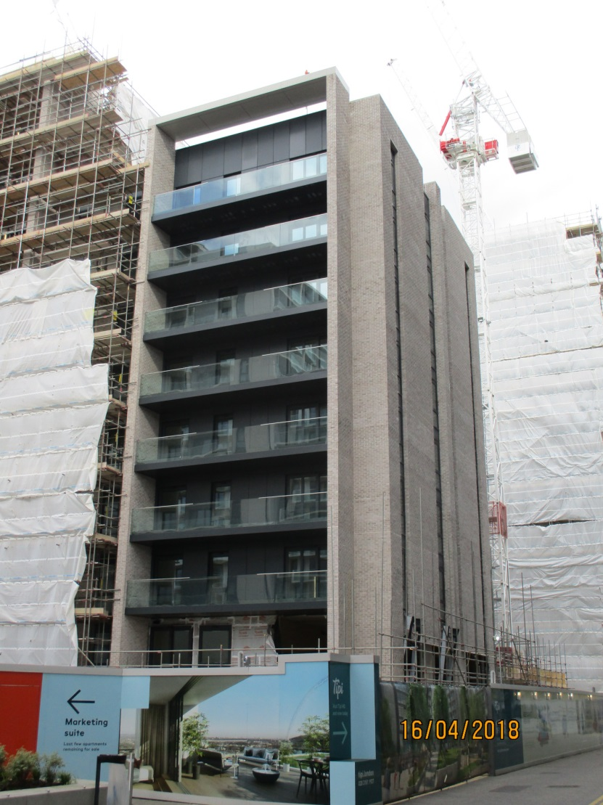
The Product – Façade

Slide 9
Affordability
Planning issues
Infrastructure levy
How much burden can the sale / rental sector take?
What happens post Brexit – labour levels and off-site manufacture

Slide 10
Step Change in Delivery
Planning doesn’t facilitate it
Market doesn’t facilitate it
Requirement for affordable housings makes housing unaffordable!
OSM only works if pipeline is predictable and certain

Slide 11
Where is the Opportunity
Build to rent
Help to buy
Standardisation of product
Production of components
e.g. Window / wall systems
Bathroom pods
Kitchens / wardrobes
Joinery
Infrastructure products
Service modules
£4bn Homes England funding

