Slide 1
The role of RSLs in increasing housing supply
Dick Mortimer, Executive Director of Development & Sales
3 May 2018

Slide 2
The New Peabody
Family Mosaic and Peabody merged in July 2017
55,000 Homes
Part of the G15
We are ‘Towns’:
- Hackney
- Islington
- Thamesmead

Slide 3
The New Peabody
Starts
Pre Merger – Less than 2,000 homes per annum
Post Merger Targets 2017 - 2021
Year | Units
18/19 | 2,821
19/20 | 3,841
20/21 | 3,361

Slide 4
Our Programme
GLA Strategic Partner
Joint Ventures
Land Partnership
Strategic Land

Slide 5
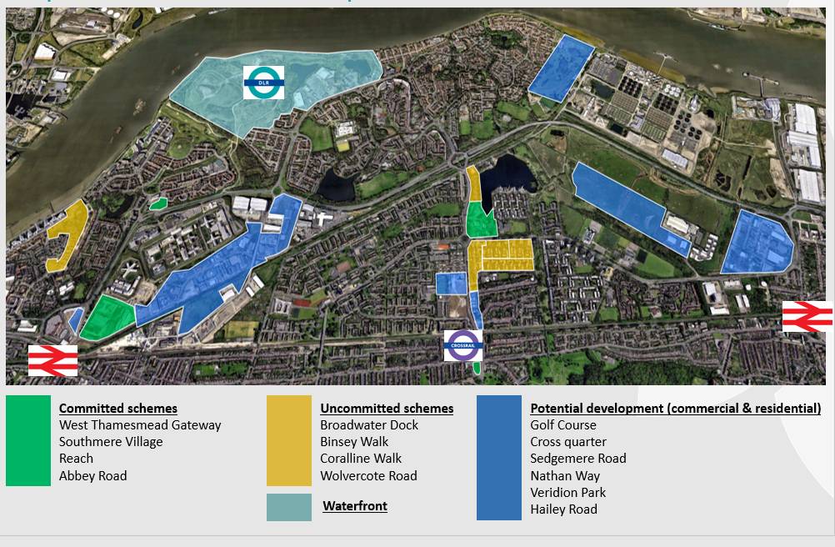
New Developments
Including:
Thamesmead

Slide 6
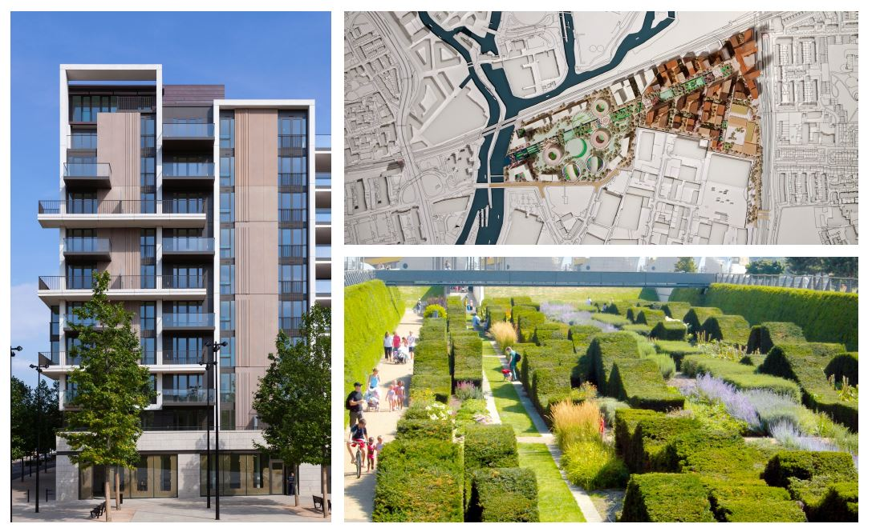
New Developments
Battersea Power Station – 386 units

Slide 7
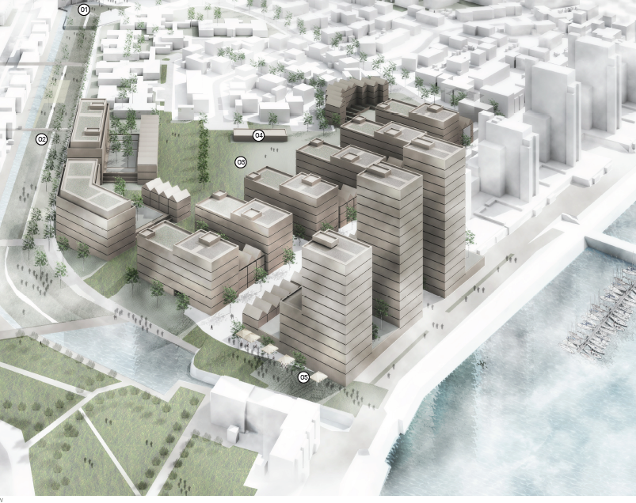
New Developments
Broadwater Dock – 660 units

Slide 8
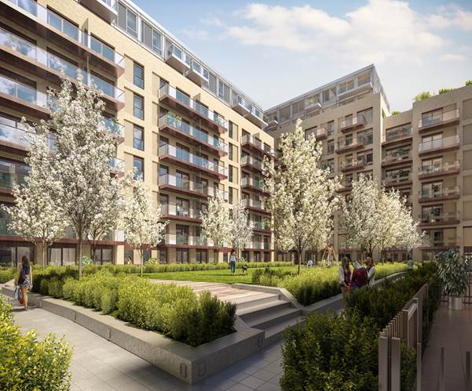
New Developments
Royal Docks – 285 units

Slide 9
Our role in increasing supply
Grant
Sales Risk
Build Cost
Planning
Infrastructure

Slide 10
Other ways forward………………

