Slide 1
The role of private sector investors in supporting Build to Rent
3 May 2018

Slide 2
Agenda
LIV Group and LIV Consult
Rise of the professionalised Private Rented Sector (PRS)
Build to Rent in the PRS
Successful examples
A look to the future

Slide 3
LIV – redefining renting
130+ staff focussed on consultancy, advisory and residential property management to the emerging Build to Rent sector
Over 2,500 Build to Rent units in operation across UK
Director at LIV Consult, the leading specialist Build to Rent consultancy operating across the UK and, shortly, in Ireland.
Holistic advisory services covering design consultancy, investor reporting, strategy and development consultancy
20,000+ Build to Rent units in our consultancy pipeline for institutions, PLC developers, private developers, housebuilders, investors and local authorities

Slide 4
Rise of the Private Rented Sector

Slide 5
Build to Rent
Notes:
Savills / BPF data: 117,893 build to rent units either completed or planned across the UK, including 20,863 completed, 33,075 under construction, and a further 63,955 with planning permission.
In London, there are a total of 60,530 units
Outside London, there are 57,363 units
General rebalancing of investment focus on housing and lower-rise development

Slide 6
What is influencing Build to Rent ambitions?
End of Help to Buy
NPPF focus on rent requirements in local plans
Housing Affordability and Viability SPG 2017, and the Draft London Plan December 2017
Continued institutional interest in BTR
JV / forward-funding with private investors capital to fund pre-planning, construction
Media and public sentiment over premium pricing
Rent growth – CPIH or other index-linked model?
Competition for sites
Provision of discounted market rent offer and negotiation on S106 agreements
Notes:
Planning: Housing Affordability and Viability SPG 2017, and the Draft London Plan December 2017. These documents provide a clear definition of ‘Build to Rent’, which now allows for the unified discussion and consideration of the sector across London.

Slide 7
What can the private sector do?
Identify appropriate sites
Engage local authority to understand professionally-managed product
Engage consultancy partners to design the best product
Partner with capital sources (institutional, funds, private equity + debt)
JV / forward-funding with private investors capital to fund the risk – pre-planning, construction
Private equity to take a short-term view of pipeline and realise the potential

Slide 8
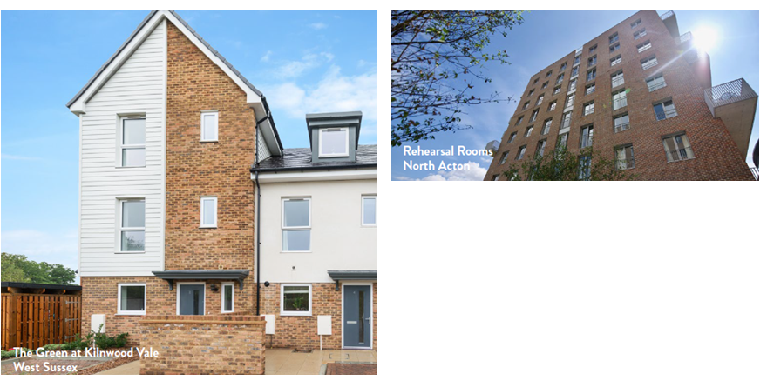
Key LIV Group examples
Notes:
In 2015, M&G Real Estate and Crest Nicholson plc, a leading developer in London and the South East of England, teamed up for a second time to sign a £51.5 million deal to fund, build and let 227 new private rented sector (PRS) homes in Faygate, three miles west of Crawley town centre
In 2014, M&G Real Estate forward-funded the £43.5 million Victoria Square scheme (152 units), now known as Rehearsal Rooms, in North Acton.

Slide 9
Selected key London examples
HUB – M&G Real Estate, Fizzy Living (Multiple Sites)
Galliard Homes – Greystar (Canary Wharf)
Be, Meyer Homes, CNM Estates – Invesco (Multiple Sites)
Many other examples across London and the South East

Slide 10
Conclusion
Private Rented Sector will continue to grow, especially in major cities
Rise of public sector land opportunities
Continuation of private sector expertise to deliver projects
Purpose-built will perform the best in the long-term
Always begin with the end in mind – operational, stabilised and efficent

Slide 11
Ashley Perry, BTR Consultancy Director – LIV Consult @AshleyPerryUK / @LIVConsult

