Slide 1
Offsite
Student Accommodation
www.premiermodular.co.uk

Slide 2
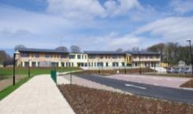
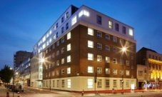

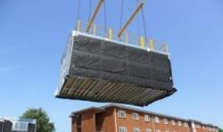


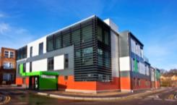
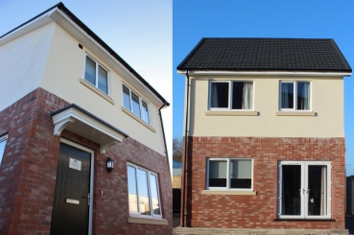
Market Sectors
Student Accommodation
Education
Retail
Defence
Commercial
Hotels & Leisure
Healthcare
Housing & Extra Care

Slide 3
The Market
Student accommodation was a top asset class in 2017.
Record student places for in the 2016/2017 academic year
Universities provide less than a ¼ of required accommodation
Most prominent in London, Edinburgh, Newcastle & Bristol
Oversees students – Globally competitive – High Quality

Slide 4
The Market
Despite intense investment – student to bed ratio rose from 2.1 to 2.3
The International (non EU) student population has risen by 73% in 10 years
Studios are the room type showing fastest growth in PBSA sector
Greater competition between universities – Higher quality teaching & accommodation facilities
Importance of student ‘experience’ at the forefront of competitive gain

Slide 5
Undersupply
HMO’s represent all students
unable to access PBSA or Halls
of Residence
Students will pay significantly
more for PBSA over HMO:
Oxford 75%
Newcastle 73%
Edinburgh 60%
London 58%
Manchester 49%
Average weekly rent ensuite
London - £250
Regional £140

Slide 6
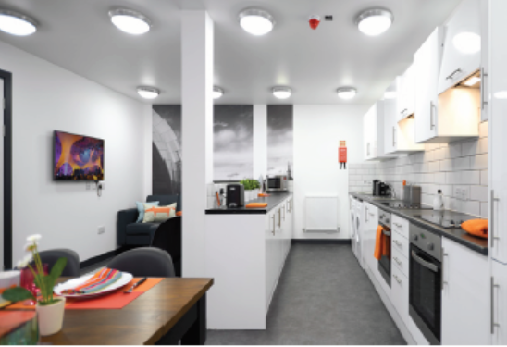
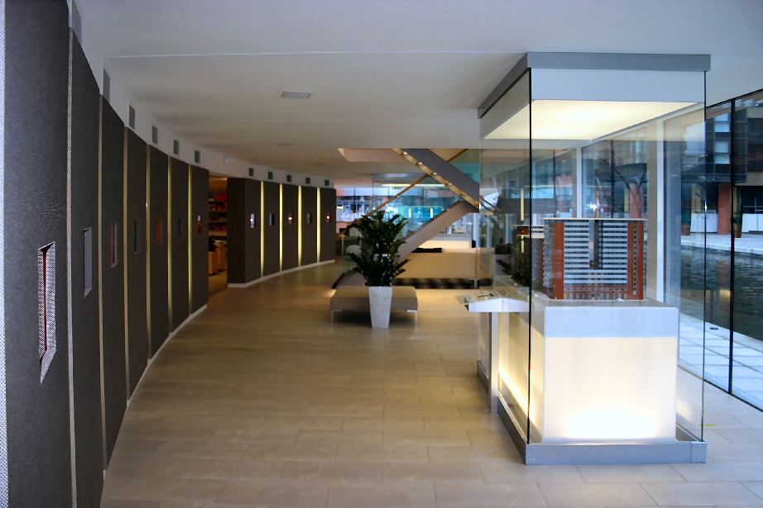
Cores/ Shared Areas
Premplus - Large, open plan room arrangements
Module widths up to 5m, lengths up to 14m supported & ceiling height up to 3.3m
25 storeys as a standalone structure
Shape flexibility, curved or angular modules can be achieved
Options for large glazing and curtain walling
Flexibility to combine with traditional build

Slide 7
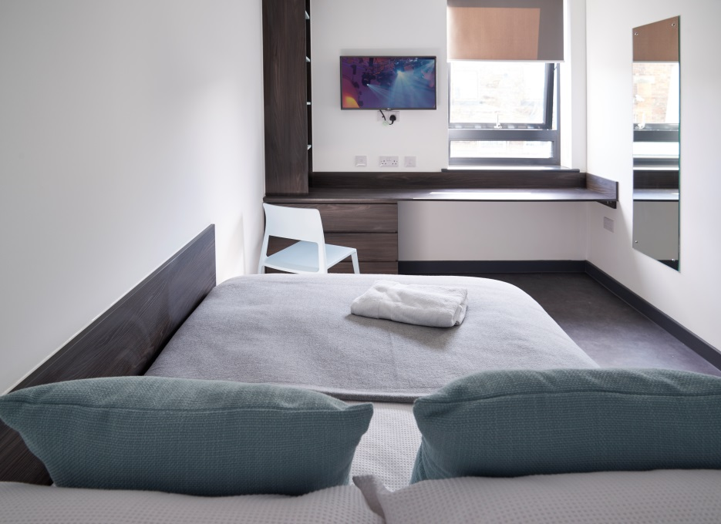
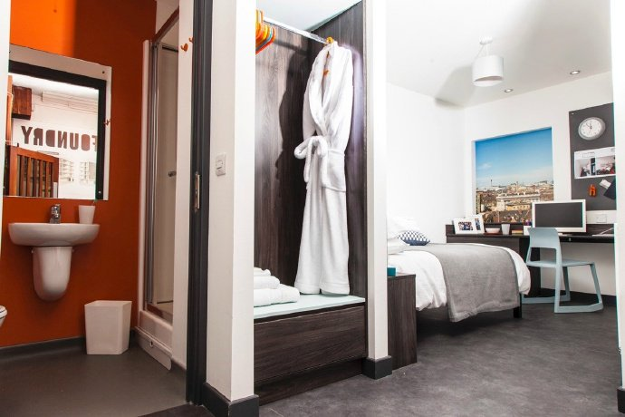
Bedrooms
Light Gauge steel Frame utilising load bearing walls – cost effective solution
Repetitive smaller room sizes
Module widths up to 5m, lengths up to 12m & ceiling height up to 3.3m
7 storeys standalone or 12 storeys tied into a supporting structure
Easily integrated design features such as balconies & dormers
Integration possible with heavier gauge to create stairwells, larger open areas

Slide 8
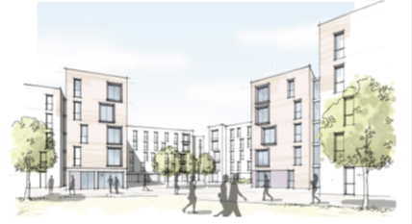
Design Philosophy
Offsite optimised design
Standardised clusters of 8 with individual entrances
Centralised Social areas
Selection of finishes to suit location

Slide 9
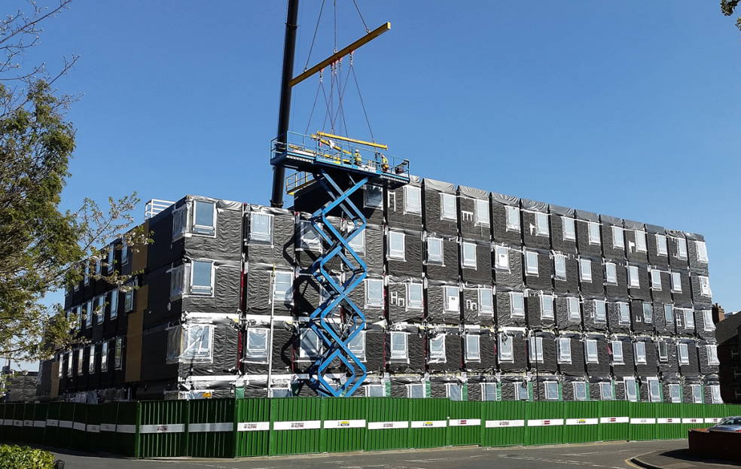
Perfect
Finished Modules
Single module per room, replicated
Double modules for shared space
Room or room plus corridor
Finished room Including furniture
Fully commissioned offsite
Linked service risers
Minimised disroption

Slide 10
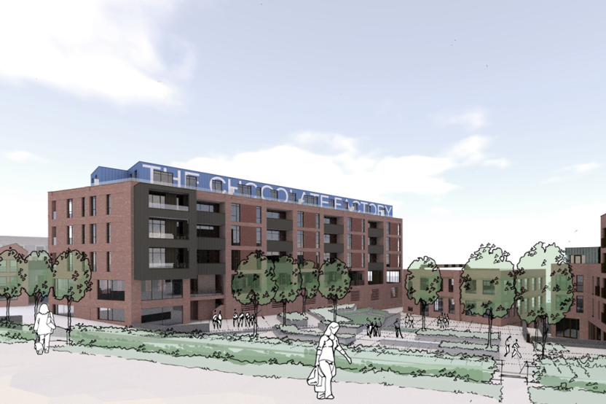
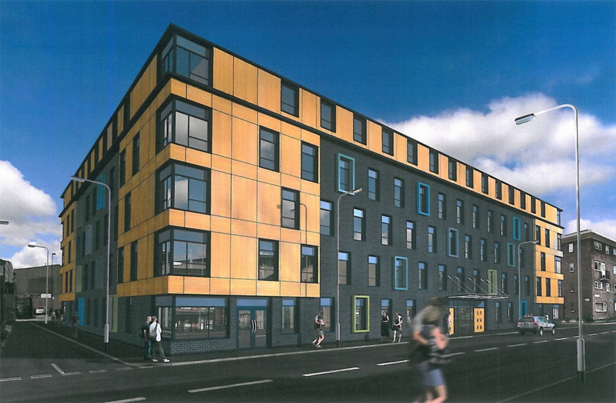
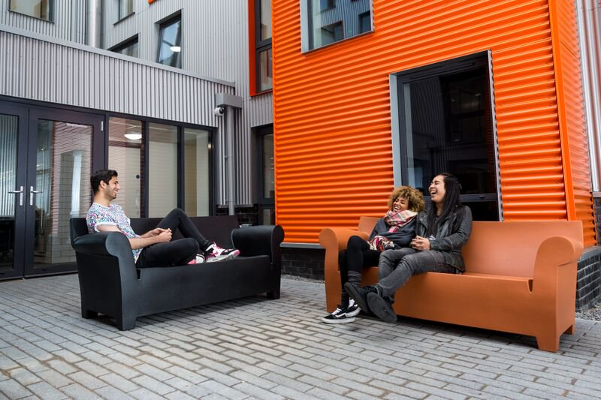
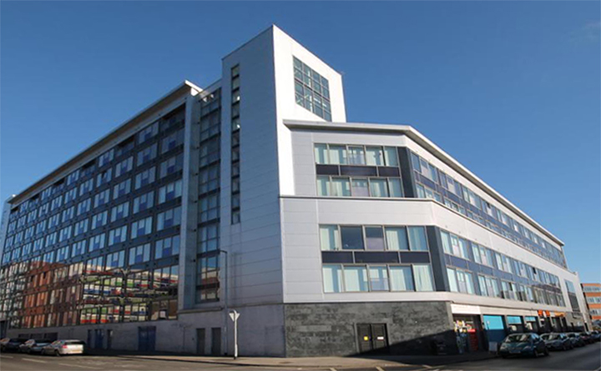
External Appearance

Slide 11
Design Characteristics
Double wall with void
Fire rating 60 mins
Acoustic rating 63RwdB
Duty Rating – Severe
Lightweight Construction – Smaller Foundations & rooftops

Slide 12
Improved Programme - Increased Rental Return
Additional rent from completing build earlier than traditional
 | Based on 58 rooms | Based on 116 rooms | Based on 232 rooms
Region | £k | £k | £k
London | 534 | 1,068 | 2,135
Midlands | 344 | 689 | 1,377
Northeast | 317 | 633 | 1,267
Northwest | 329 | 657 | 1,315
Oxford/Cambridge | 451 | 903 | 1,805
Scotland | 329 | 659 | 1,317
Southeast | 335 | 670 | 1,339
Southwest | 370 | 740 | 1,479
Yorkshire | 292 | 584 | 1,167

Slide 13
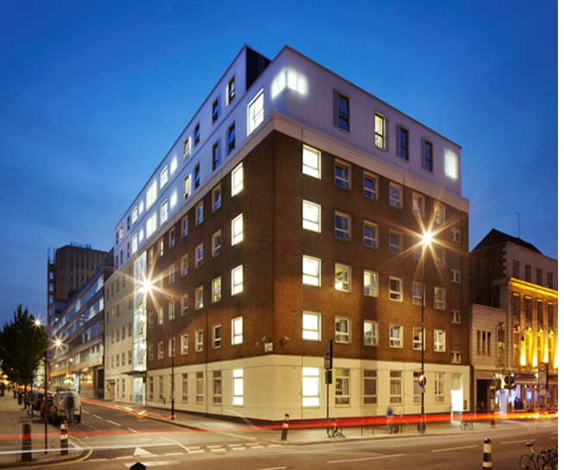
UCL – John Dodgson House
Two storey rooftop extension in Central London
55 Bedrooms with ensuites
Shared space including kitchens, lounges & study rooms
Non reflective glass cladding & green roof
Night time lift
12 weeks on site

Slide 14
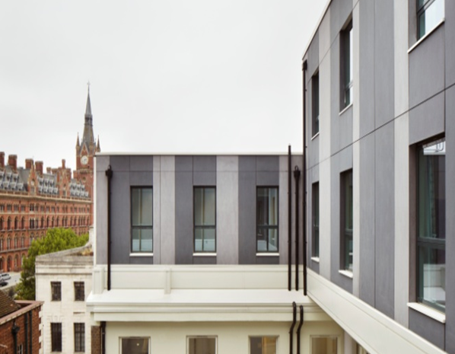
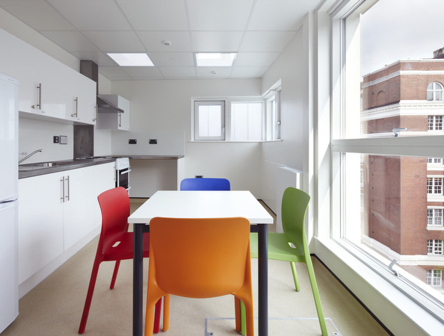
UCL – John Dodgson House

Slide 15
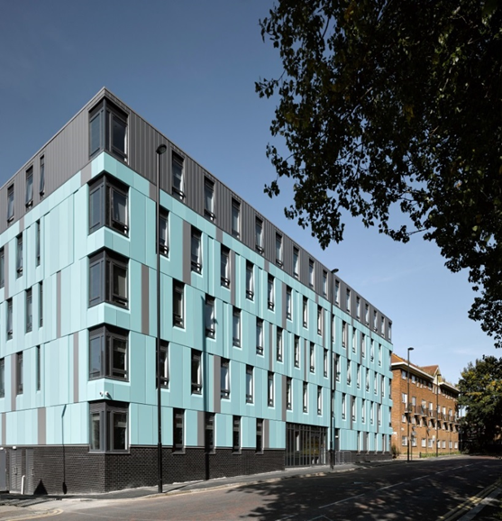
The Foundry, Newcastle
5 storey building Newcastle City Centre
54 Studio flats, 150 en-suite bedrooms and 2 accessible bedrooms
Immovable programme for September intake
300 modules fully fitted out in the factory
42 weeks on site
Won ‘Project of the Year’ 2016

Slide 16
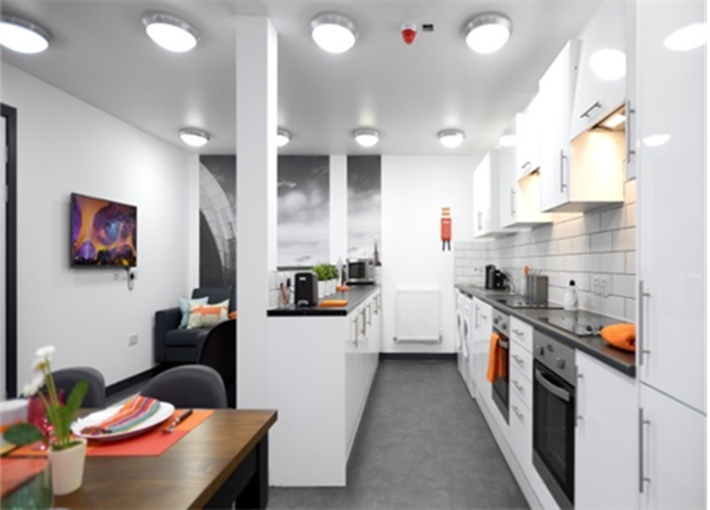
The Foundry, Newcastle

