Slide 1
Offsite Construction – a client’s view Paul Bandeen Director, Accommodation Services April 2018

Slide 2
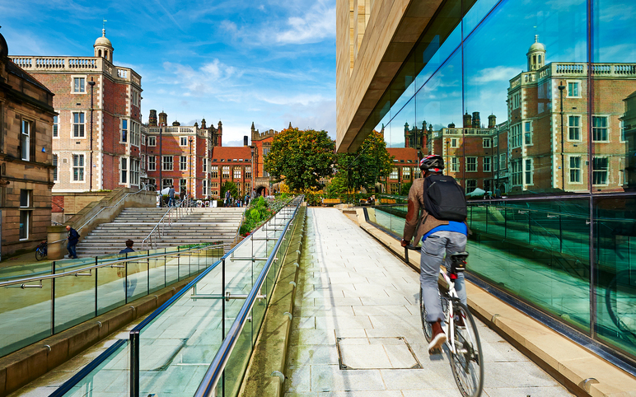
The Newcastle experience
Notes:
Good afternoon, and thank you for the opportunity to speak at today’s Conference.
My name is Paul Bandeen and I am Head of Accommodation & Residential Services at Newcastle University, and today I’d like to share our experiences of off-site construction at Newcastle.

Slide 3
Presentation overview
Key objective
Specification and brief
Why modular ?
Learning points
Park View Student Village
Notes:
During the presentation I would like to firstly put in to context where Newcastle was in terms of the residential estate, what our key objective was and what we wanted to achieve with our student accommodation, why this then led us to an off-site modular solution, what we learned as a client and design team and finally to illustrate this in practice through the latest new build scheme itself, Park View Student Village.

Slide 4
Our key objective
To ensure a sufficient range and diversity of accommodation is available to meet the changing demands and expectations of students, with regard to security, condition, fitness for purpose, facilities, amenity provision and welfare support
Notes:
The key objective is clear, namely we wanted to provide a range and diversity of housing that could adapt and meet the ever changing needs of current and future students with regard to the key factors of security, condition, facilities, amenities and welfare support
We believed that much of this could be provided by getting the built environment right so our first strategy was published in 2010 with the onus on improving facilities and amenities through increasing the number of ensuite study bedrooms, in 2014 the strategy was reviewed and looked to improve on condition and fitness for purpose by selective demolition, disposal and new build schemes which will be covered later
Finally, the latest version of the strategy concentrates on location and nearness to campus by having the majority of accommodation in three student villages, a mixture of new build and redevelopments, within walking distance of the two main areas of the university

Slide 5
Specification and brief
Accommodation demonstrating innovative approach to modern student living
University environmental and sustainability policies
UUK code of practice
Internal specifications
Student and community involvement
Notes:
It was also important that any redevelopment met or complied with a number of key performance requirements (Go through each bullet point)
For our latest development it became clear that for us the answer was modular construction

Slide 6
Why modular ?
Shorter construction time
Quicker financial returns
Better phasing and planning
Consistent and enhanced quality
Environmental factors
Reduced site labour requirements
Safer construction
Reduced disruption
Notes:
Modular construction offered a number of district advantages for us as a university, namely:
A shorter construction time, almost 12 months for PVSV which means
A quicker financial return both in terms of income, ie. rents in earlier and rent loss
Modular also gave us better phasing and planning and an easier to follow works programme
Because the modules come finished, there was a consistency in quality due largely to the factory control and inspection process
The factory production techniques also led to less waste being produced, in addition to less waste on actual site. Reports were also required to demonstrate other environmental efficiencies such as CO2 emissions
Reduced site labour requirements meant no disruptions due to lack of certain trades but also a safer site because of the reduced man hours
Finally, as with all major projects, especially in residential areas, harmony with neighbours crucial, and modular construction has led to reduced noise, mess etc. and fewer complaints!

Slide 7
Learning points
Not all modules are the same – know what you want
Early appointment of and engagement with modular designer will maximise design efficiency
Value engineering
Notes:
The whole process has been a learning curve for us. I would say, from the outset be clear as to the different types of modular construction and which one suites your particular project best.
The sooner you decide this and then appoint the modular contractor the better, as early discussions and review will lead to a much more efficient design process, maximising value engineering and getting something to meet your needs – a bespoke modular system!

Slide 8
Park View Student Village
£75.5 million project
Galliford Try main contractor
CIMC modular provider
Two year construction programme
1,277 en suite rooms
Opens September 2018

Slide 20
Thank you

Slide 21
