Slide 1
Light Gauge Steel Frame
Offsite Construction in Practice

Slide 2
Peter Boundy
Kier Design Manager
Design Lead for University of Northampton Student Residences

Slide 3
Project Background
Waterside Campus
Full Campus re-location
Residences consist of 994 Student Rooms and associated ancillary spaces
Cluster Flats and Townhouses
Metframe solution chosen
Largest LGS student residence scheme
First to be delivered to BIM Level 2 standard
Use of pre-fabricated bathroom pods

Slide 4
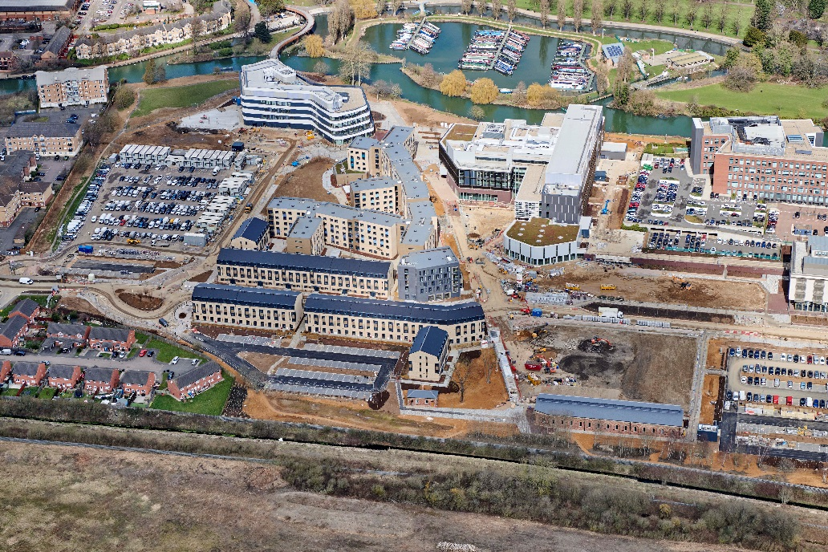
Why Offsite?
Main Project Challenges
Programme
Site Logistics
Scale
Speed and Complexity of overlapping elements
Space for materials at a premium
994 rooms over a series of buildings and differing building types

Slide 5
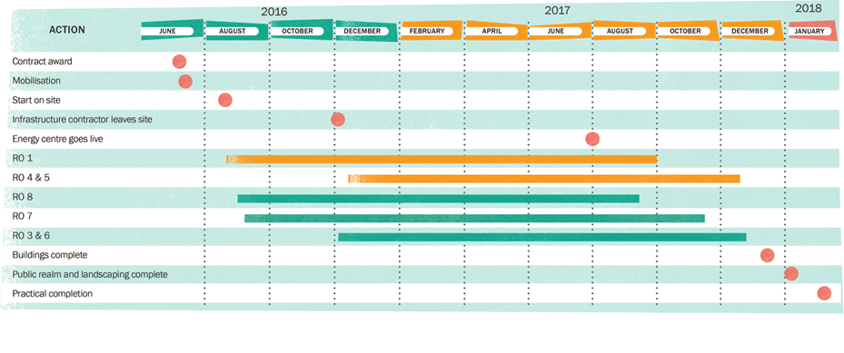
Why Offsite?
Outline Construction Programme
Notes:
Key to Student Accommodation is sufficient time for finishing trades. Reduction in frame erection and earlier watertightness allows more time for these key trades

Slide 6
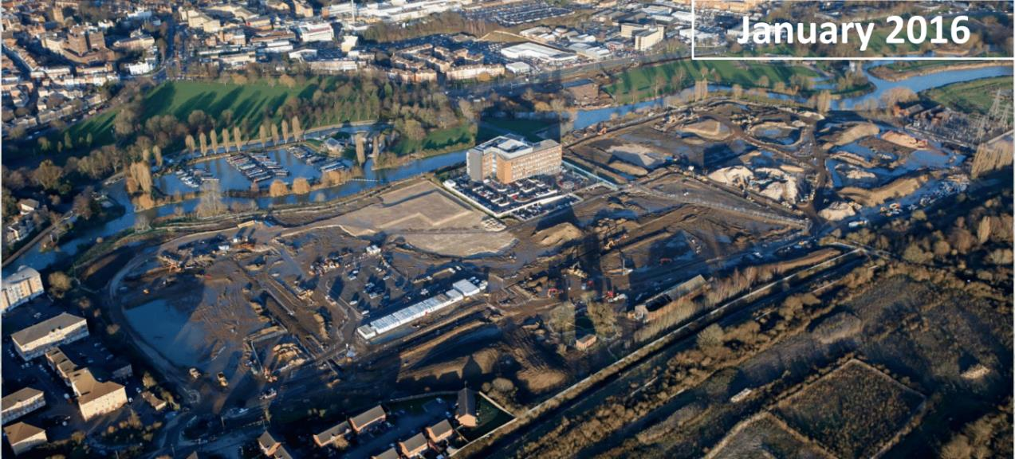
Why Offsite?
Up to 40% faster delivery than traditional construction methods

Slide 7
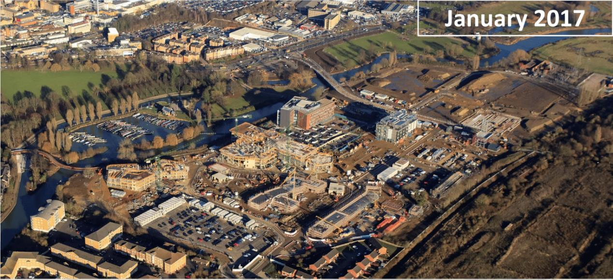
Why Offsite?

Slide 8
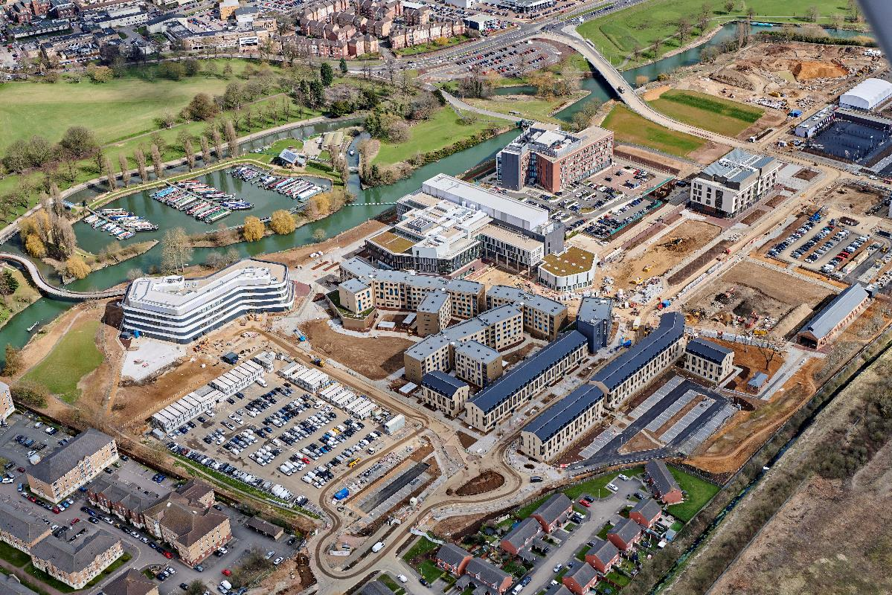
Why Offsite?
March 2018

Slide 9
Why Offsite?
Collaboration & Innovation
Notes:
Innovation
The use of BIM to coordinate with other trades, as well as being able to incorporate other bespoke, offsite manufactured products into the system to achieve an architectural individual selection of buildings. Furthermore, the development of bespoke Metframe details, not previously used elsewhere, added to this innovative approach.
Collaboration
The bespoke nature of the collaboration between Metsec as the designer / provider and their two installers working together simultaneously. This highlights the technological benefits of BIM along with introducing a new, co-operative way of working to achieve a better end product.

Slide 10
Why Offsite?
Collaboration & Innovation
BIM Level 2 Capabilities
The Metframe solution utilised full BIM Level 2 capabilities, including a complete 3D model of each building to allow full coordination with other designs, such as facades and M&E installations

Slide 11
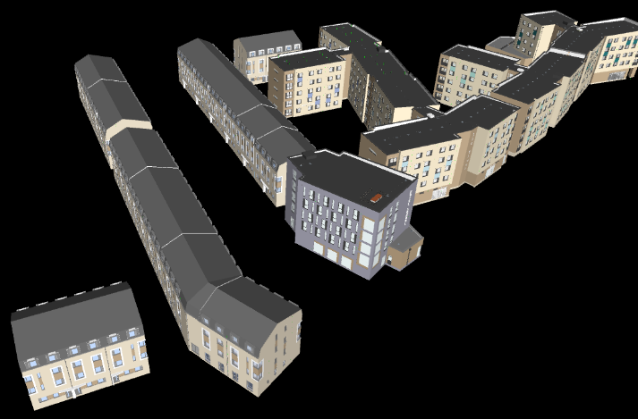
Why Offsite?
Collaboration & Innovation
BIM Level 2 allowed for a virtual build first, meaning problems could be ironed out prior to actual construction
Clash detection with trades, most importantly MEP
The use of this technology provides certainty in a digital age

Slide 12
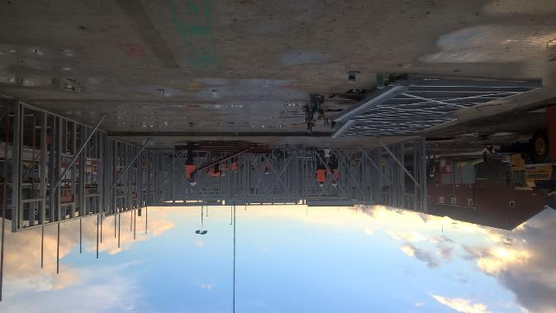
Why Offsite?
Driving Efficiency & Quality
Prefabricated Panels
A Lightweight Structure
Less Work in the Ground
Design Certainty
Reduction in foundation and supporting structure
Reduced Risk
Certainty, Clarity & Design Standardisation

Slide 13
Why Offsite?
Sustainability
Zero Waste
Offsite construction = efficient system design and panel layout
Erection factory conditions = reduced waste
More efficient deliveries = reduced carbon footprint

Slide 14
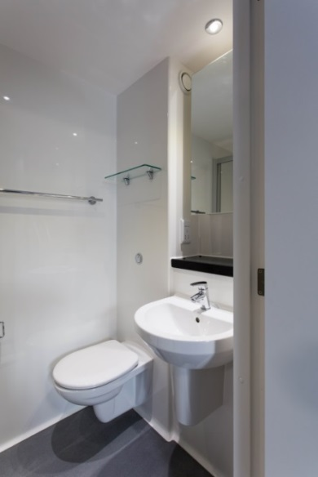
Why Offsite?
Prefabricated Bathrooms
Quality Assurance
Reduction in “wet trades”
Further programme efficiencies and surety
Design Standardisation

Slide 17
Why Offsite?
Summary
Speed of Construction
Quality of Product
Design Standardisation
Sustainability
Efficiencies in Associated Designs

