Slide 2
The national picture
Homes needed

Slide 3
Our ambitions
over 5 years

Slide 4
Modern methods of construction

Slide 5
Innovation Village

Slide 6
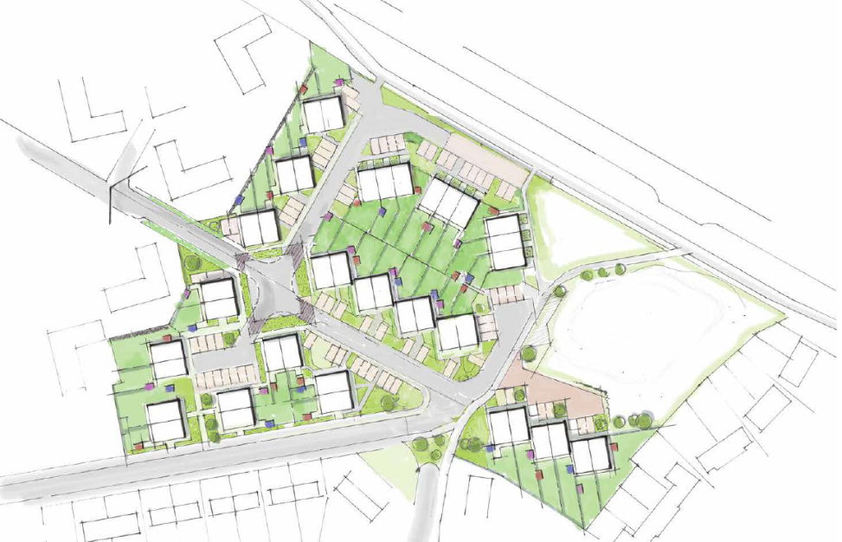
Innovation village

Slide 7
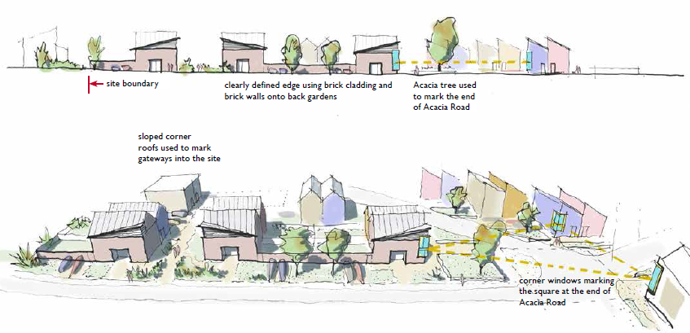

Slide 8
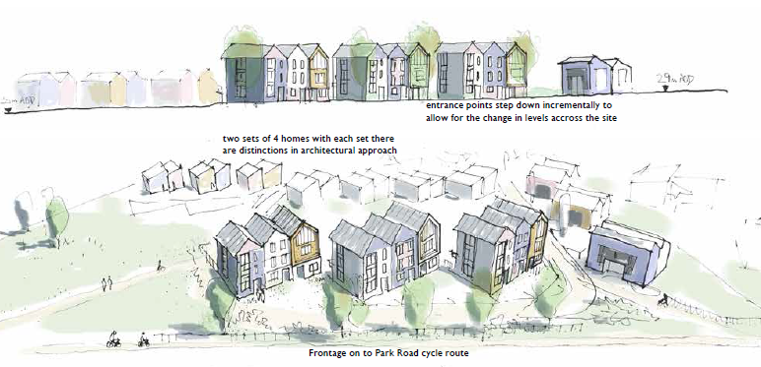

Slide 9
Three things to test
The modular methods
Electric heating methods
Smart homes and technologies

Slide 10
Our selection process
Design flexibility
Affordability
Mortgageability
Build warranties
Insurability
Market analysis identified 12 potential suitable suppliers
8 of the 12 were shortlisted to interview and assessed
5 suppliers were selected for the project

Slide 11
Our suppliers
Ilke – volumetric light steel frame (good affordability for volumetric)
Icarus – panelised light steel frame (good design flexibility, fewer constraints and logistical challenges than volumetric)
Xella – aerated concrete panels (good design flexibility, fewer constraints and logistical challenges than volumetric, new to residential UK market)
Premier – volumetric light steel frame (good design flexibility for volumetric, experience of delivering)
Simply Modular – volumetric timber frame (good design flexibility, smaller modules for easier transportation)

Slide 12
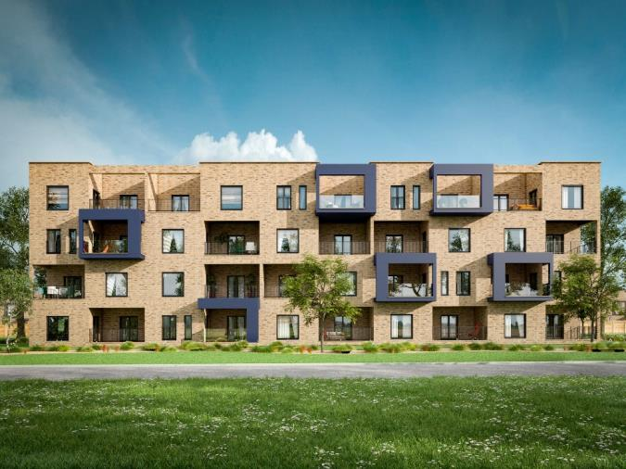
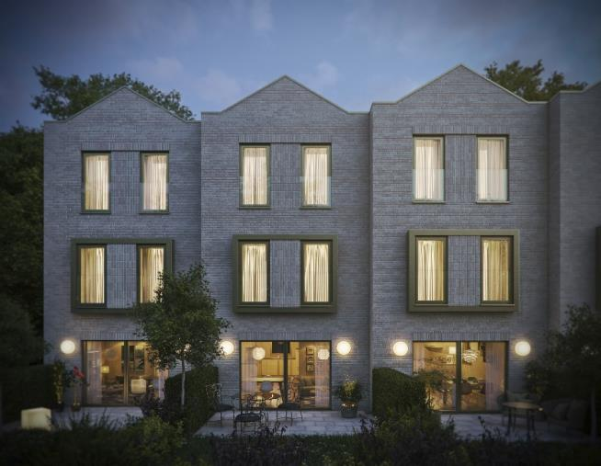
Ilke – volumetric light steel frame

Slide 13
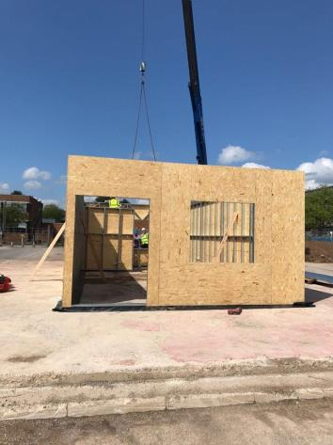
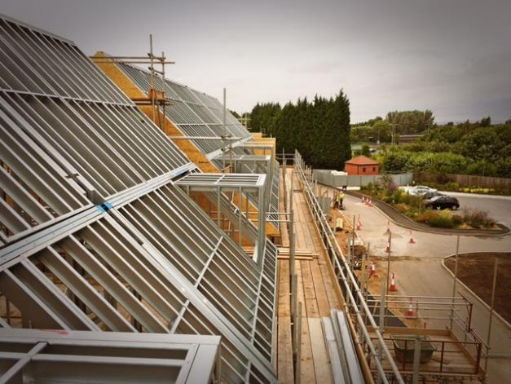
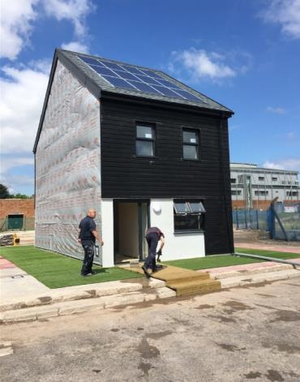
Icarus – panelised light steel frame

Slide 14
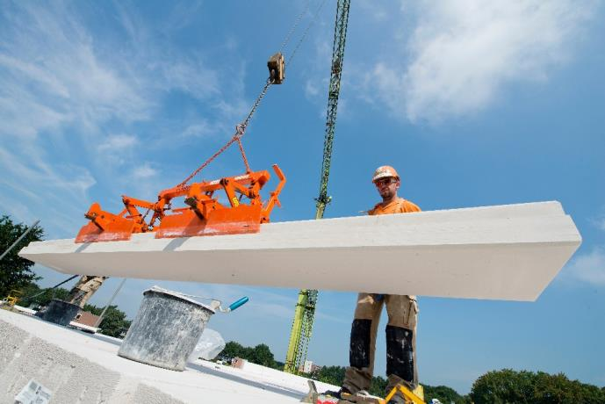
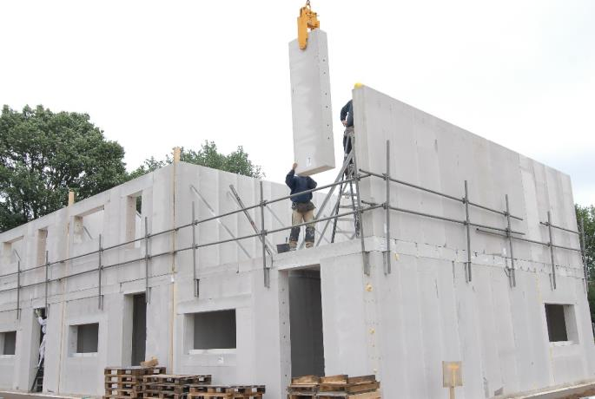
Xella – aerated concrete panels

Slide 15
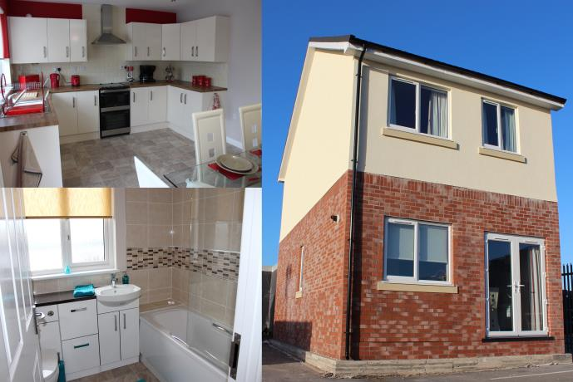
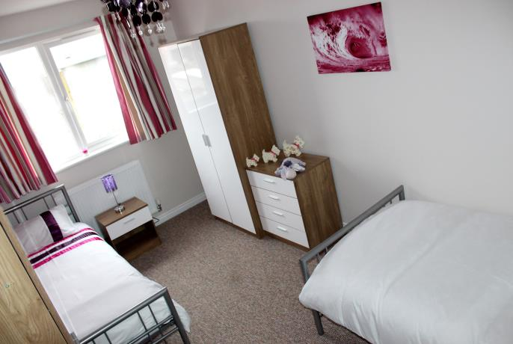
Premier – volumetric light steel frame

Slide 16
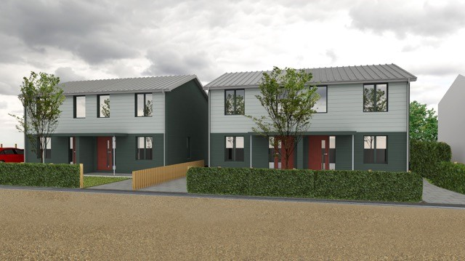
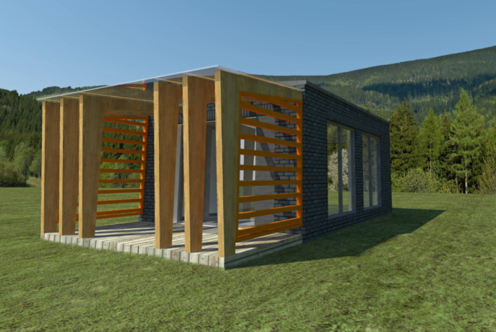
Simply Modular – volumetric timber frame

Slide 17
Three heating systems
Communal borehole ground array with individual ground source heat pumps provided to each property
Enhanced fabric energy efficiency, highly insulated electric storage heaters and phase change store providing domestic hot water
PV, air source heat pump and phase change heat store providing domestic hot water
The options will inform our heating system decisions for our future development programme, moving towards a low carbon heat future

Slide 18
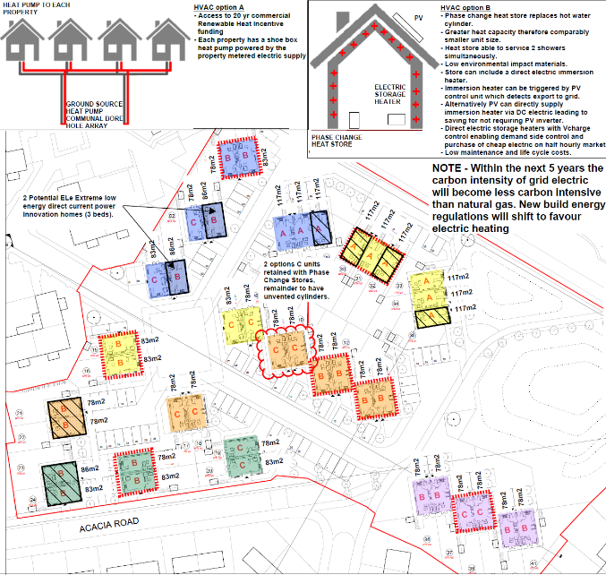

Slide 19
CIBSEJournal
April 2018

Slide 20
Smart homes

Slide 21
Timeline so far
2017 |  |  |  |  | 2018
Aug | Sep | Oct | Nov | Dec | Jan | Feb | Mar | Apr
Project start
Planning submission
23rd October
Planning detail
20th November
Planning Committee
approval 24th January
Groundworks and infrastructure start on site
Homes England grant approved

Slide 22
What’s next…
Groundworks and infrastructure start on site
Superstructure start on site
First homes occupied
Exhibition of the North

Slide 23
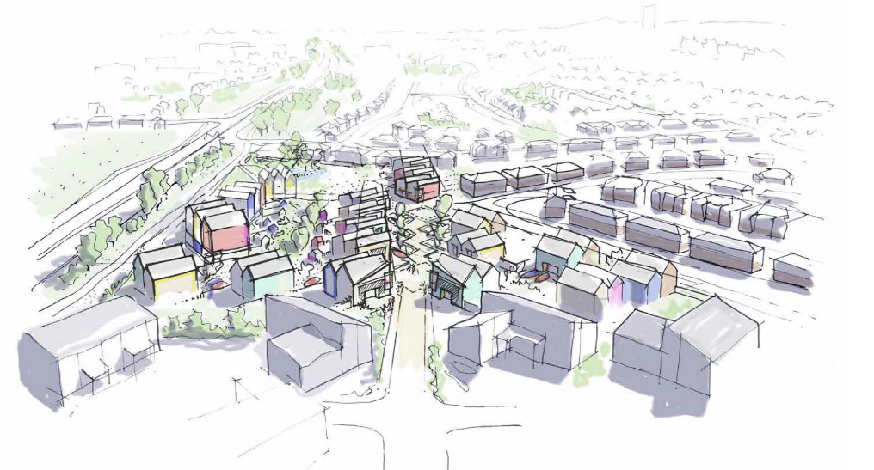

Slide 24
Any questions?

