Slide 1
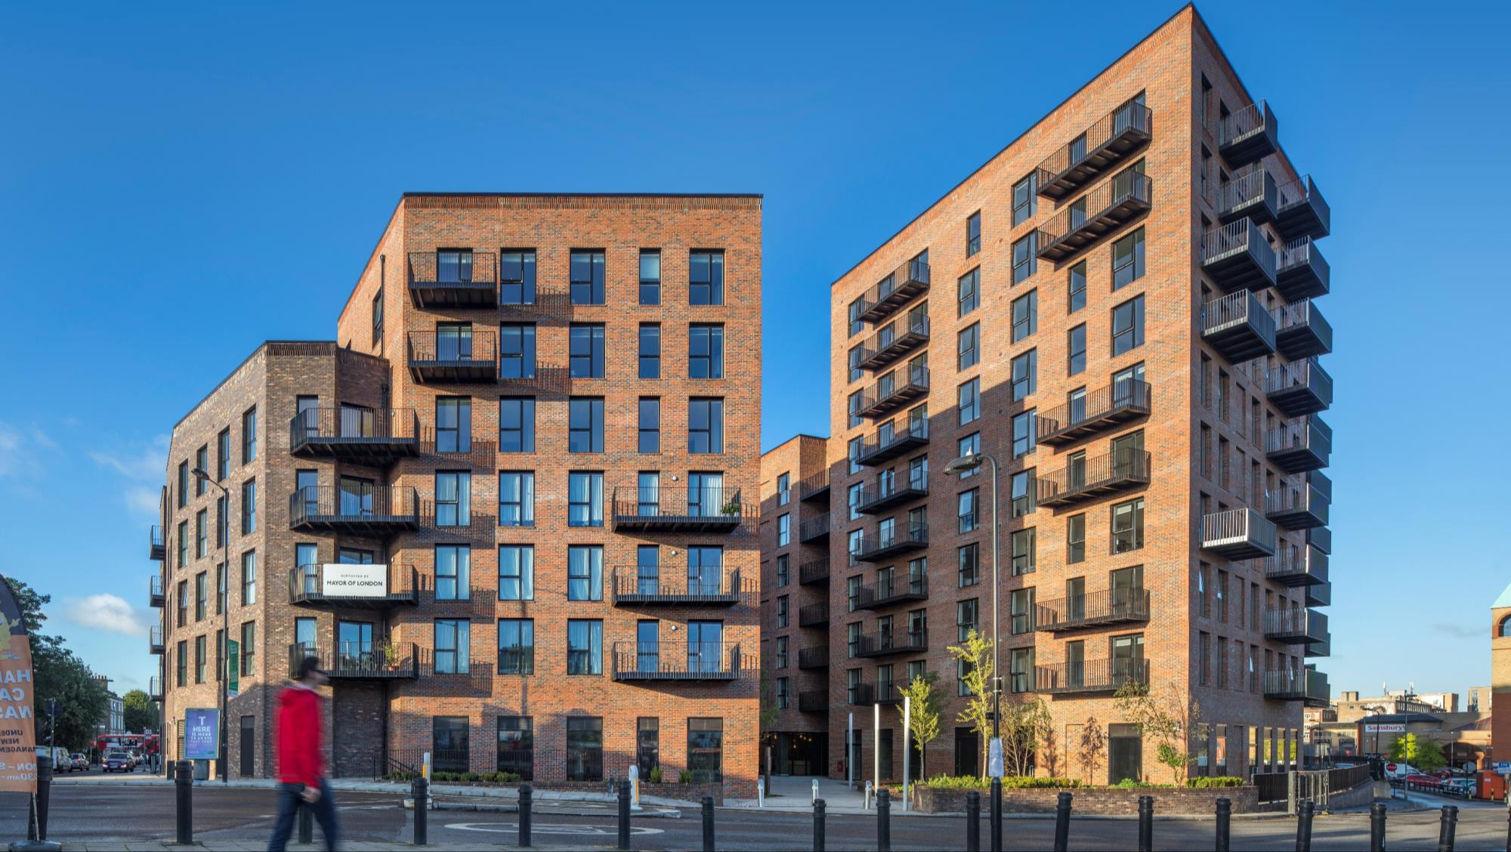
Dalston Lane, Hackney Wayne Yeomans – B&K Structures

Slide 2
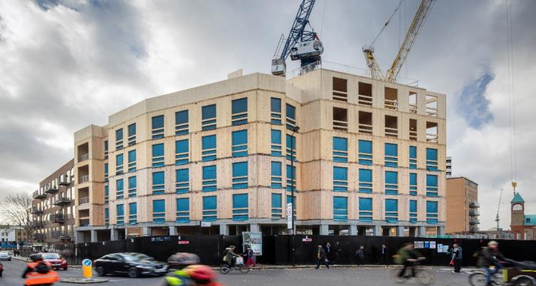
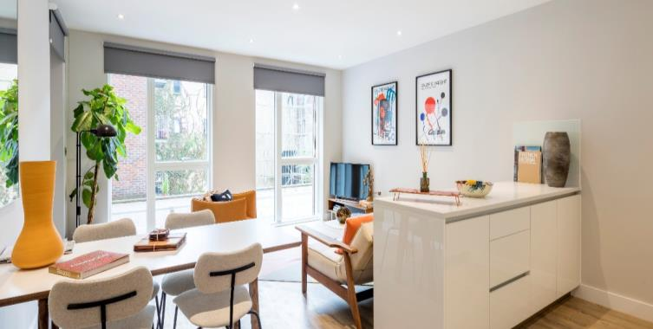
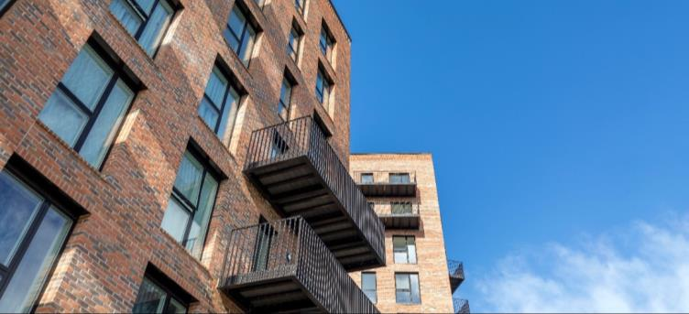
about us….
Over 40 years experience
Forecasting £30m turnover for 2018/19
Part of Bowmer & Kirkland, a 1bn turnover Construction group
Financially robust
Main products including CLT, Glulam, Structural Steelwork, Wall Cassettes, Roof Cassettes
In-house Structural Engineers
plus external engineering partners
In-house 3D cad technicians, working to BIM Level 2 protocols
In-house Project Delivery Teams
Directly employed Site Management
Dedicated QA / Environmental Management
Dedicated Health & Safety Management

Slide 3
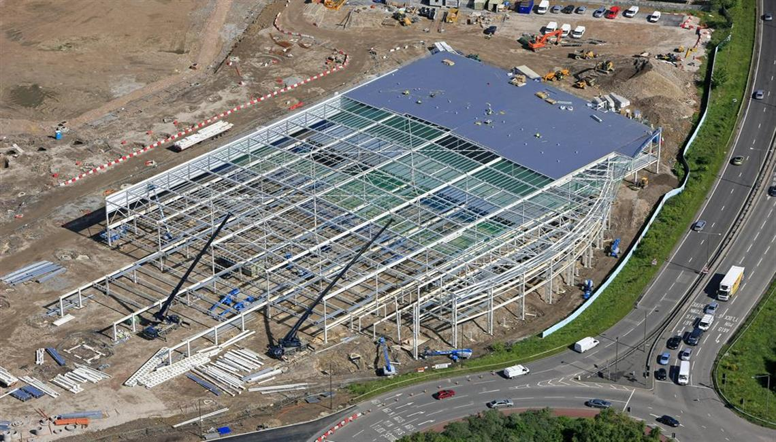
Where we started….

Slide 4
Dealing with the challenges faced by housing
01. Creating high quality housing quickly
02. Shortening construction periods for private developers – realising earlier return on investment
03. Ever increasing traditional build costs coupled lack of affordable land and shortage of skilled site labour
04. Maximising value to tenants through sustainability and innovation

Slide 5
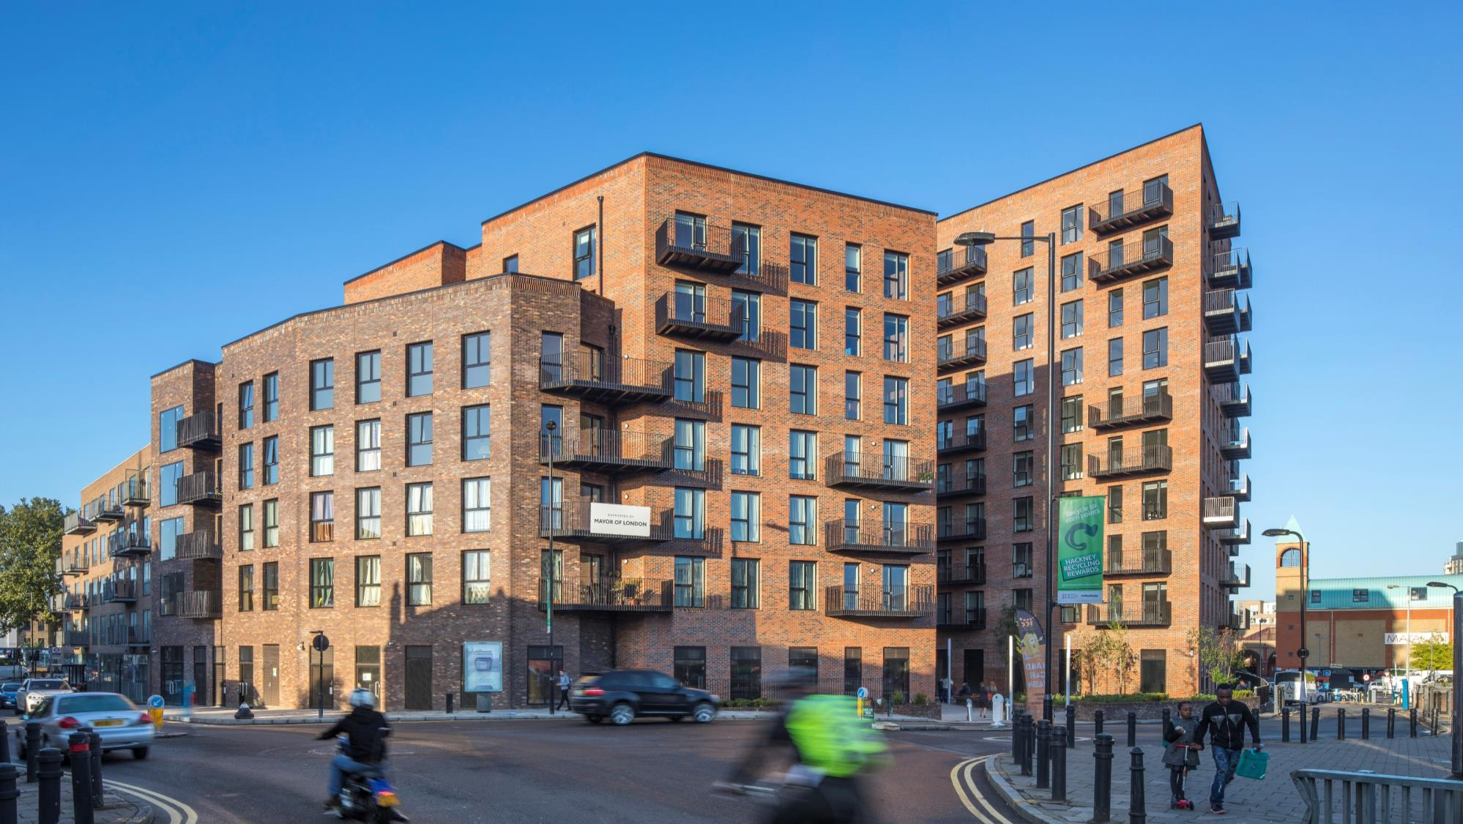
about Dalston Lane….
Still one of the UK’s tallest timber structures, standing over 33m
Still one of the world’s largest CLT buildings by volume of CLT
10 storeys at highest point
121 units, expandable to 141 units
CLT weighing 1/5 of a reinforced concrete frame alternative
80% reduction in deliveries
Approximately 4,650m³ of CLT
3,460m² of commercial space
10,850m² of residential accommodation

Slide 6
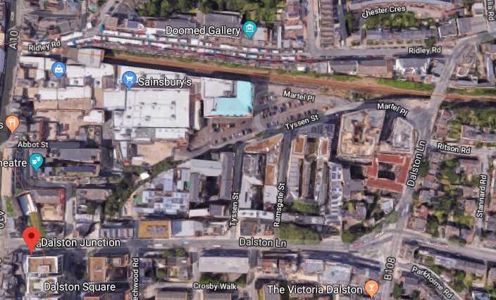
about Dalston Lane….
Challenging Site
Railway Line to the North of the Site
Crossrail 2 was originally anticipated to run under the site
‘Hot Spot’ zones across the site added further complication to the foundation design. These zones were ‘no go’ areas for piles
Weight factor of the original RC frame design was adding to the challenges of the foundation design on this site

Slide 7
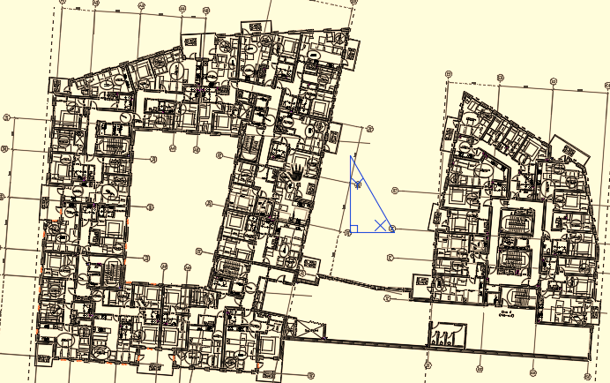
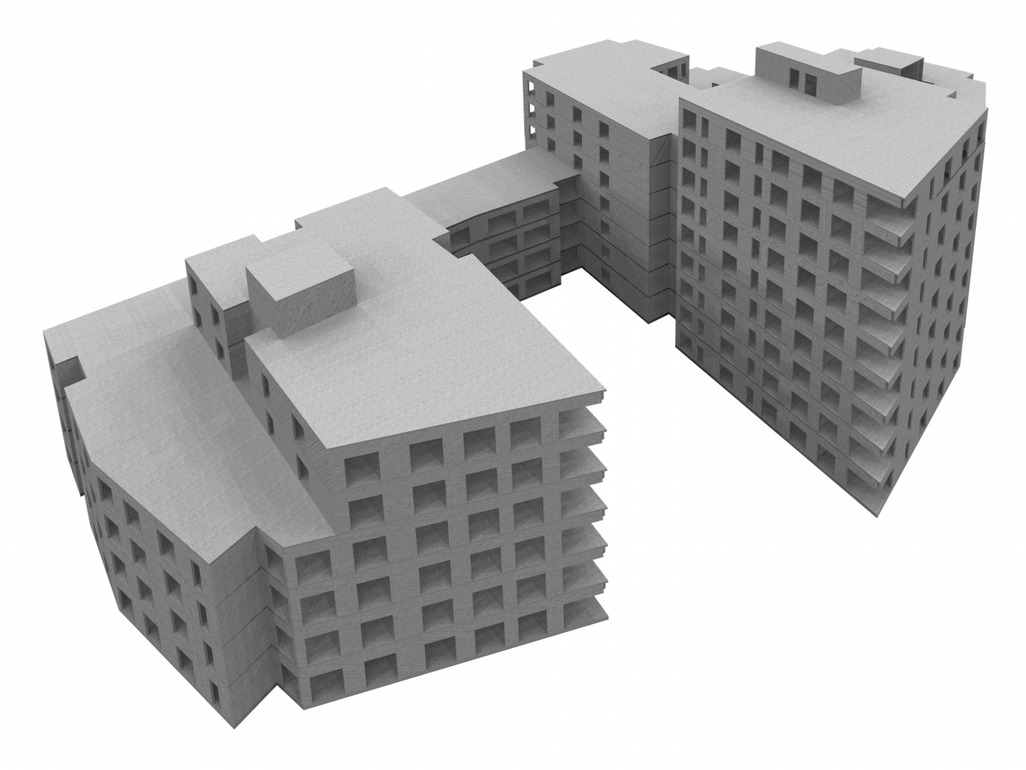
Original Concept….RC
10,700 TONNES OF CONCRETE
Original design intent was an RC frame throughout, and included 700 tonnes of rebar reinforcement

Slide 8
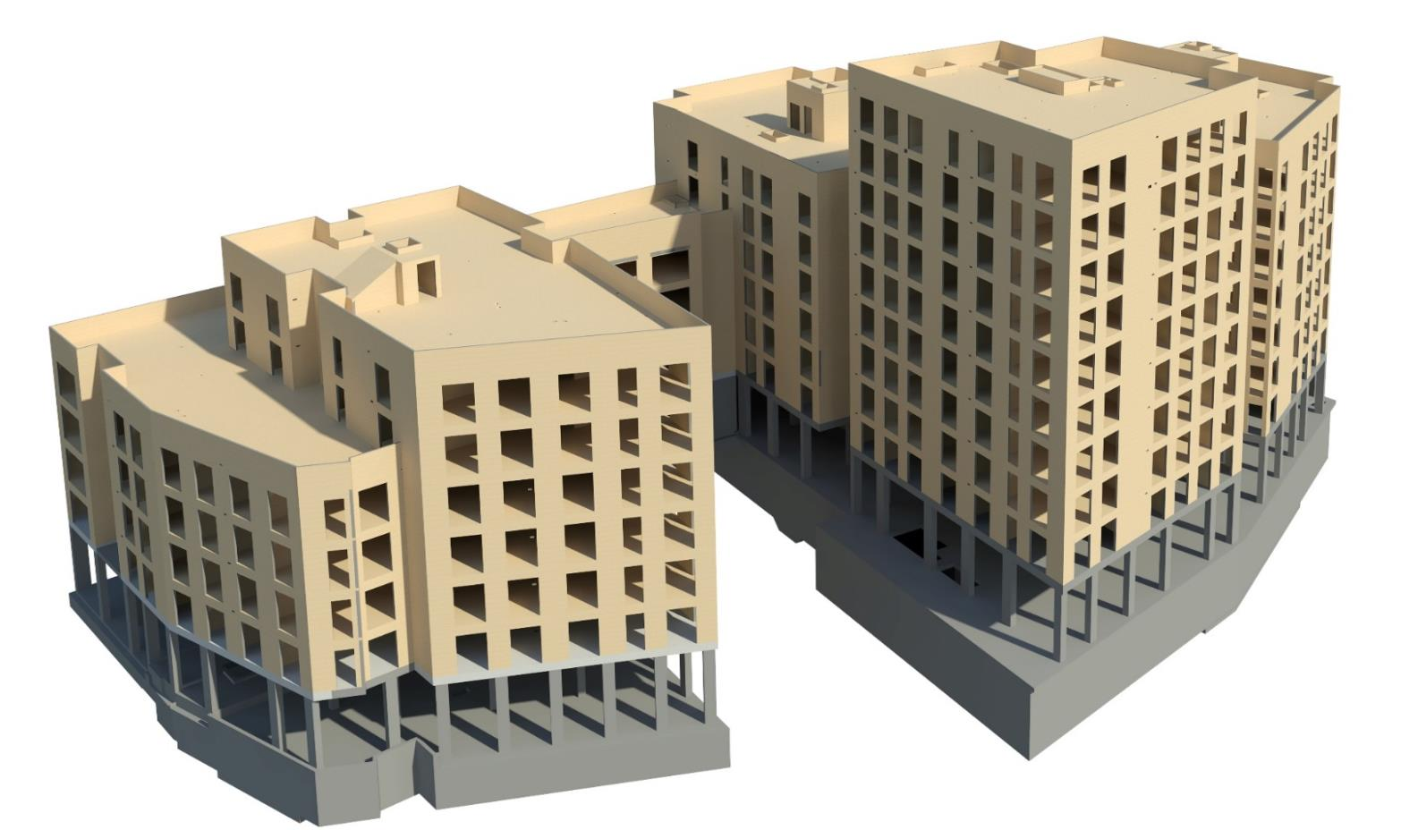
Mass Timber Choice…..
2,300 TONNES OF CLT / RC HYBRID
RC Frame from basement to first floor
CLT utilised for all upper floors
Significant benefit to foundation design

Slide 9
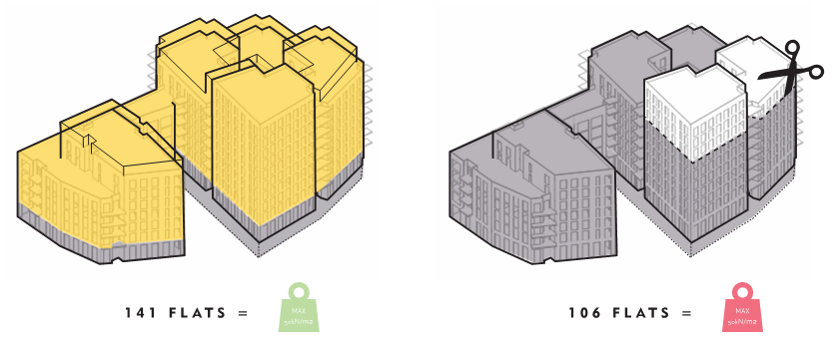
Benefits of a CLT Hybrid
more units achievable compared to original RC frame design

Slide 10
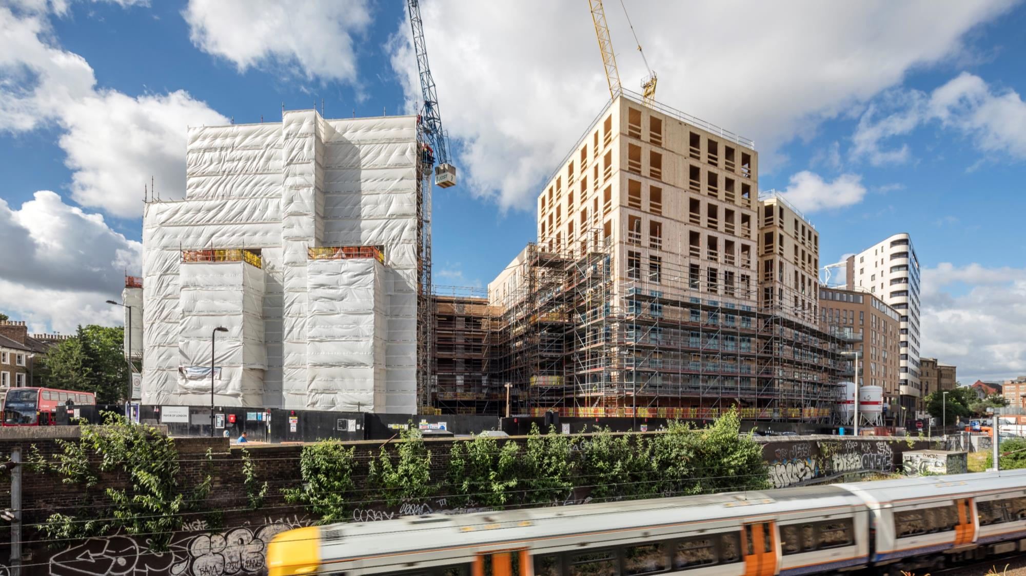
programme benefits…..
21 week installation programme for the CLT works, using 1-site based tower crane for offloading, distribution and installation of materials
BKS Installation team consisted of 8-erectors
1-non-working BKS site supervisor
1-resident BKS site manager
Reduced amount of site personnel minimises the disruption to local community
Some 60-70% less material delivery vehicles

Slide 11
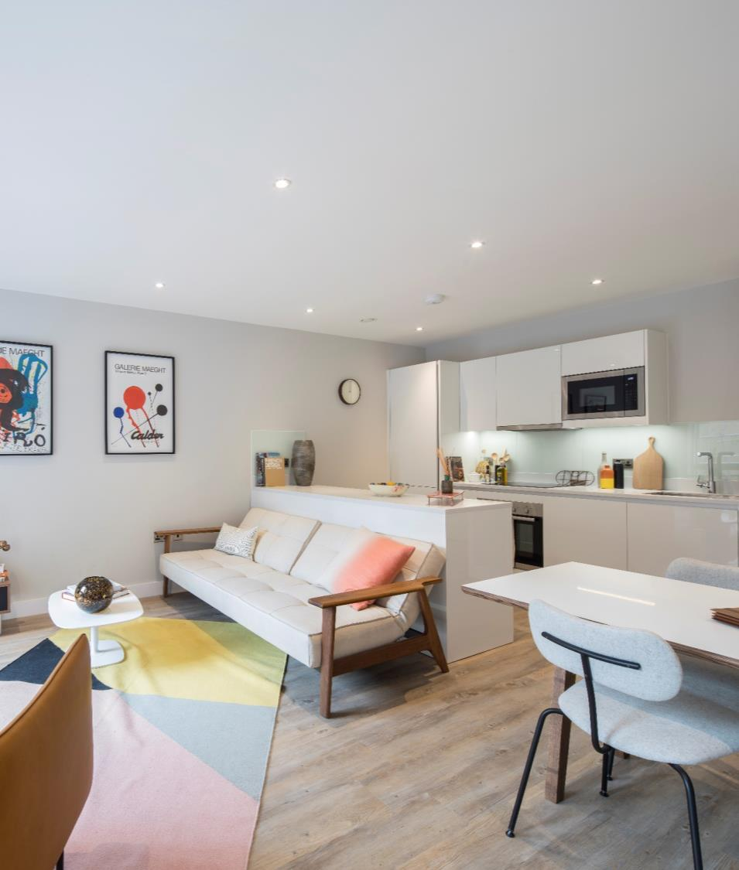
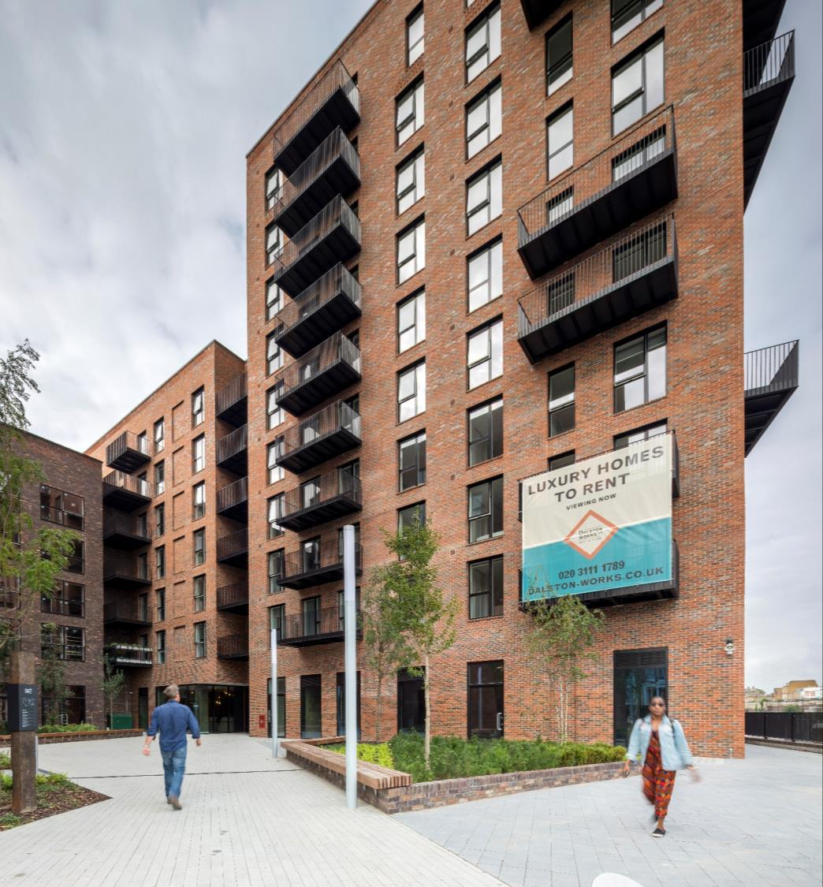
post completion results….
Average Air Permeability value of 2.37 (m3/(h.m2)
Airborne Sound Insulation Tests:
Floors, source room Lounge/Kitchen and receiving room Lounge/Kitchen, rating 53(dB)
Walls, source room Lounge/Kitchen and receiving room Bedroom, rating 51(dB)
Impact Sound Insulation Tests:
source room Lounge/Kitchen and receiving room Lounge/Kitchen, rating 51(dB)
source room Bedroom and receiving room Bedroom, rating 45(dB)

Slide 12
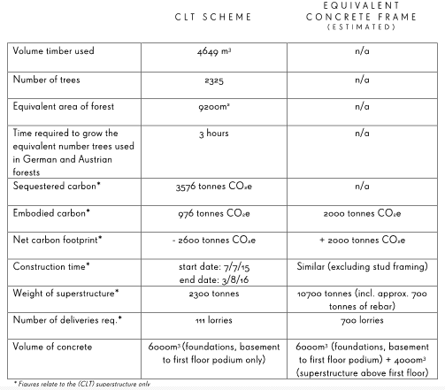
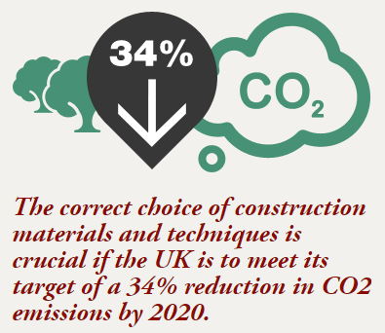
a few stats……..
Co2 saving could mean that every resident in this development could run a car for 14 years without producing any emissions !

Slide 13
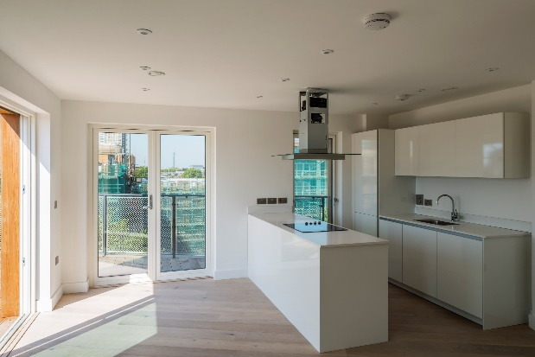
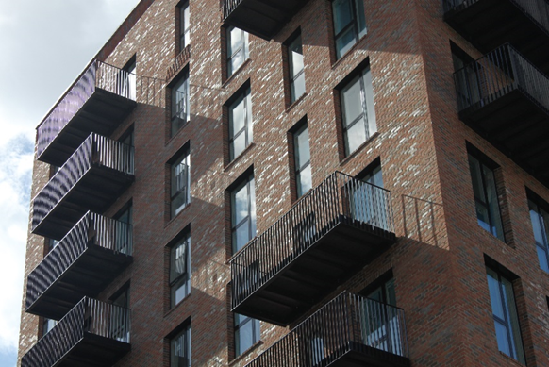
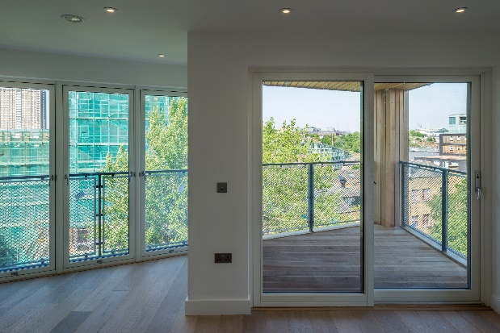
Higher Rise…..

Slide 14
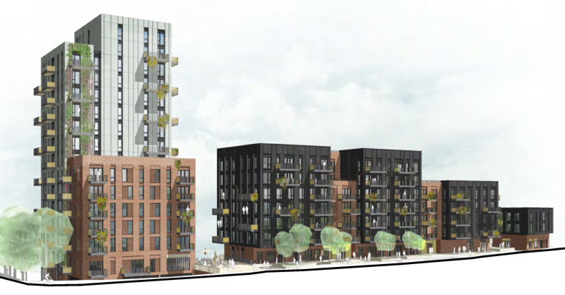
Bath Road, Bristol…..

Slide 15
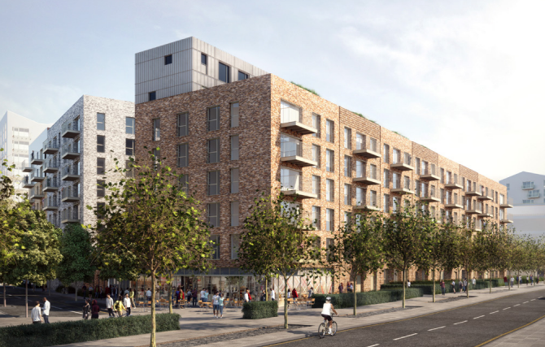
Larger Developments…..

Slide 16
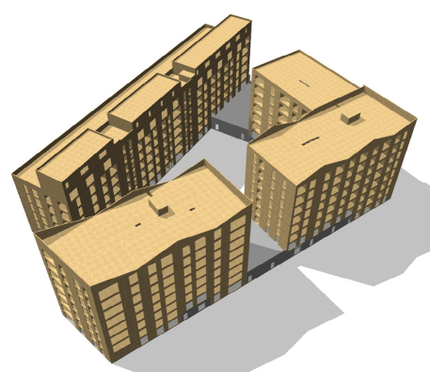
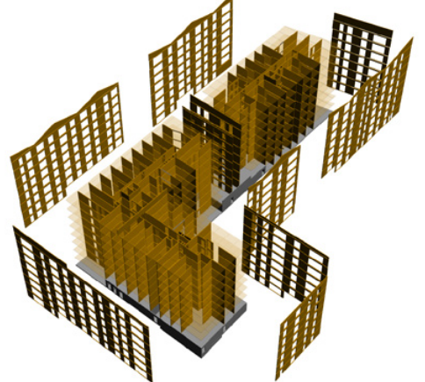
Larger Developments…..

Slide 17
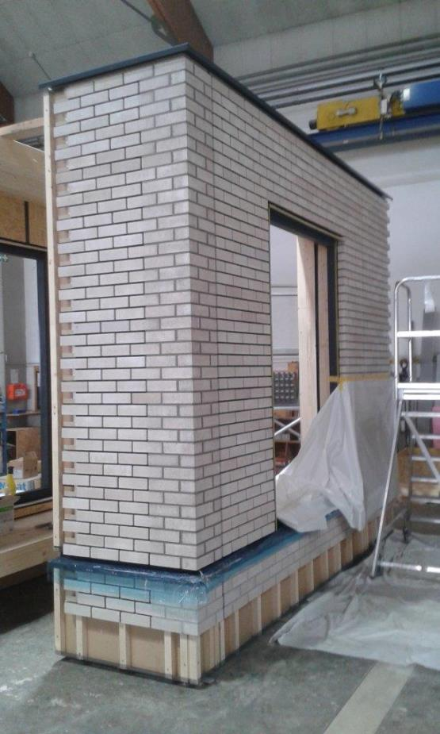
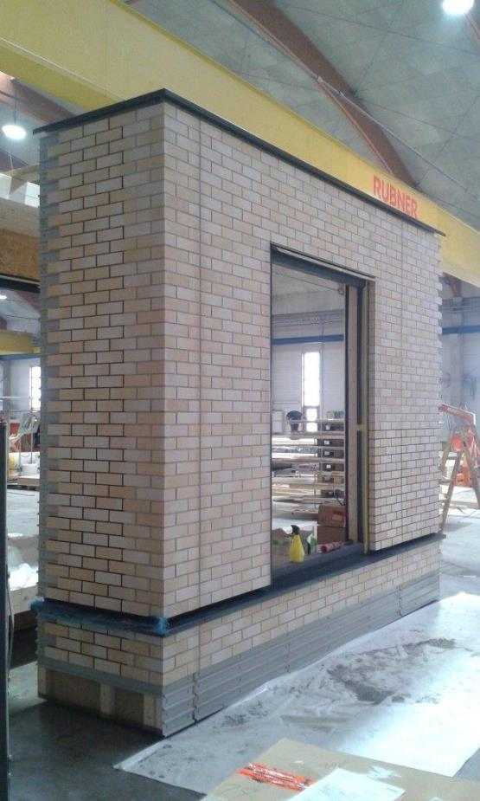
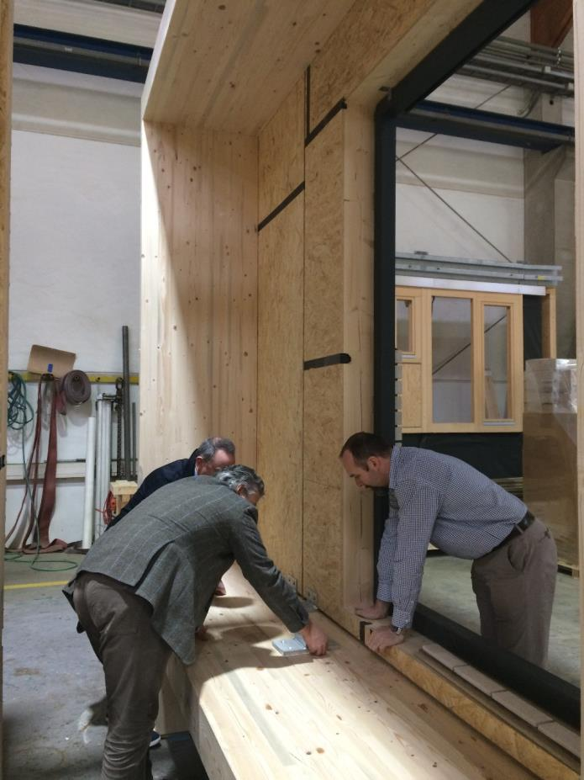
Innovation…..looking ahead

Slide 18
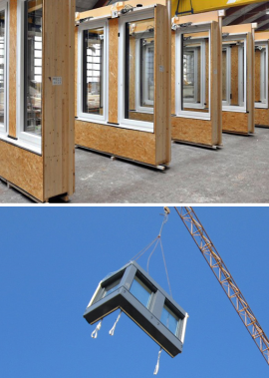
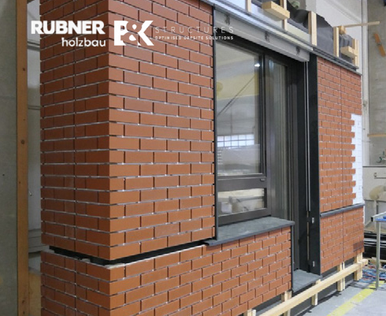
Innovation…..looking ahead

Slide 19
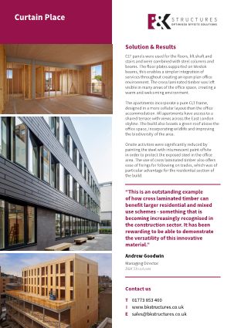
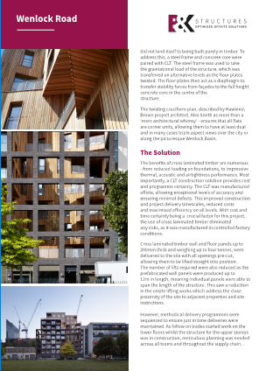
Residential schemes…..

Slide 20
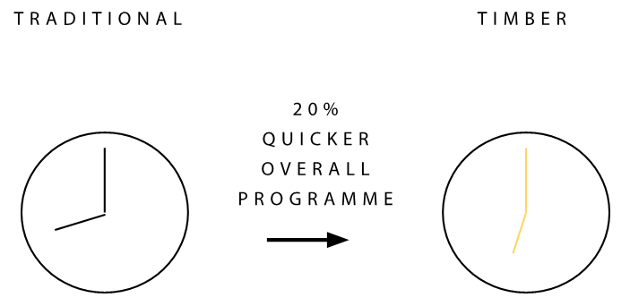
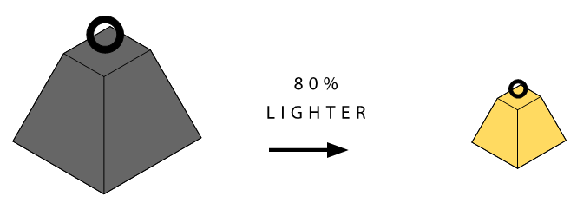
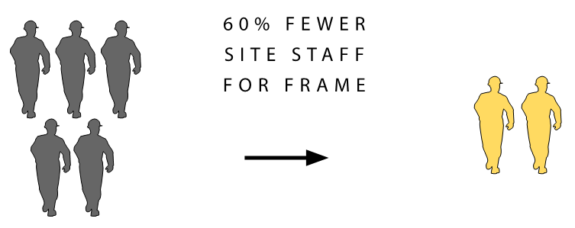
in summary…….

Slide 21
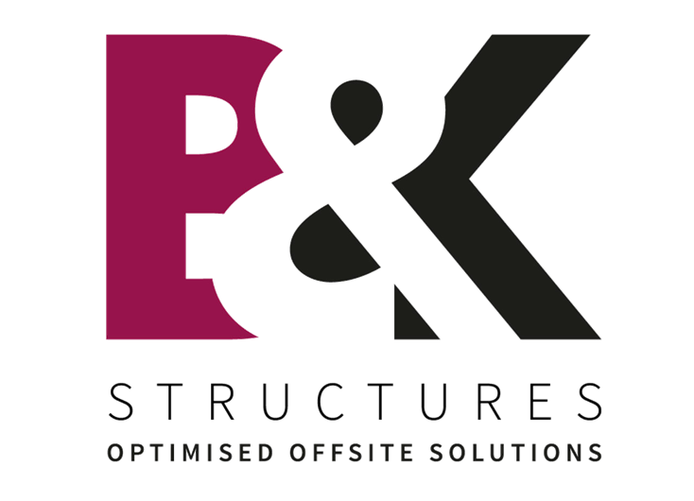
Thank You
for listening

