Slide 1
residential hub
Enabling Housing Delivery
How pre-manufactured homes are being used to increase housing supply

Slide 2
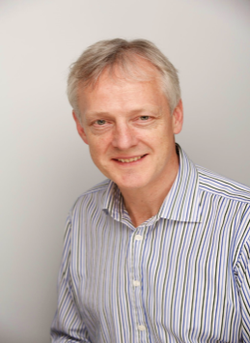
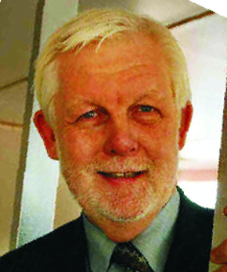
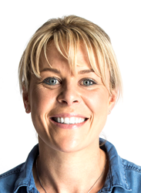
Dennis Seal
Tim Hall
Keith Blanshard
Lisa Norton
Anna Whiting

Slide 3
NEW MEMBERS
BRE
NPS Norwich
PROTRADE
Scottish Water
Connect2 Cleanrooms
Meinhardt
Berkeley Modular
BIM Object
Flagship Group
Ilke Homes
Walltec

Slide 4
Today’s Agenda
14:00 Registration
14:15 Welcome
14:25 Buildoffsite Residential Hub
14:45 Speakers
Brian Ham, Home Group
Wayne Yeomans, B&K Structures
Brendan Geraghty, GT Architects
Michael O’Doherty, One Public Estate
15:45 Afternoon Tea & Networking
16:30 Panel Debate
Collaboration
17:00 Open Discussion
17:45 Other Business
Update, Feedback, Interests, Future Plans, Constitution, Sub-Group, Strategy, Future Events, Participation, Membership, Other business
18:00 Optional Drinks & Networking

