Slide 1
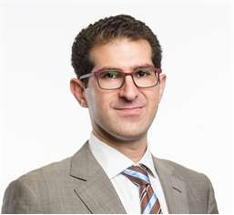
Michael joined Quintain in 2015 and was responsible for launching Quintain's residential rental platform, Tipi, in 2016. He now heads up our strategy for future expansion and is responsible for ensuring Tipi is at the forefront of Build to Rent (BtR) innovation, technology and design. He has over 10 years of BtR experience in the US having previously managed 4,000+ units for TIAA-CREF and 2,000+ units in New York City for institutional investors. Both portfolios gave Michael exposure to all aspects of investment and asset management, new build/ refurbishment and operational management. Michael holds a Master of City Planning degree from MIT.

