Slide 1
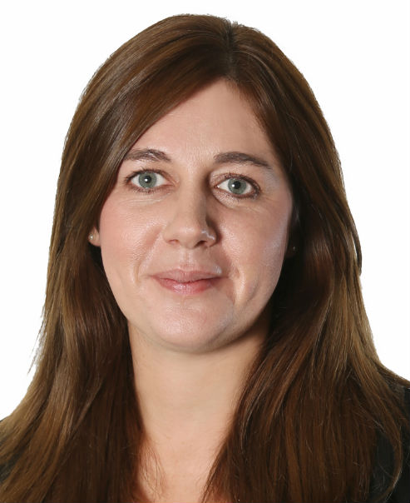
Michelle leads the strategic advisory and research service line at Cast which is focused on providing Clients with solutions to creating new delivery platforms or business opportunities to expand or grow sector involvement. Michelle has worked in the Residential Sector for 13 years and currently leads on both our internal and external research commissions which are mostly focused around offsite construction and the delivering of housing in the UK.
Michelle started her career working for Tribal Group as a Residential Consultant supporting Housing Associations & Local Authorities with Strategic Needs Assessment and Business & Financial Planning for housing in London, and the regions. Michelle previously spent 5 years with EC Harris (latterly Arcadis). Michelle joined EC Harris as a financial analyst within the Residential business, and most recently headed up the Financial Modelling Team that was focussed on providing Clients with residential development consultancy advice and support in relation to site acquisition, masterplanning, planning viability and the raising of equity & debt financing.
Michelle’s focussed specialism has been the Build to Rent sector where she has worked with developers in creating their business plan to demonstrate to private equity investors the deliverability and operation of the brand. This has involved supporting developers with creating a robust development and investment financial appraisal that demonstrates not only the viability of delivering the development but also the viability of operating it. In supporting with the operational model Michelle is involved in the early stages of brand thinking to ensure the operational expenditure correctly represents the service being proposed for customers and there is a clear link back to the capital expenditure proposed in terms of understanding a building whole life costs. Michelle authored the Cast publication ‘The Rental Space Race: Commercial Impact of Amenity in Build to Rent’.

