Slide 1
Data Templates
For
Information Exchange
December 2017

Slide 2
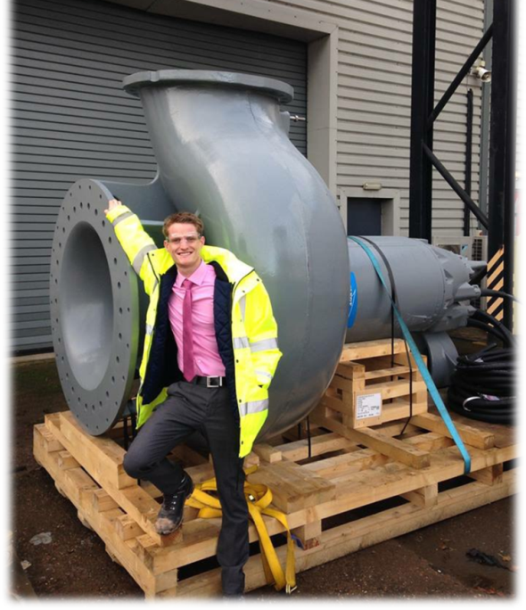
Intros
Jamie Mills
Mere mortal mechanical engineer
Systems Engineering Department Xylem Flygt
BIM4Water Steering Group
Chair BIM4Water Standard Libraries
PAS1192 Part 7 Steering Group
jamie.mills@xyleminc.com
Ask me about: | Don’t ask me about
Engineering | Relationship Advice

Slide 3
Safety Moment

Slide 4
BIM4Water
Standard Libraries
Data Templates
Classification
Development Procedure for Water Industry PDTS
PAS1192 Part 7 / CEN442
Challenges

Slide 5
UK Utilities Market

Slide 6
BIM4Water
Better Information Management
Cost reduction and reduced wastage on Capital Delivery, Maintenance and Operation
Improved TOTEX efficiencies, investment planning and delivery
Being a part of the wider Digital Build Britain
Reference BIM Guidance for the Water Industry Owner Operator
http://www.britishwater.co.uk/bim.aspx

Slide 7
BIM4Water Standard Libraries
28 members
10 WASCs
Define and implement a standard practice for creating water industry product data templates; align these to European and International Standards

Slide 8
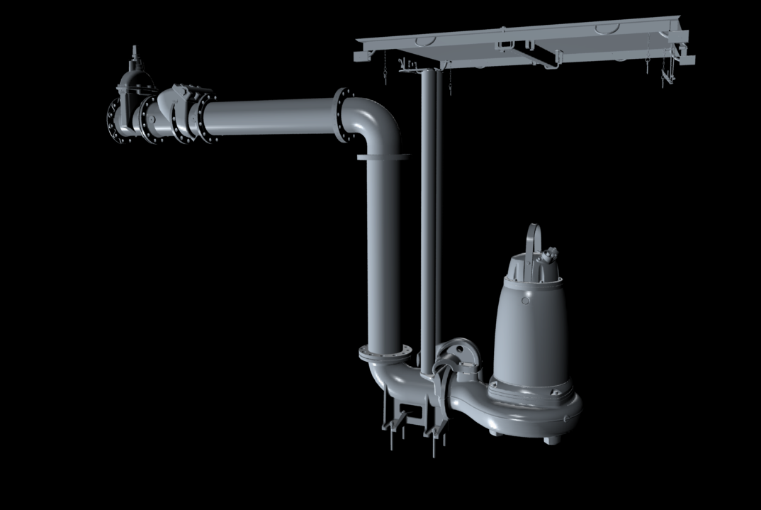
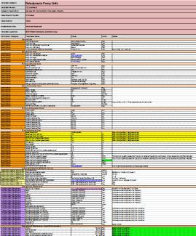
Information Model
Notes:
The collection of this information results in a model.
This comprises of Product data and graphical information

Slide 9
Data Templates / Data Sheets
Installation
Operation
Service Repair Maintenance
Decommissioning
Specification
PDT

Slide 10
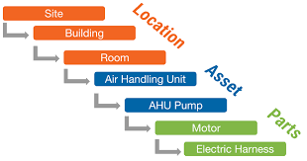
Classification
Uniclass 2015

Slide 11
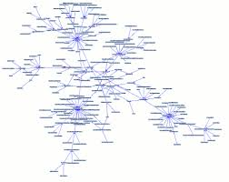
Naming Convention
ISO 15926
Notes:
88 companies sponsor BIM4Water

Slide 12
Development
Notes:
88 companies sponsor BIM4Water

Slide 13
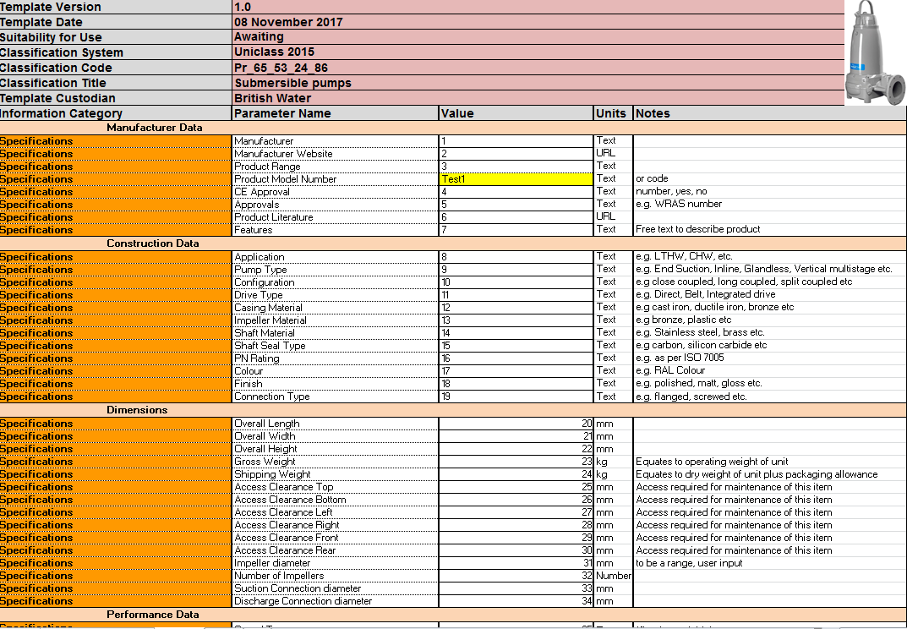
Temporary Format

Slide 14
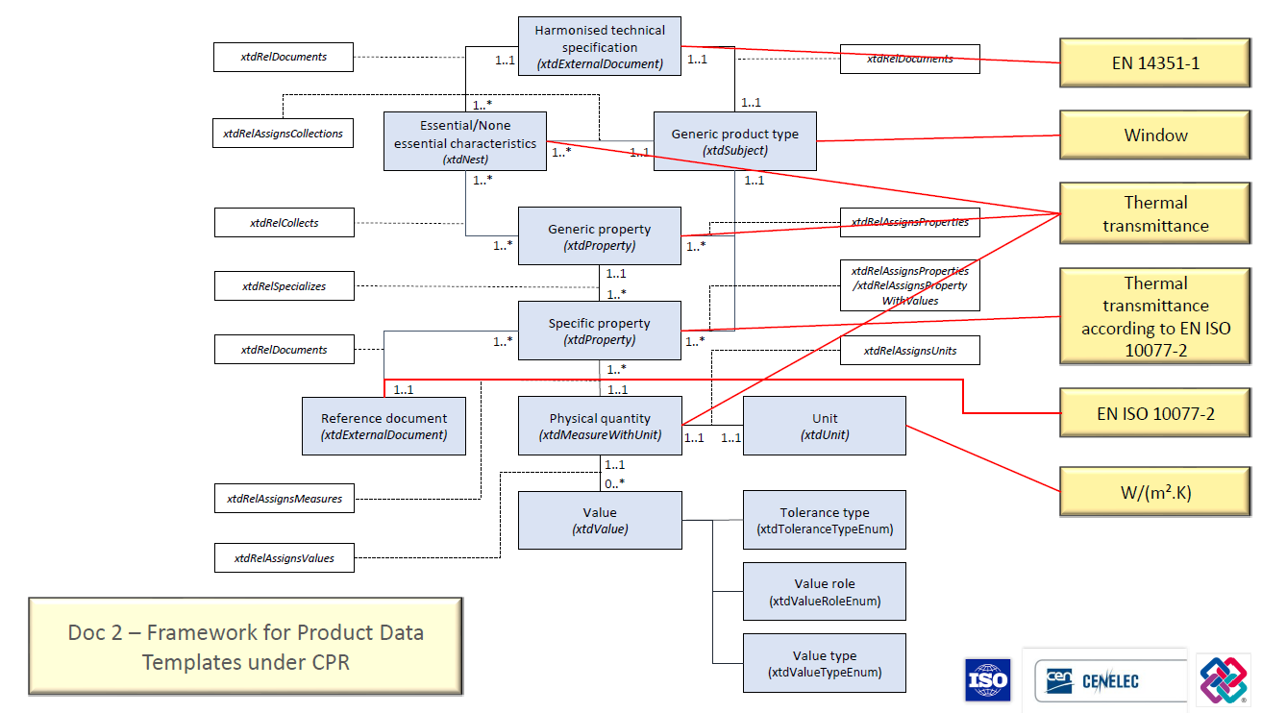
PAS1192/7 and CEN442
November 2018
IFC XML
GUID

Slide 15
Challenges
Mapping
Data Transfer
Cultural change
Consensus
Manufacturers
Governance
Change

