Slide 1
Laing O’Rourke, 30 October 2018
Rotherham Metropolitan Borough Council’s Journey into the Unknown (aka MMC)
Wendy Foster, Strategic Housing Coordinator

Slide 2
Krynkl

Slide 3
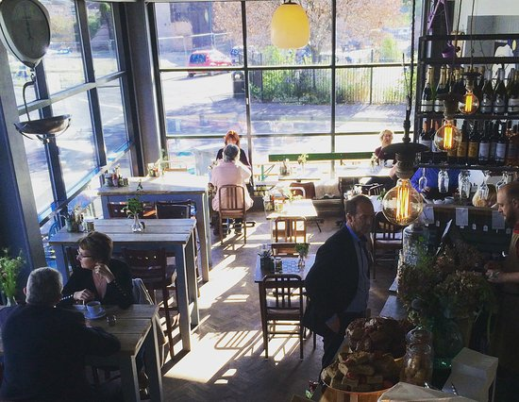
Krynkl

Slide 4
Cross-party Scrutiny Review
The scope for the review is to look into the viability of providing low cost (affordable) housing for young single individuals and young families in one and two bedroom modular accommodation and wherever possible, incorporating suitable technology to reduce running costs along with the ability to move the buildings where they are most needed.

Slide 5
Build Off Site
Newcastle University, April 2018
Enabling Housing Delivery
How pre-manufactured homes are being used to increase housing supply.

Slide 6
Build-Off Site

Slide 7
Meet the Buyer Event

Slide 8
Specs/Procurement

Slide 9
Currently ...
Bids closed end September
Procurement checks done
--------------------------------------------------------
Individual evaluations – Financial/Quality
Moderation
Selection and feedback
Discussions and award contracts
Start on site

Slide 10
Watch this space ...
Wendy-regen.foster@Rotherham.gov.uk

Slide 11
A message from my competitors
Save the date
What: “Building Homes in Hull,” an opportunity for local builders and people working in construction trades to hear about forthcoming opportunities to do business with Hull City Council and meet some of the current contractors and business support organisations.
When: Tuesday 27 November, 4 – 8pm
Where: Hilton Doubletree, Ferensway, Hull HU2 8NH
How to register: https://www.eventbrite.co.uk/e/building-homes-in-hull-tickets-51190656632
Building Homes in Hull
A good relationship between Hull City Council, local builders and building industry suppliers is vital to building better homes in Hull. To help achieve this, the Council is organising an event for small businesses and sole traders in the construction industry, which takes place on Tuesday 27 November from 4 – 8pm at the Double Tree Hilton on Ferensway in Hull.

