Slide 1


Buildoffsite Rail Hub
Step Free Access Programme
06 November 2017
Part Two

Slide 2

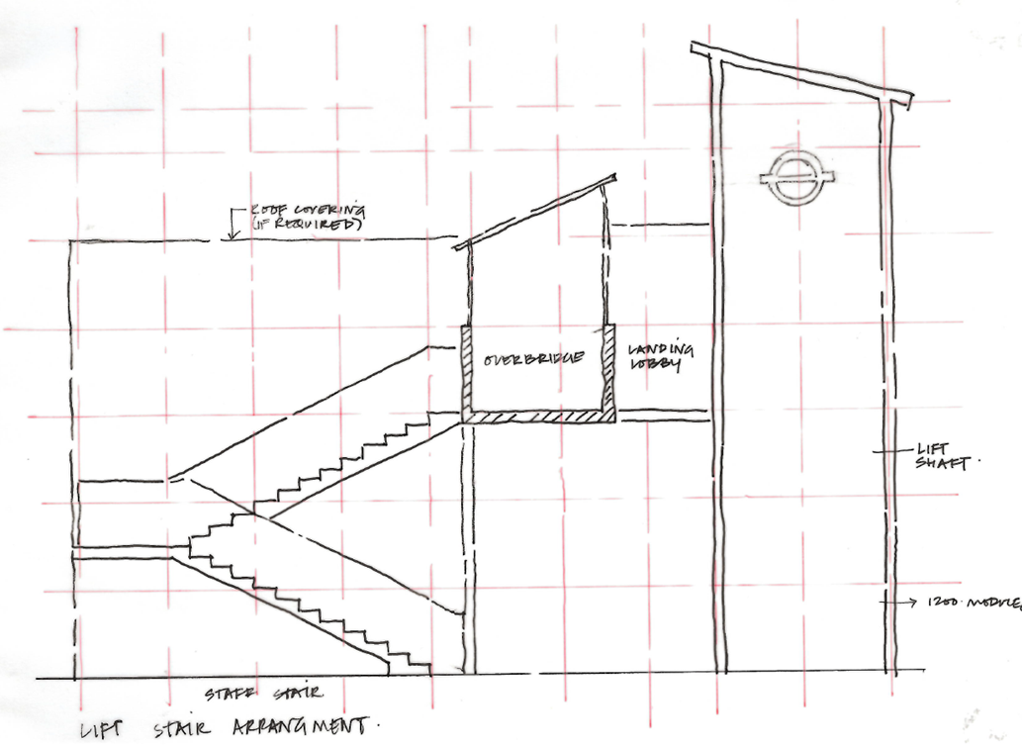
Step Free Access
Standardised Modular Approach
HOLDING PIC – WAITING FOR KEVIN S TO PROVIDE PAN TFL

Slide 3
Step Free Access – (SFA)
Problem Definition
There is a need to deliver a significant number of SFA type structures in overground stations. It is intended to employ modularisation of the SFA structure to achieve reduced unit cost with following benefits and characteristics:
  Modular offsite fabricated Lego like parts that are interchangeable
  Product of high quality by introducing repeatability
  Lower unit costs by introducing competition in the manufacture of the Lego blocks.
  Reduced on site construction time
  Reduced maintenance costs over the life of the asset

Slide 4
Step Free Access – (SFA) Lego Blocks
The basic Lego blocks are formed of functional components with all finishes included as follows:
  Foundations
  Support Legs
  Lift tower
  Main bridge unit over track
  Gap filler bridge unit
  Stairs bridge unit (if required)

Slide 5

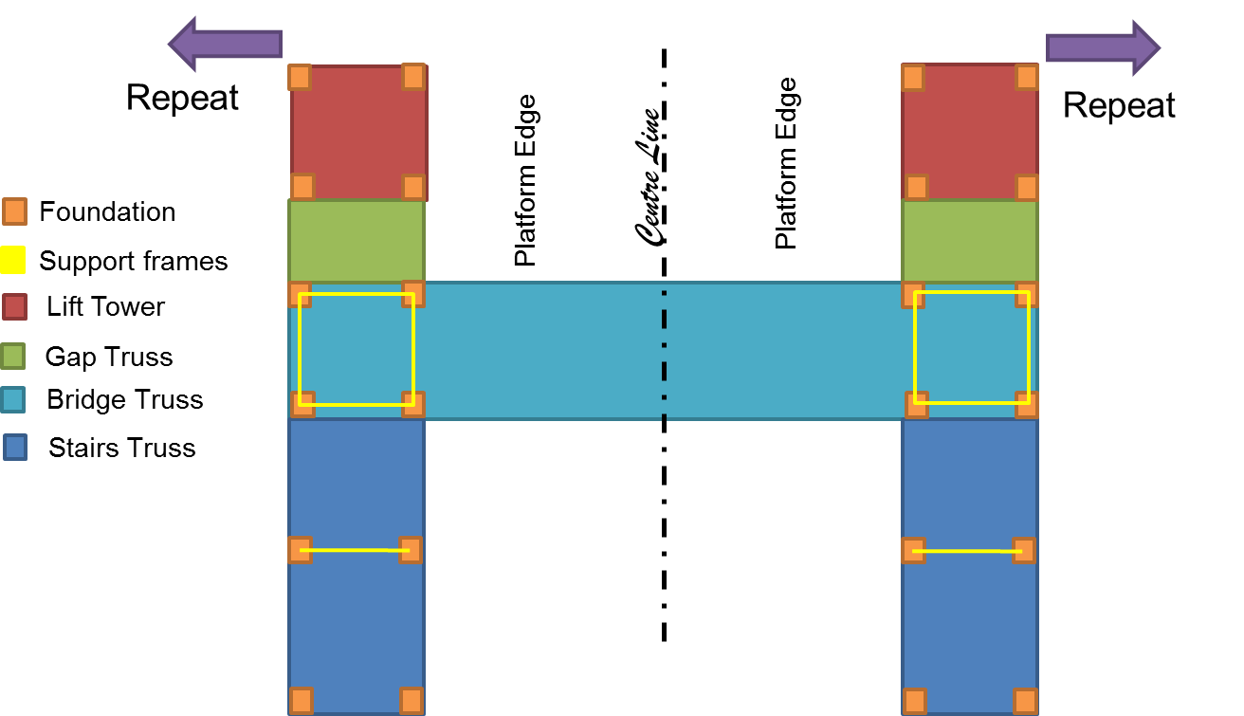
HOLDING PIC – WAITING FOR KEVIN S TO PROVIDE PAN TFL

Slide 6
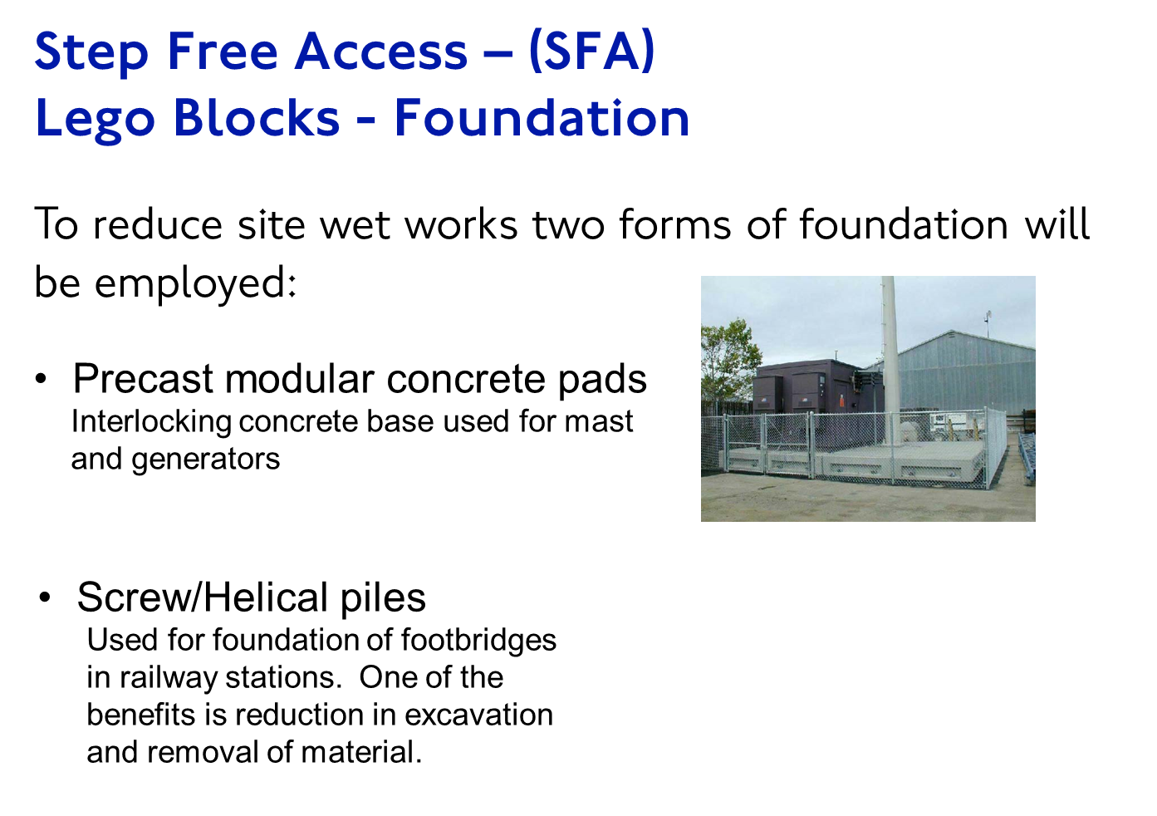
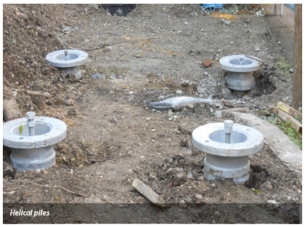
HOLDING PIC – WAITING FOR KEVIN S TO PROVIDE PAN TFL

Slide 7
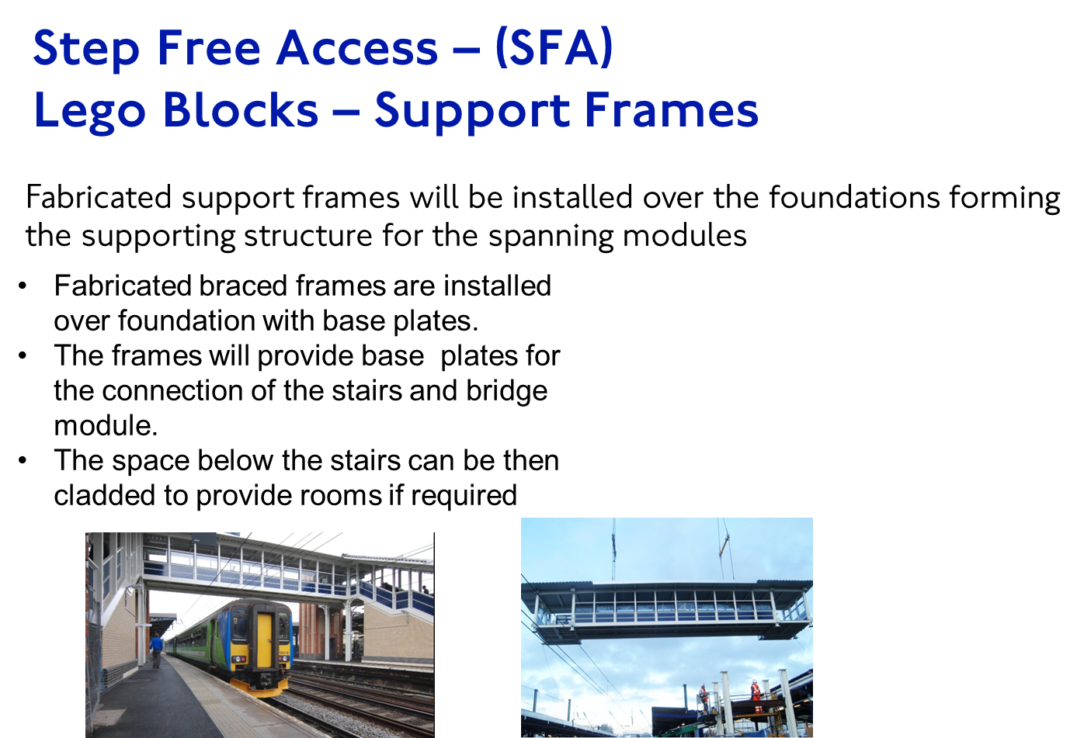
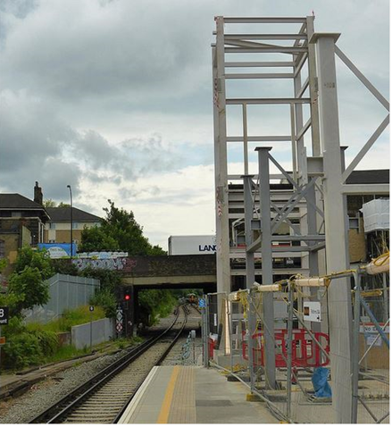
HOLDING PIC – WAITING FOR KEVIN S TO PROVIDE PAN TFL

Slide 8
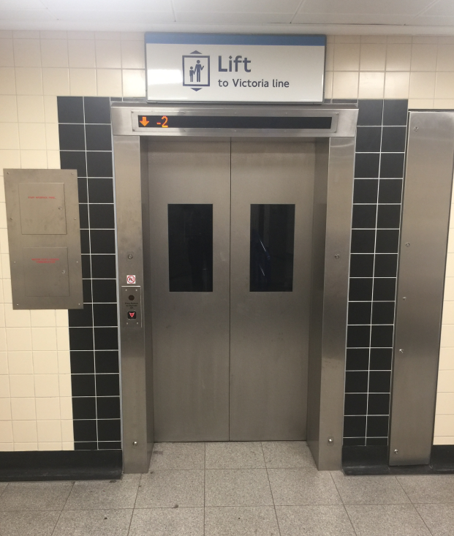
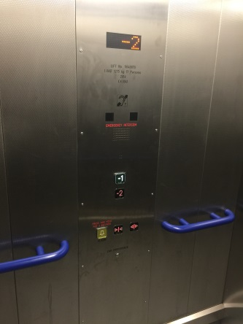
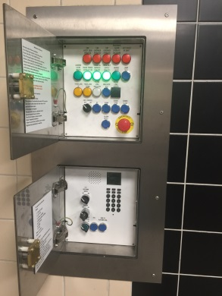

SFA Lift Specification Development
The Value engineering challenge:
Build upon success of the cost saving secured in the Pan TfL lift procurement contract – but enable further cost reductions at outlying stations, without compromising reliability or performance
The approach adopted:
Engage with lift and component suppliers
Review specifications of other lift users
  Network Rail, BAA, DLR & Overground
Visit step free installations outside of LU
  Gatwick Airport, Heathrow T5, Berlin, Paris
Appropriately challenge LU CONOPS
Target cost less than £150K
HOLDING PIC – WAITING FOR KEVIN S TO PROVIDE PAN TFL

Slide 9
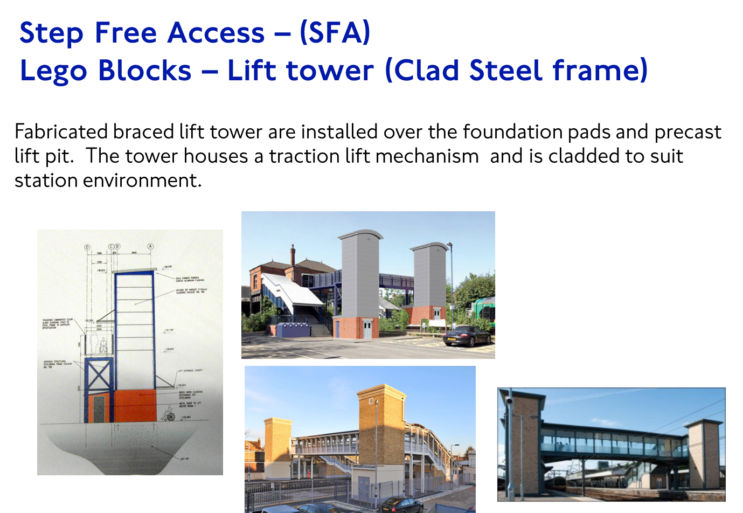
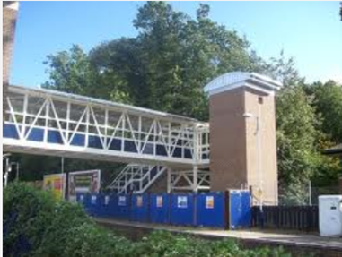
HOLDING PIC – WAITING FOR KEVIN S TO PROVIDE PAN TFL

Slide 10
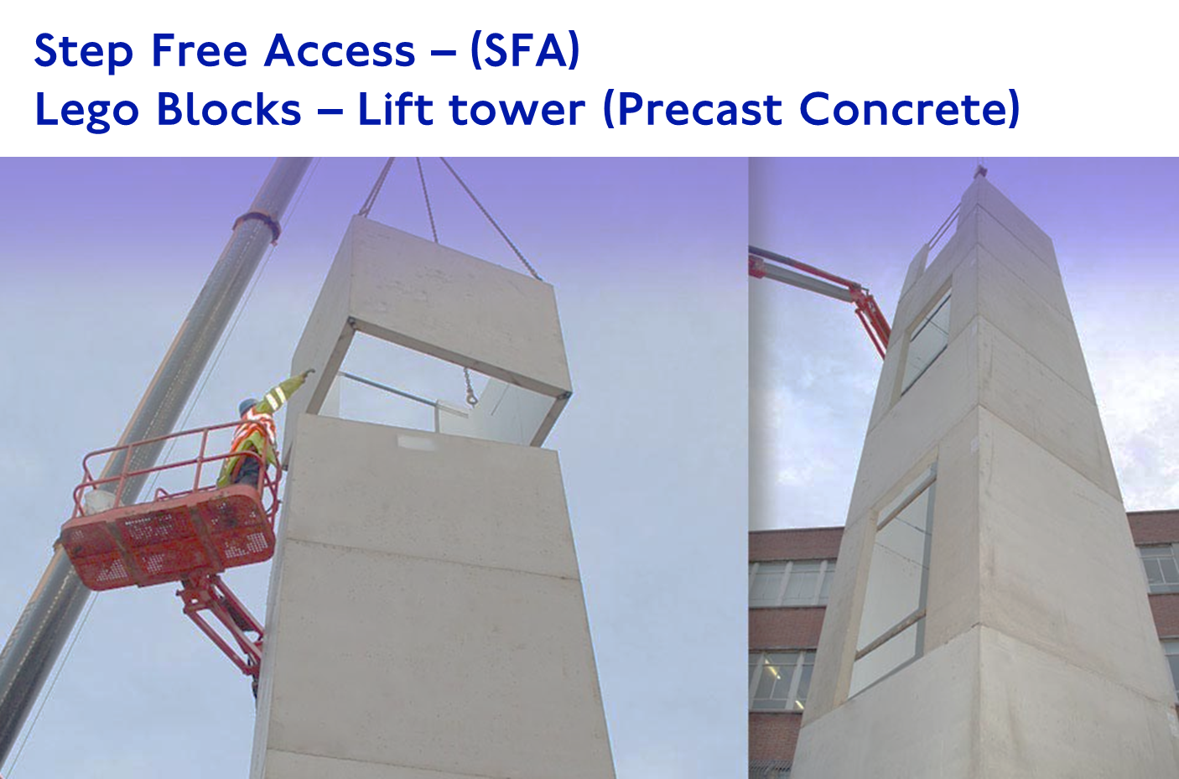

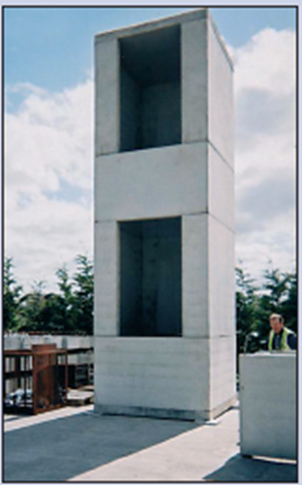
HOLDING PIC – WAITING FOR KEVIN S TO PROVIDE PAN TFL

Slide 11
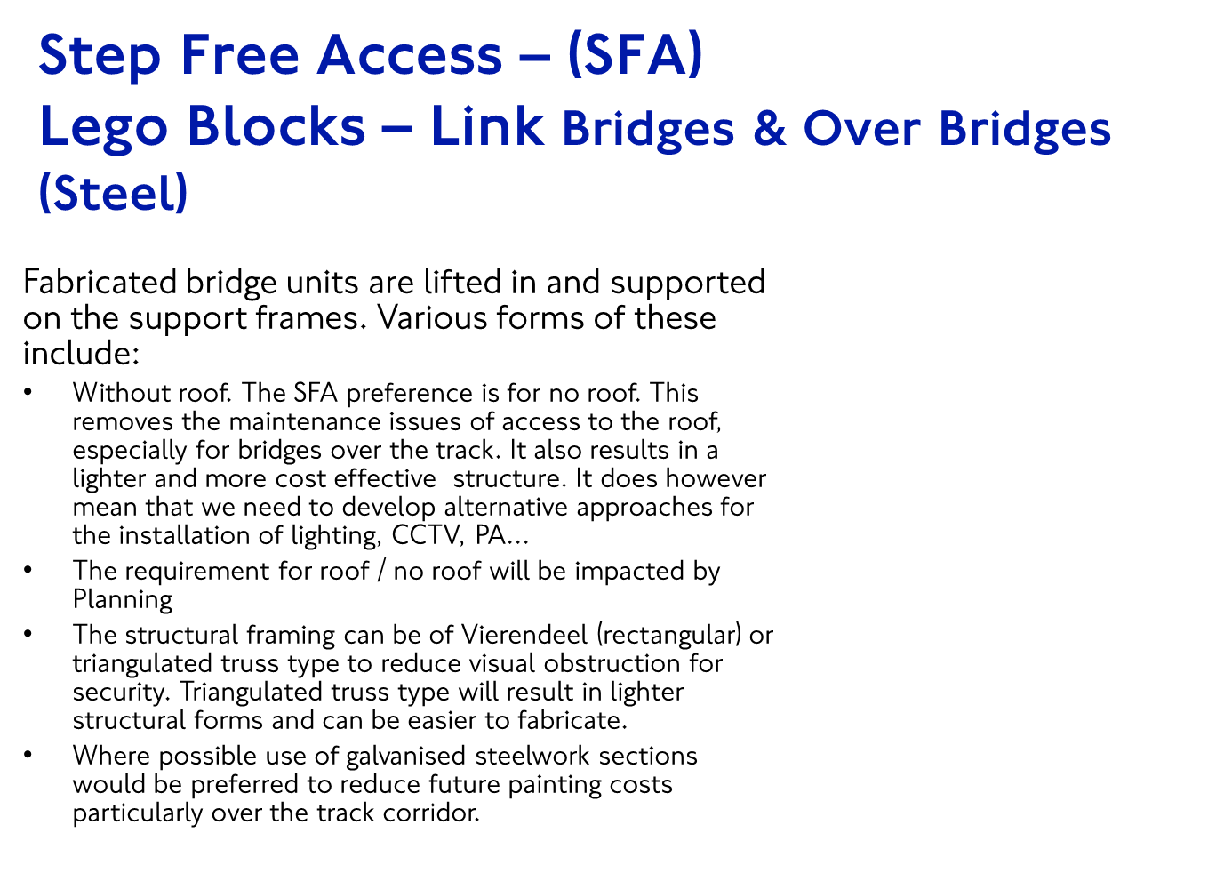
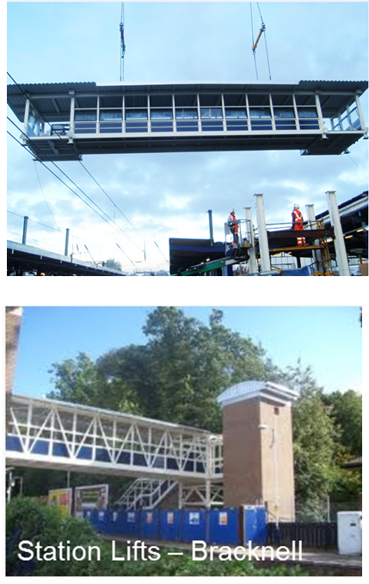
HOLDING PIC – WAITING FOR KEVIN S TO PROVIDE PAN TFL

Slide 12
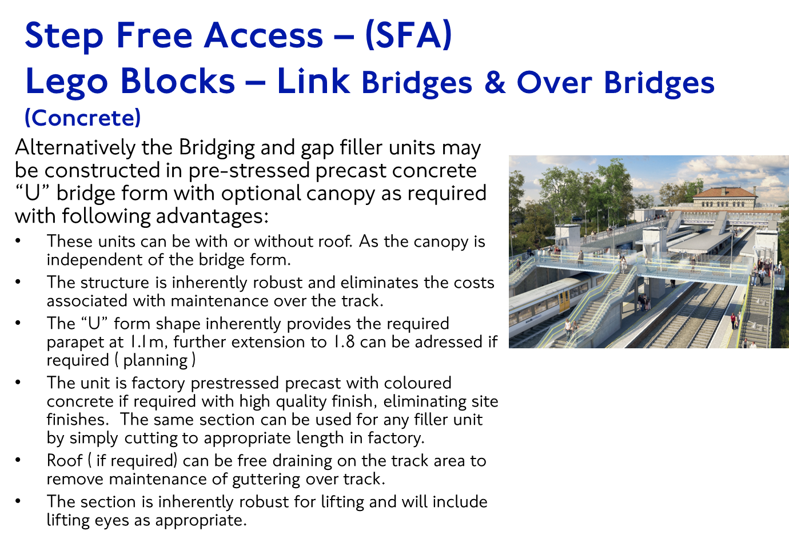
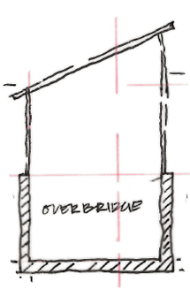
HOLDING PIC – WAITING FOR KEVIN S TO PROVIDE PAN TFL

Slide 13
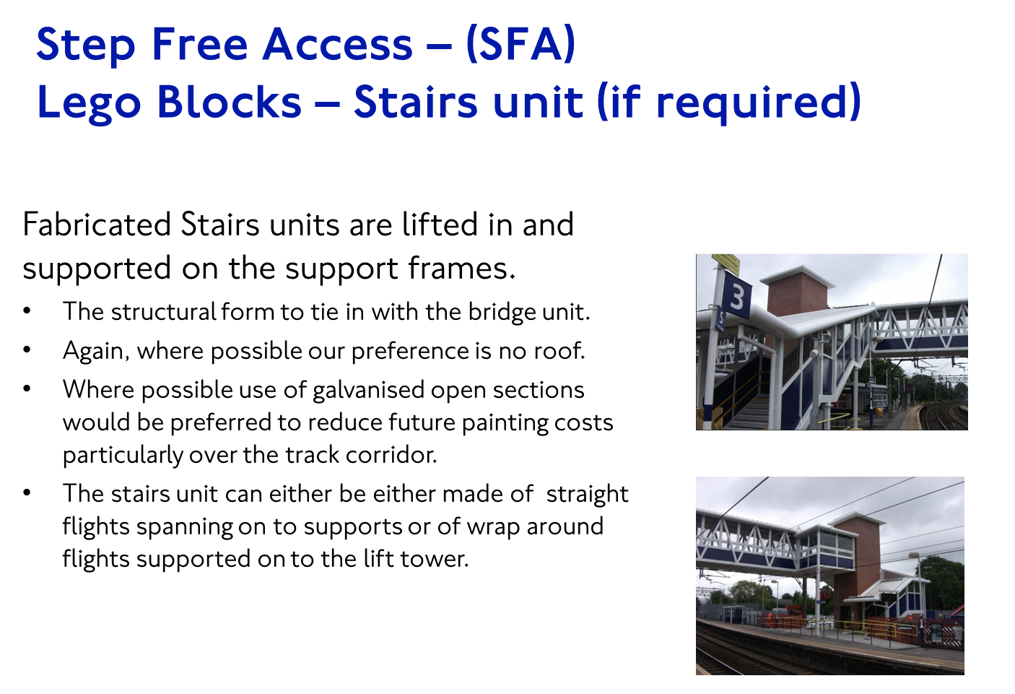
HOLDING PIC – WAITING FOR KEVIN S TO PROVIDE PAN TFL

Slide 14
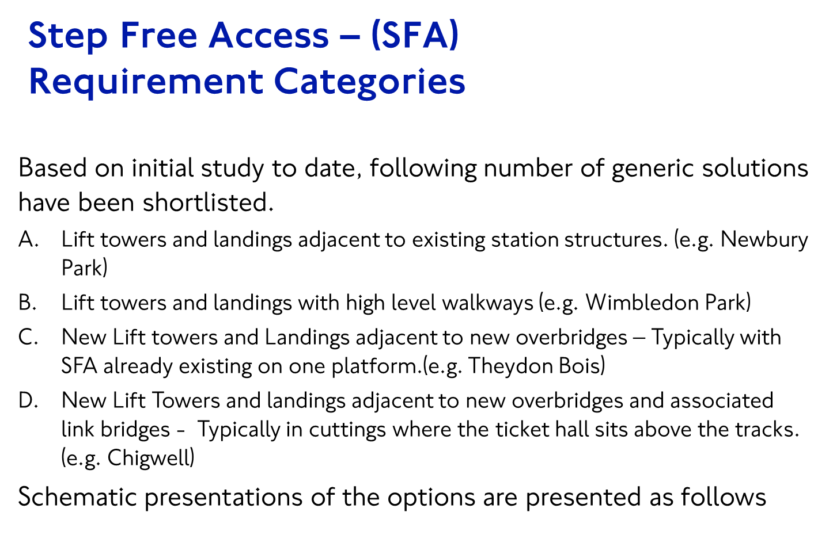
HOLDING PIC – WAITING FOR KEVIN S TO PROVIDE PAN TFL

Slide 15
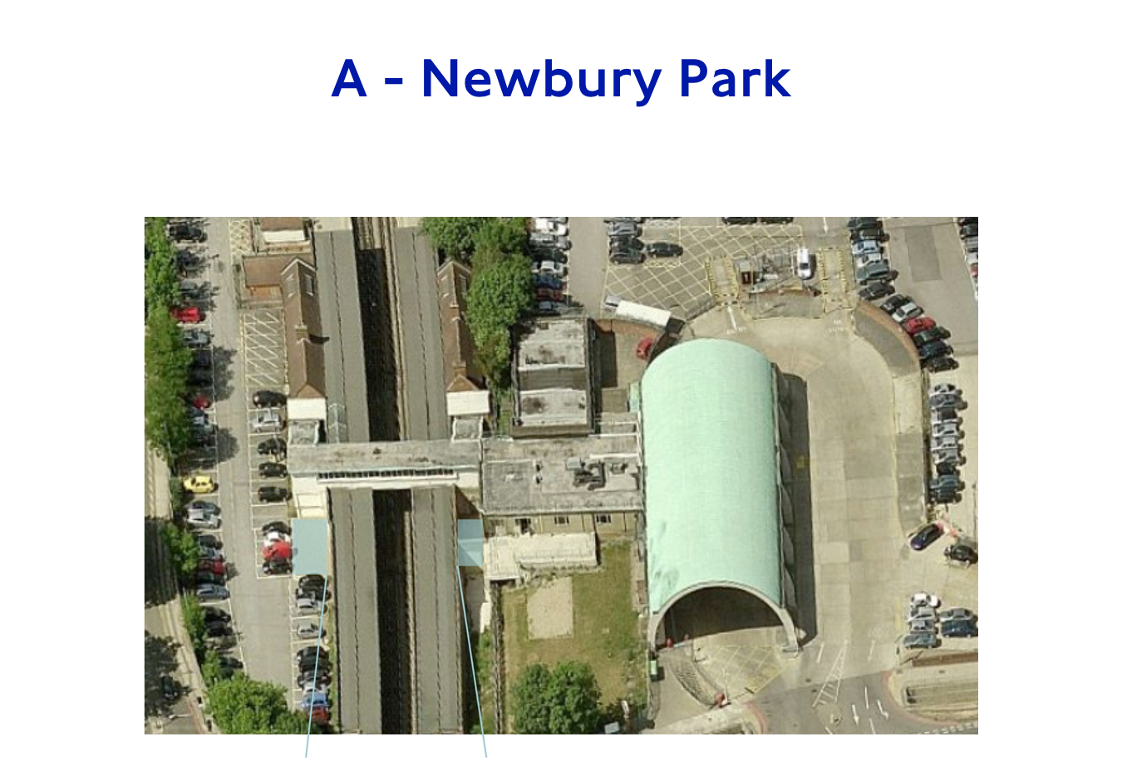
HOLDING PIC – WAITING FOR KEVIN S TO PROVIDE PAN TFL

Slide 16
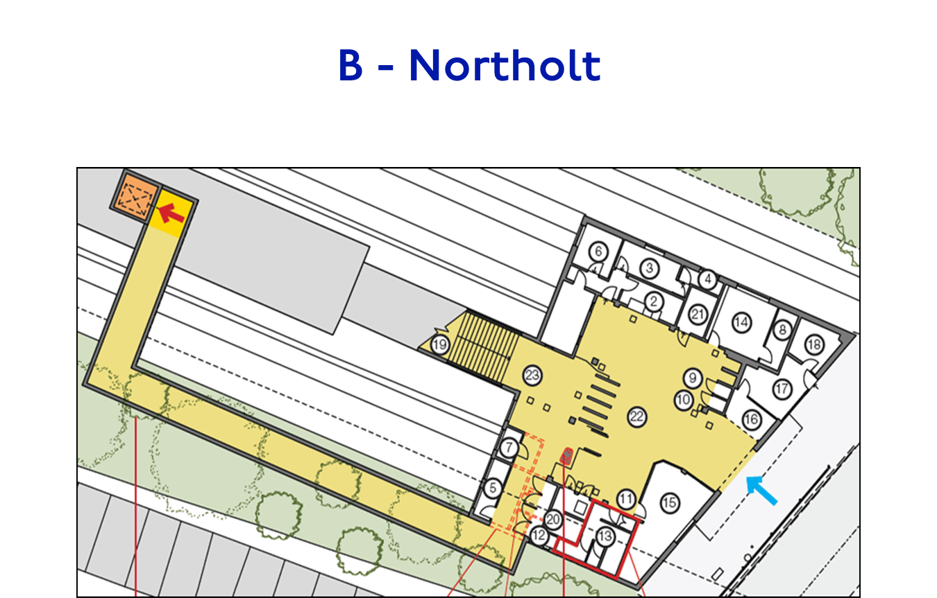
HOLDING PIC – WAITING FOR KEVIN S TO PROVIDE PAN TFL

Slide 17
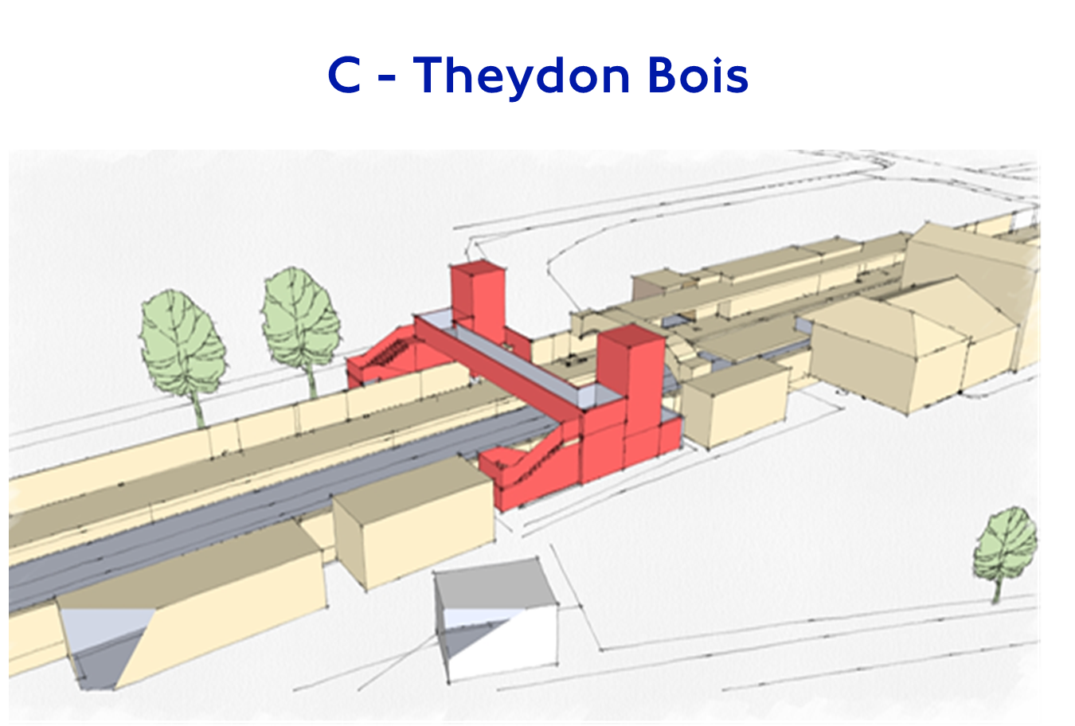
HOLDING PIC – WAITING FOR KEVIN S TO PROVIDE PAN TFL

Slide 18
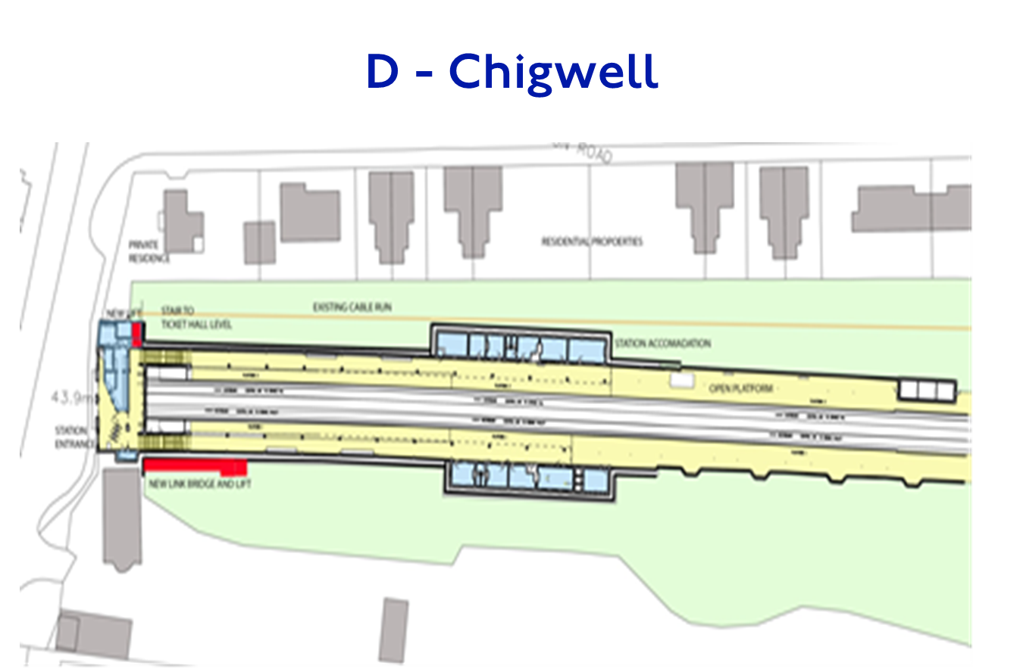
HOLDING PIC – WAITING FOR KEVIN S TO PROVIDE PAN TFL

Slide 19
SFA Design Management Approach
Early identification of requirements; driven by standards, operational & maintenance concepts
      challenge and regularise early to avoid abortive design costs
      Forums
Risk based assurance
      Betterment vs Compliance; clear Policy on regularising existing non-compliances
      Differentiation of requirements - eg Fire Strategies
Commitment to milestone delivery
      weekly visualisation sessions to escalate critical issues
Robust design reviews with focus on 'over-design’
      Central design co-ordination & reviews across Delivery Partners to ensure cross transfer of best practice
Collaborative working with commercial
      active management of issues, interfaces & assumptions
      risk & estimating processes to support option selection/value engineering

Slide 20
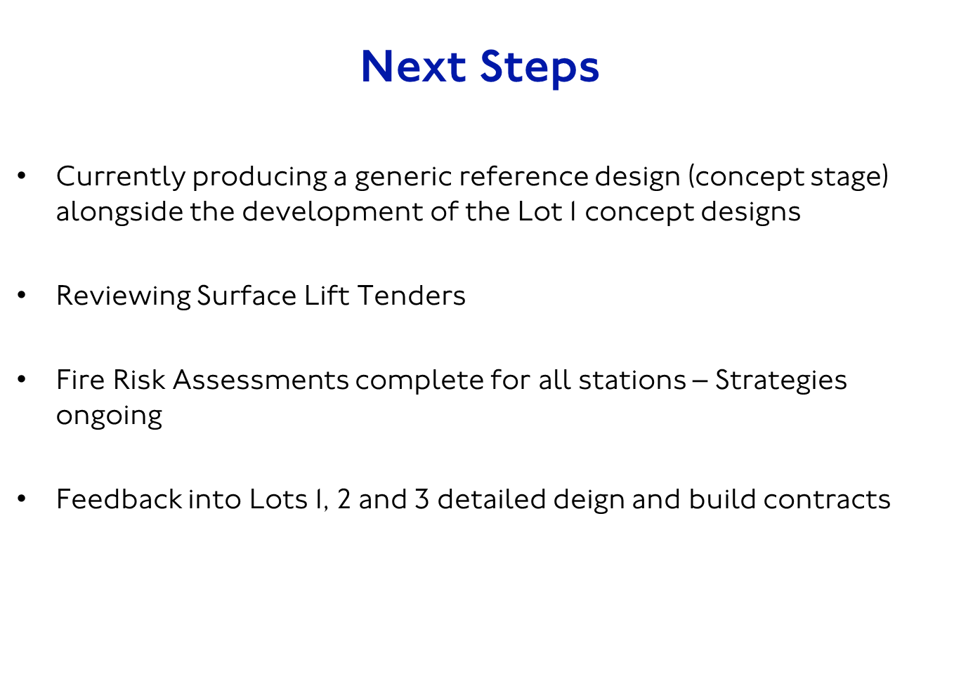
HOLDING PIC – WAITING FOR KEVIN S TO PROVIDE PAN TFL

Slide 21

21
London Underground Products Register

Slide 22
Access to the LU Products Register is by using this link:
http://www.lu-apr.co.uk/Pages/Logon.aspx
and applying for a user name and password by clicking on the ‘Request a log on’ box

Slide 23
Anyone with a legitimate reason for wishing to access the Products Register can obtain
view-only access

Slide 24
The manufacturer can apply for proposer rights but in order to make a product proposal he must have an LU sponsor who is able to confirm a business need for the given product and who is willing to ‘pull’ the product through the acceptance process

Slide 25
The manufacturer can find a sponsor by having his product specified on an LU Project and ask the LU project discipline-specific engineer if (s)he will be his product sponsor

Slide 26
The product must have a Uniclass2015 product level code.
The code will need to contain four sets of double digits Pr_xx_xx_xx_xx

Slide 27
Uniclass2015 product level codes can be ascertained here:
https://toolkit.thenbs.com/articles/classification#latestupdates

Slide 28
Once the manufacturer has a product specified for a project, has an LU project-specific sponsor and a product level Uniclass2015 code he can propose the product.

Slide 29
We are planning to update the Products Register software, but in the meantime we will need to send the manufacturer a Product Data Template (PDT) in which to transpose his product technical and safety information and create his product-specific Product Data Sheet (PDS).
(The forthcoming PAS 1192 Part 7 refers)

Slide 30
In the interim period the manufacturer can obtain this generic PDT or any other information or advice they require
from the Products Register Manager
terry.price@tube.tfl.gov.uk

Slide 31
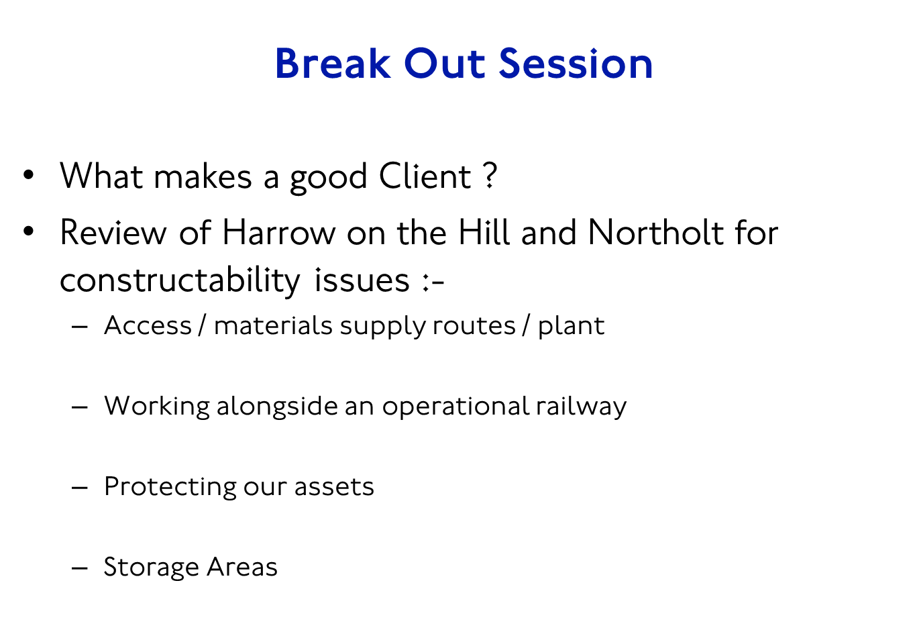
HOLDING PIC – WAITING FOR KEVIN S TO PROVIDE PAN TFL

